Slide 1
TASK
Equivalent forms
Identify all the equations which are equivalent to: $$x^{2}+3x−5=0$$
$$x^{2}+3x=5$$ | $$x^{2}+4x−5=x$$
$$x^{2}+2x−5=x$$ | $$x^{2}−5=3x$$
$$x^{2}=5+3x$$ | $$x^{2}=5−3x$$
$$x^{2}+2x+1=−x+6$$ | $$x^{2}+2x+1=x+6$$
$$x^{2}+2x+1=−x−6$$ | $$x^{2}−1=−3x+4$$
$$x^{2}−4=3x−1$$ | $$2x^{2}+6x−10=0$$

Slide 2
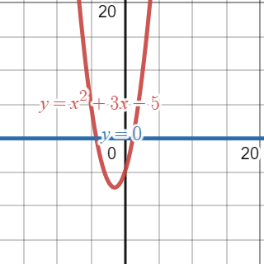
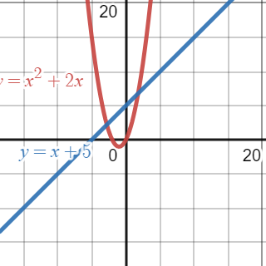
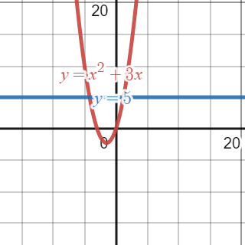
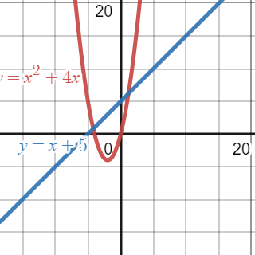
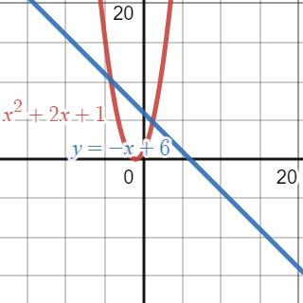
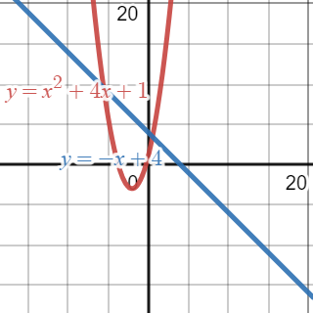
TASK
Graphical solutions
Identify all the graphs which can be used to solve $$x^{2}+3x−5=0$$

Slide 3
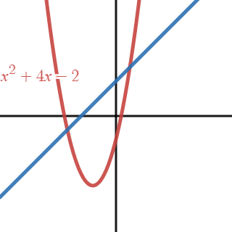
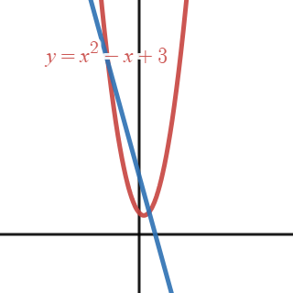
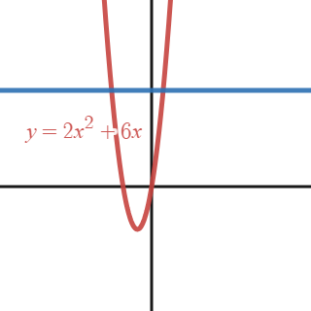
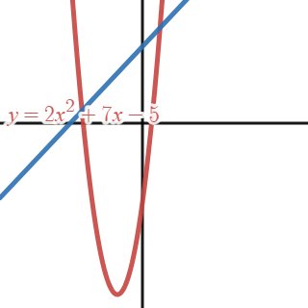
TASK
Graphical solutions
All these graphs can be used to solve $$x^{2}+3x−5=0$$ work out the equation of the straight line

Slide 4
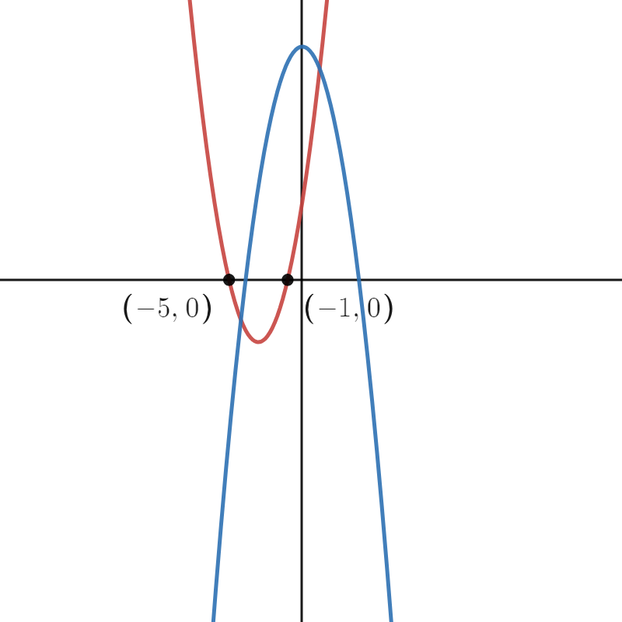
TASK
Graphical solutions
The graphs of these two quadratics can be used to solve $$x^{2}+3x−5=0$$ The red quadratic is of the form $x^{2}+bx+c$
(1) | Find $b$ and $c.$
(2) | The blue quadratic is of the form $−x^{2}+dx+e$. Find $d \text{and} \text{e}$.

Slide 5
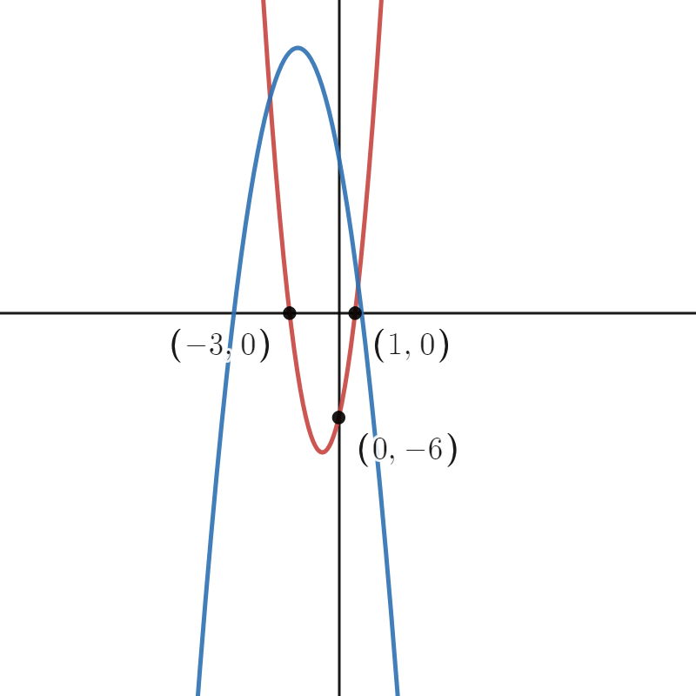
TASK
Graphical solutions
The graphs of these two quadratics can be used to solve $$x^{2}+3x−5=0$$ The red quadratic is of the form ${ax}^{2}+bx+c$
(1) | Find the equation of the red quadratic.
(2) | The blue quadratic is of the form $−x^{2}+dx+e$. Find $d \text{and} \text{e}$.

Slide 6
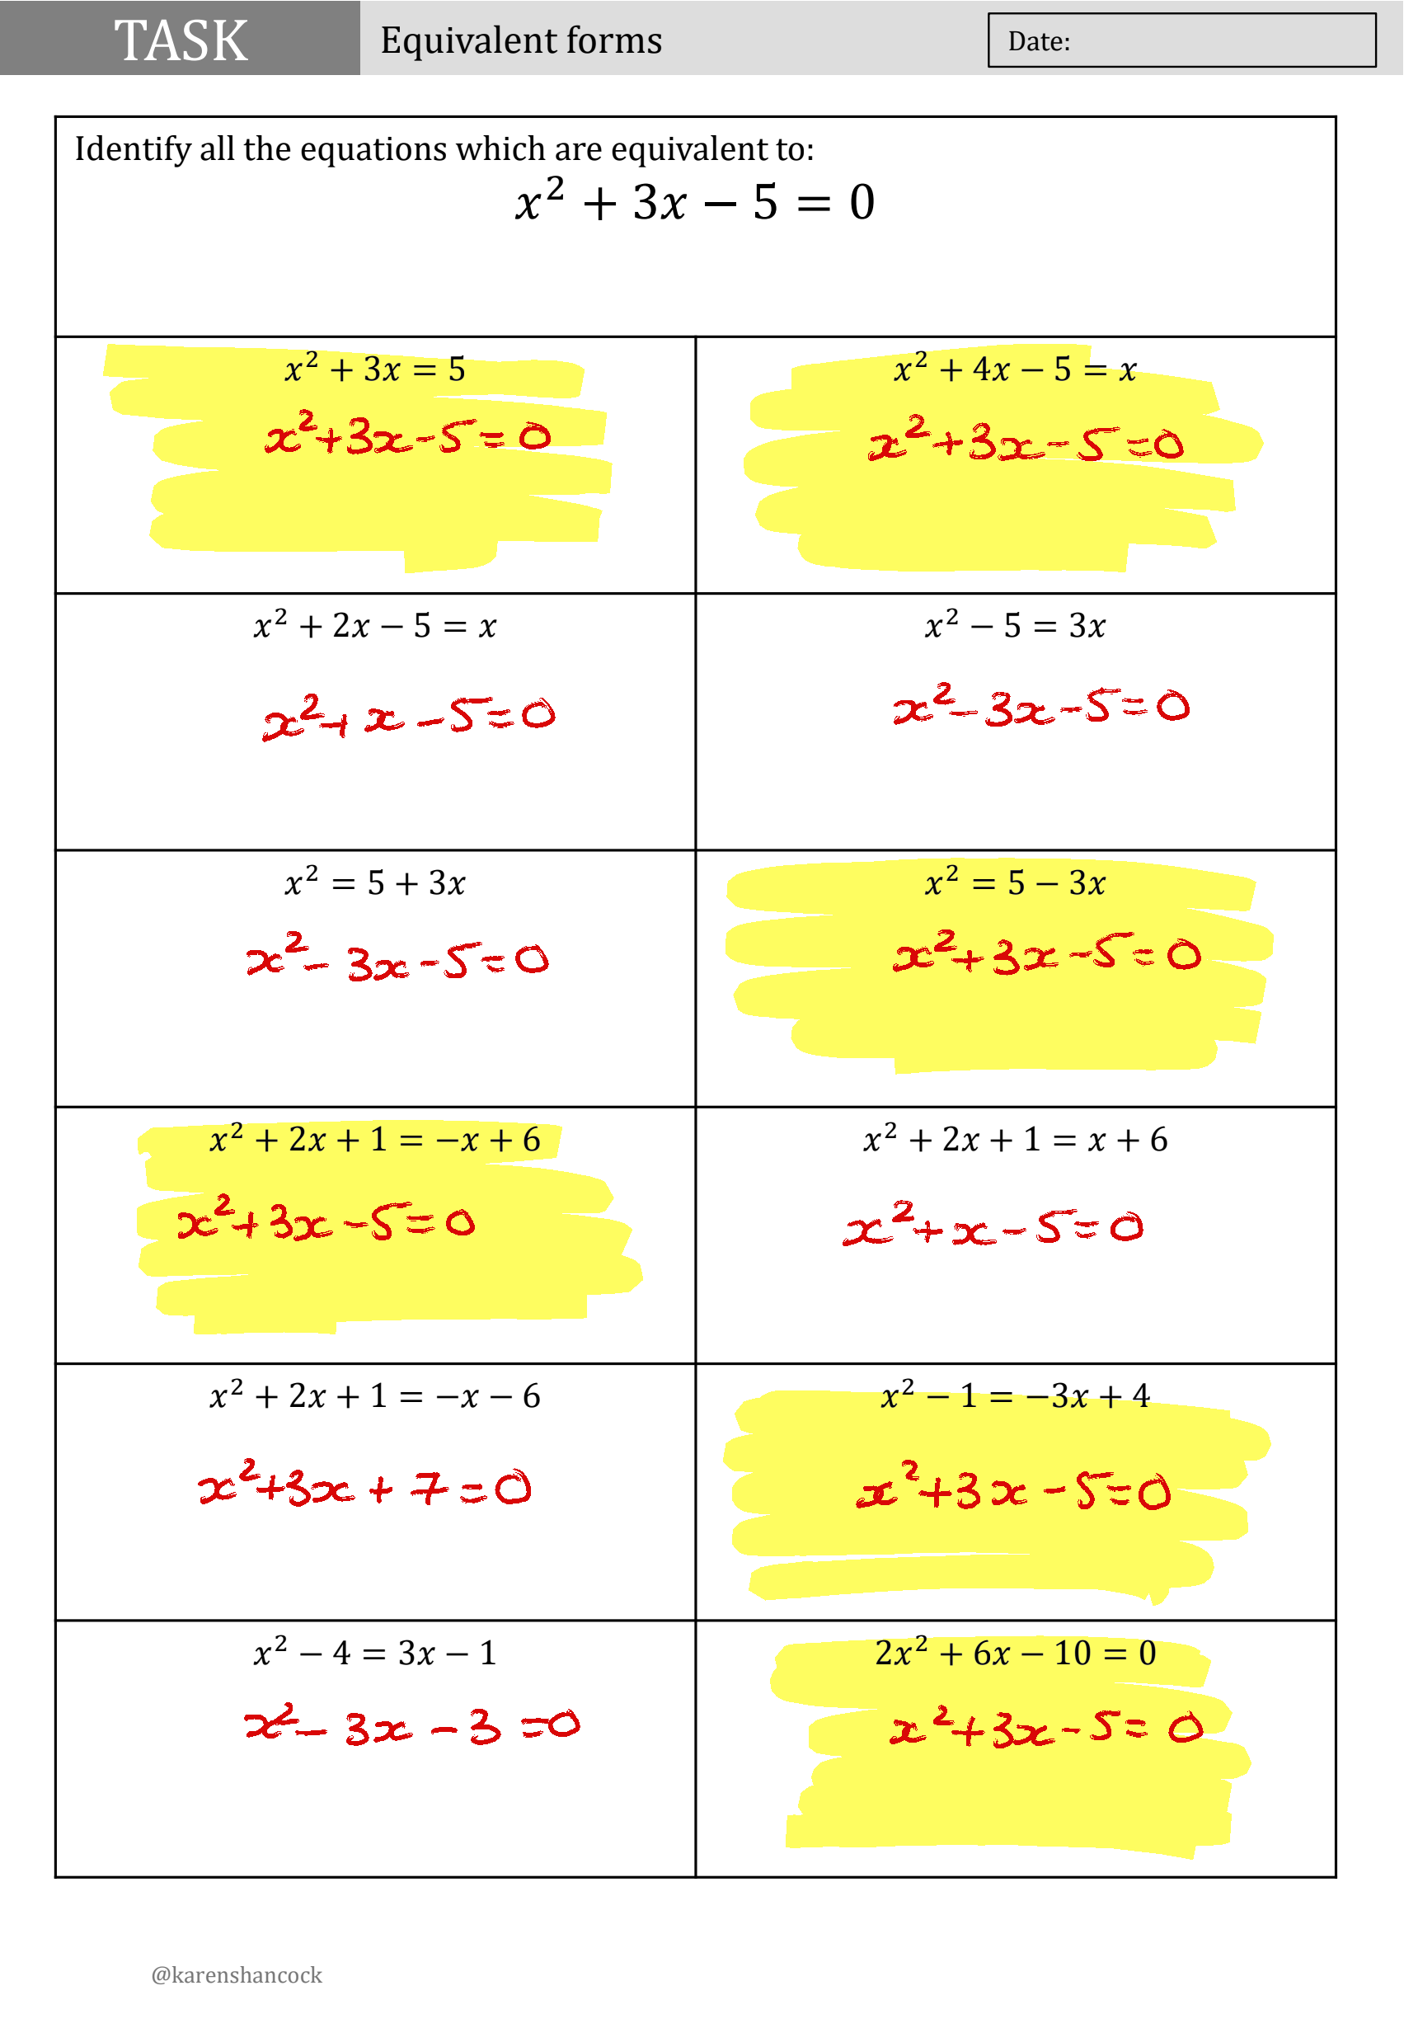

Slide 7
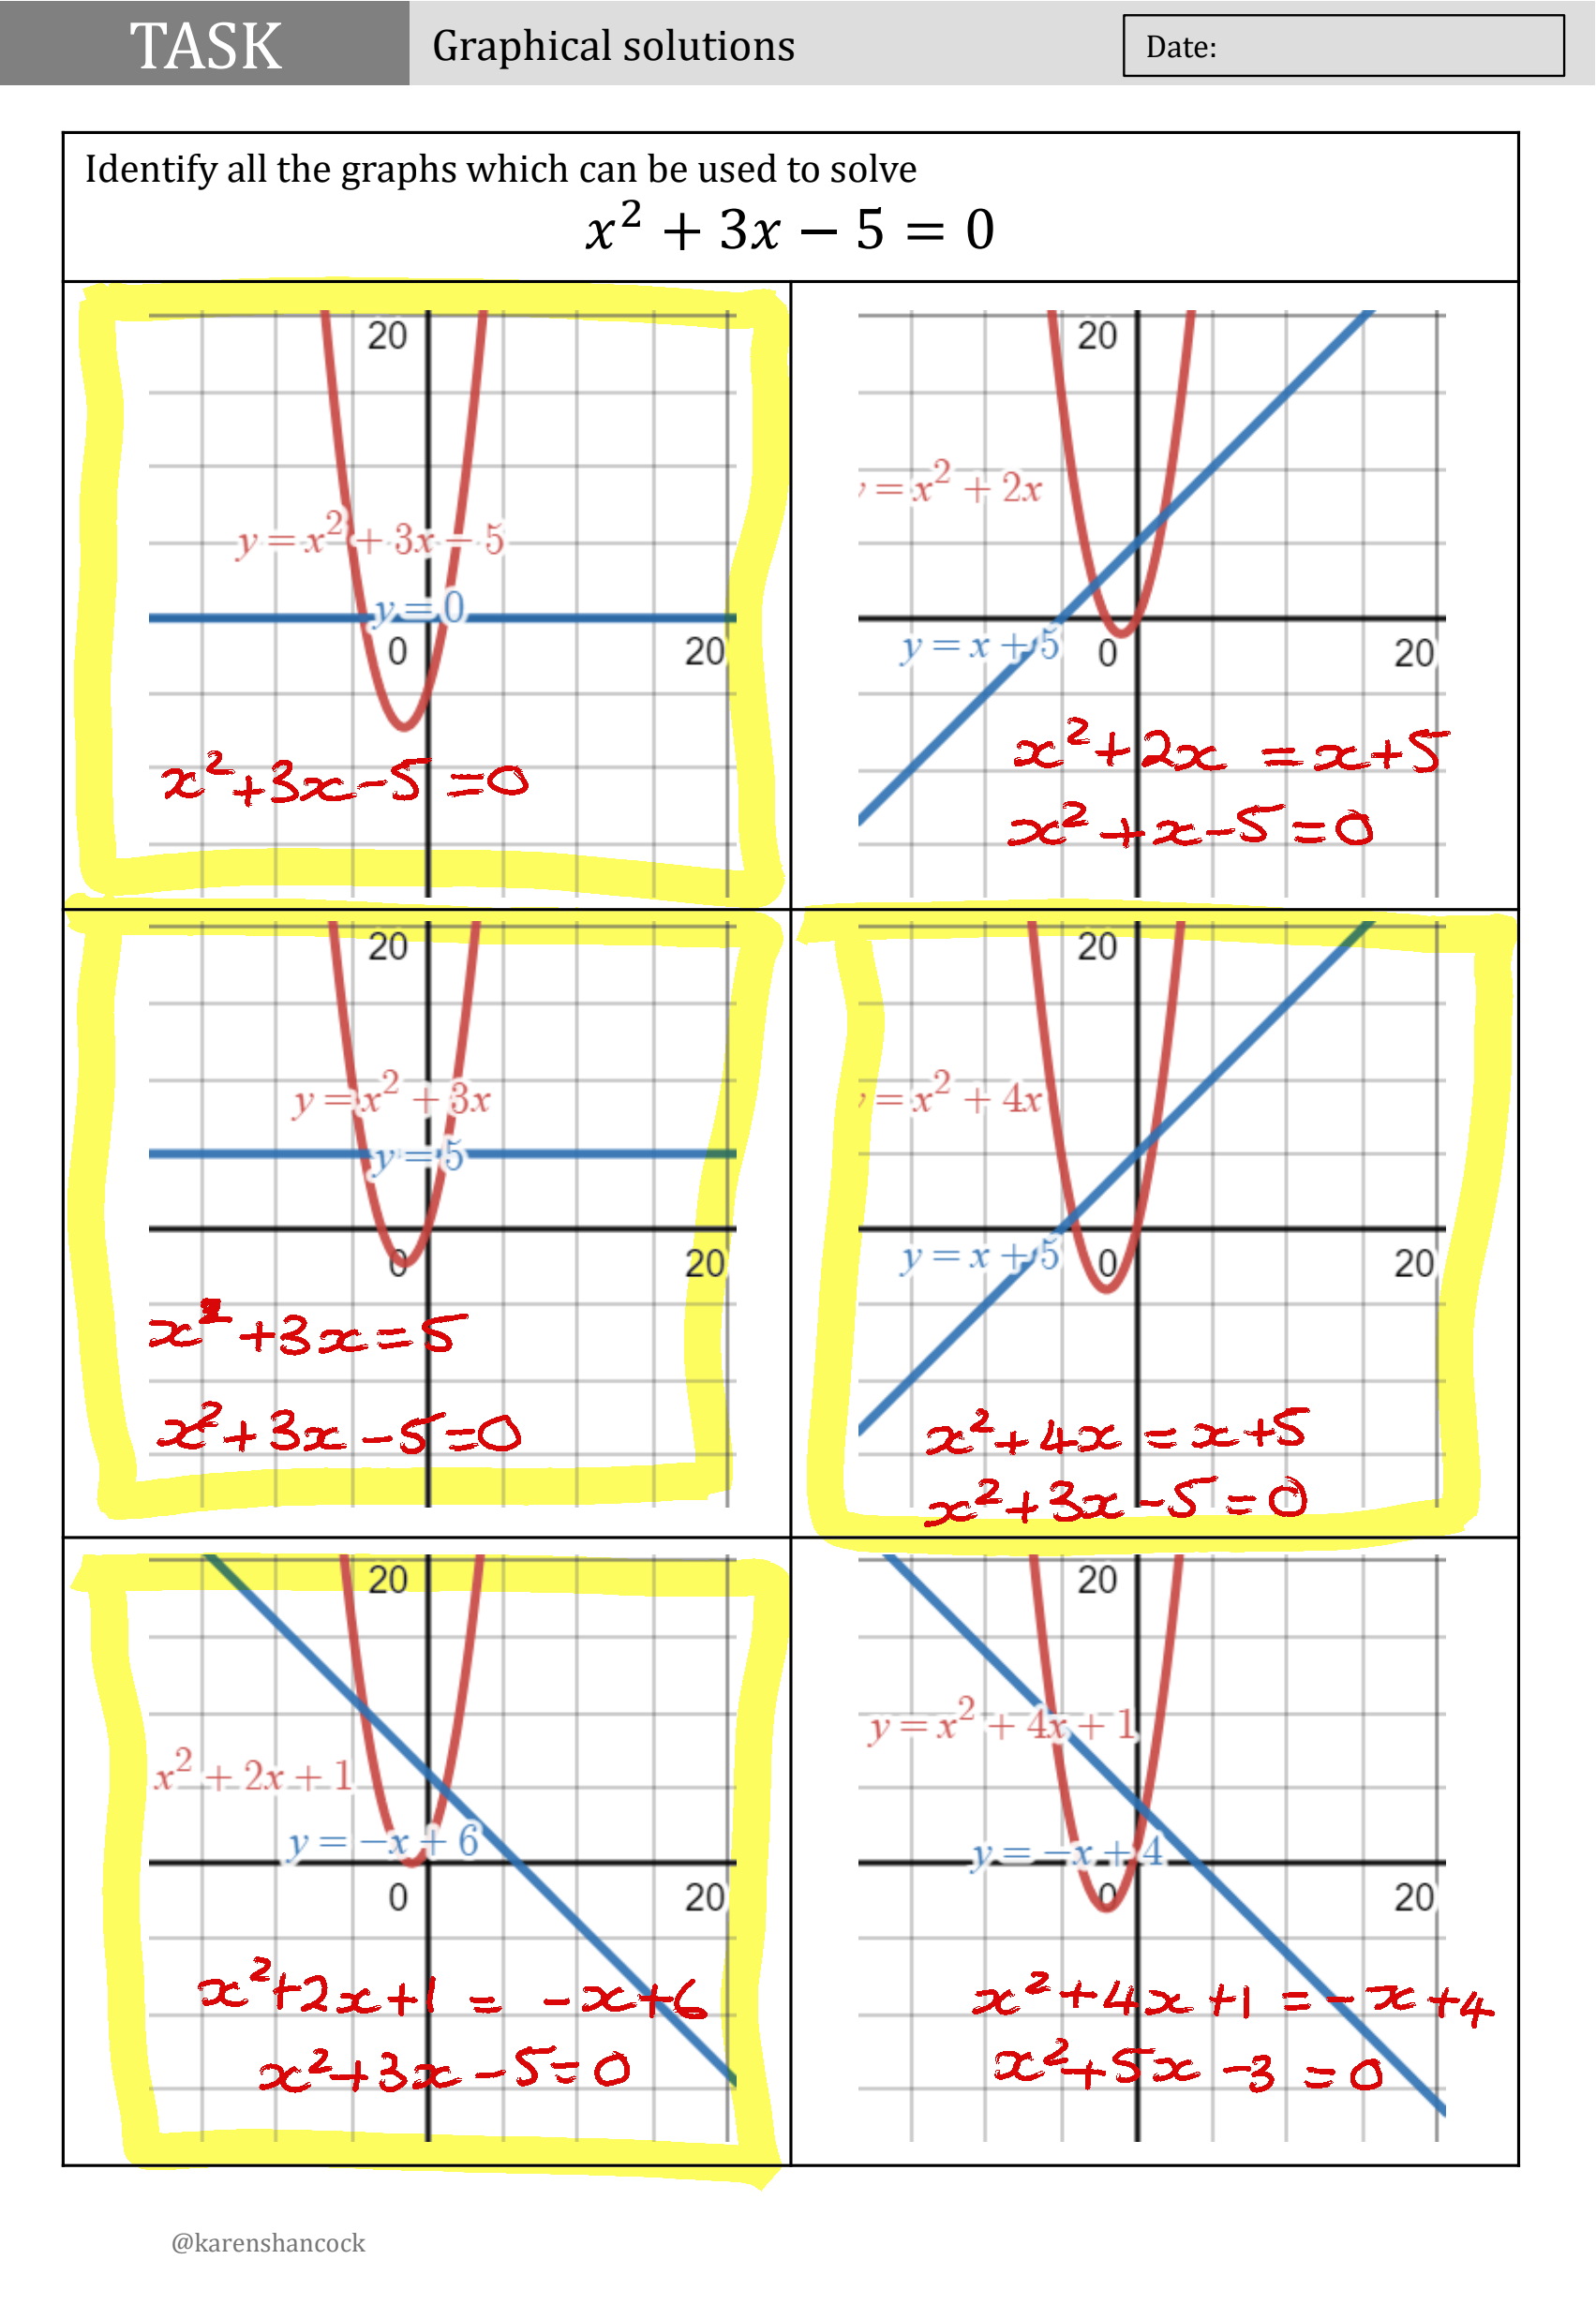

Slide 8
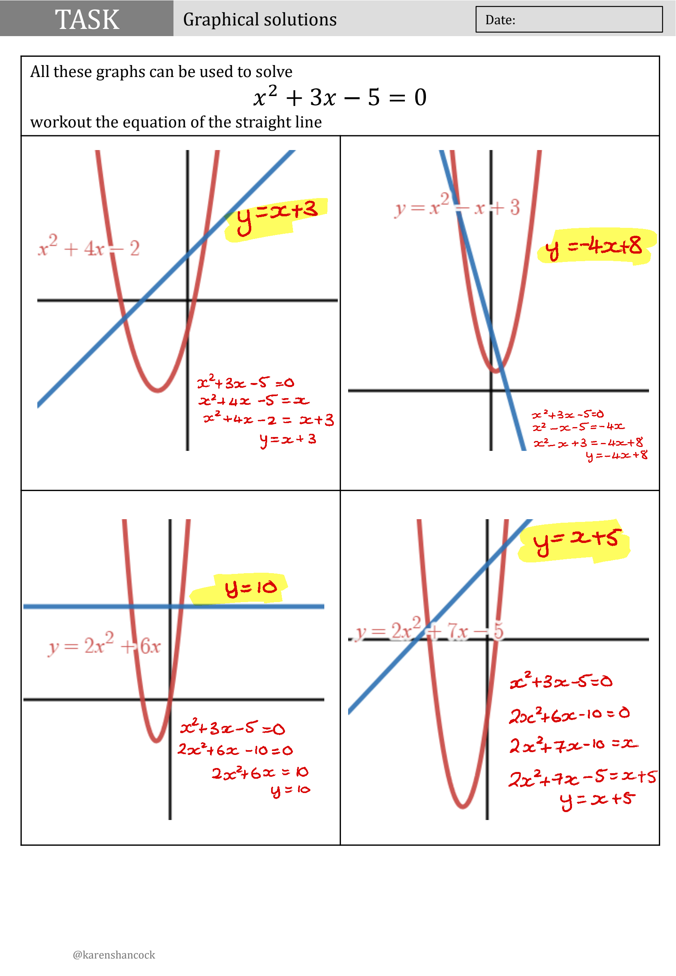

Slide 9
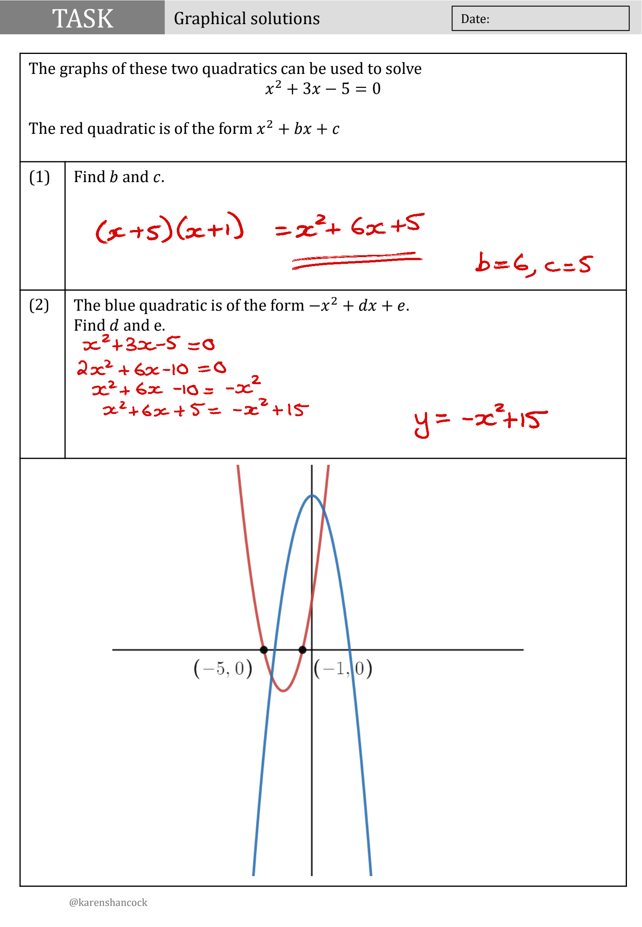

Slide 10
