Slide 1
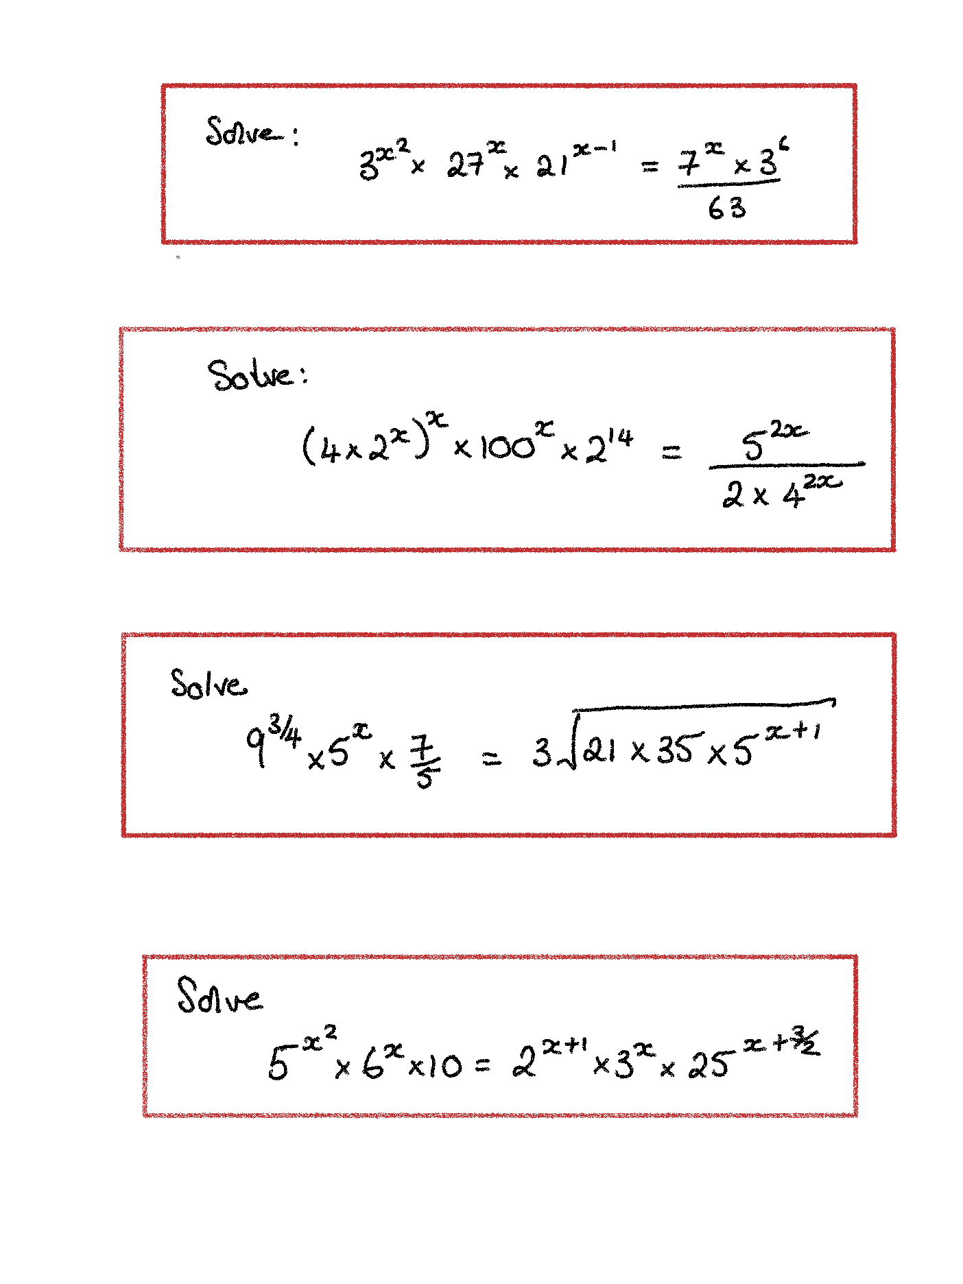
POWER EQUATIONS
1

Slide 2
2

Slide 3
3

Slide 4
4

Slide 5
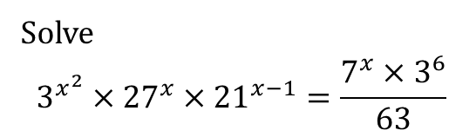
POWER EQUATIONS
1
Solve
$$3^{x^{2}}×{27}^{x}×{21}^{x−1}=\frac{7^{x}×3^{6}}{63}$$

Slide 6
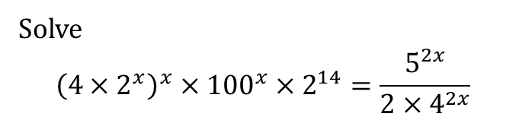
2
Solve
$${\left(4×2^{x}\right)}^{x}×{100}^{x}×2^{14}=\frac{5^{2x}}{2×4^{2x}}$$

Slide 7
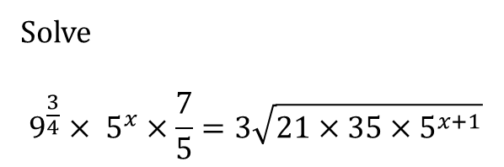
3
Solve
$$9^{\frac{3}{4}}× 5^{x}×\frac{7}{5}=3\sqrt{21×35×5^{x+1}}$$

Slide 8
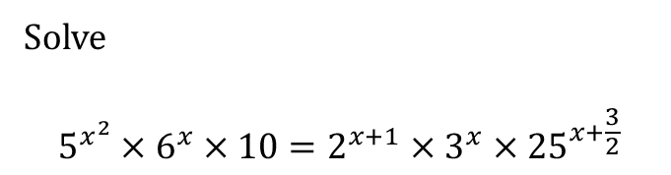
Solve
$$5^{x^{2}}×6^{x}×10=2^{x+1}×3^{x}×{25}^{x+\frac{3}{2}}$$
4

Slide 9
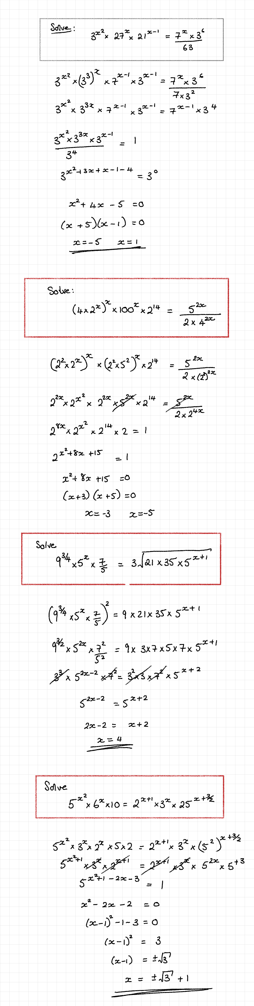
1

Slide 10
2

Slide 11
3

Slide 12
4

