Slide 1

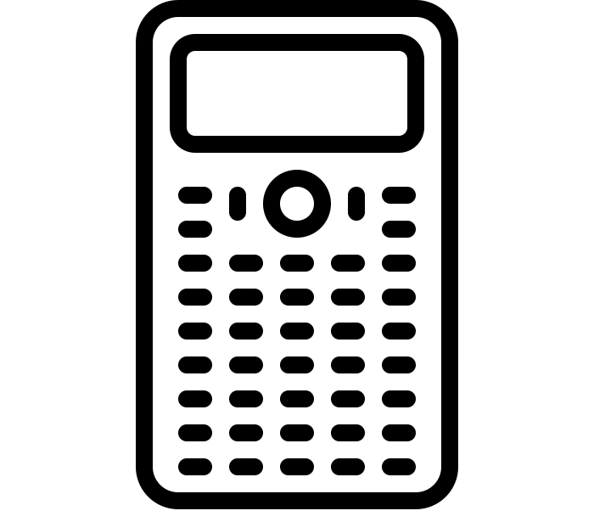

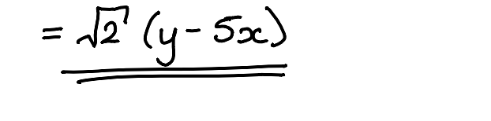
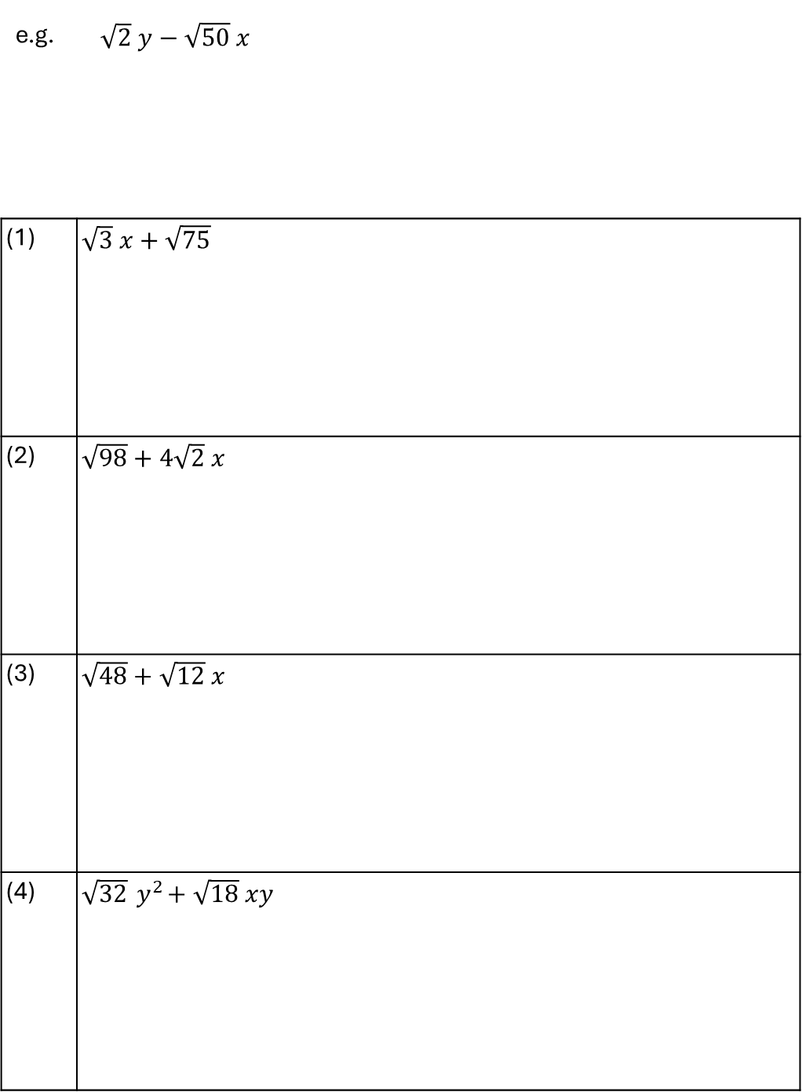
TASK
Fully factorise
e.g. | $\sqrt{2} y−\sqrt{50} x$
(1) | $\sqrt{3} x+\sqrt{75}$
(2) | $\sqrt{98}+4\sqrt{2} x$
(3) | $\sqrt{48}+\sqrt{12} x$
(4) | $\sqrt{32}{ y}^{2}+\sqrt{18} xy$

Slide 2
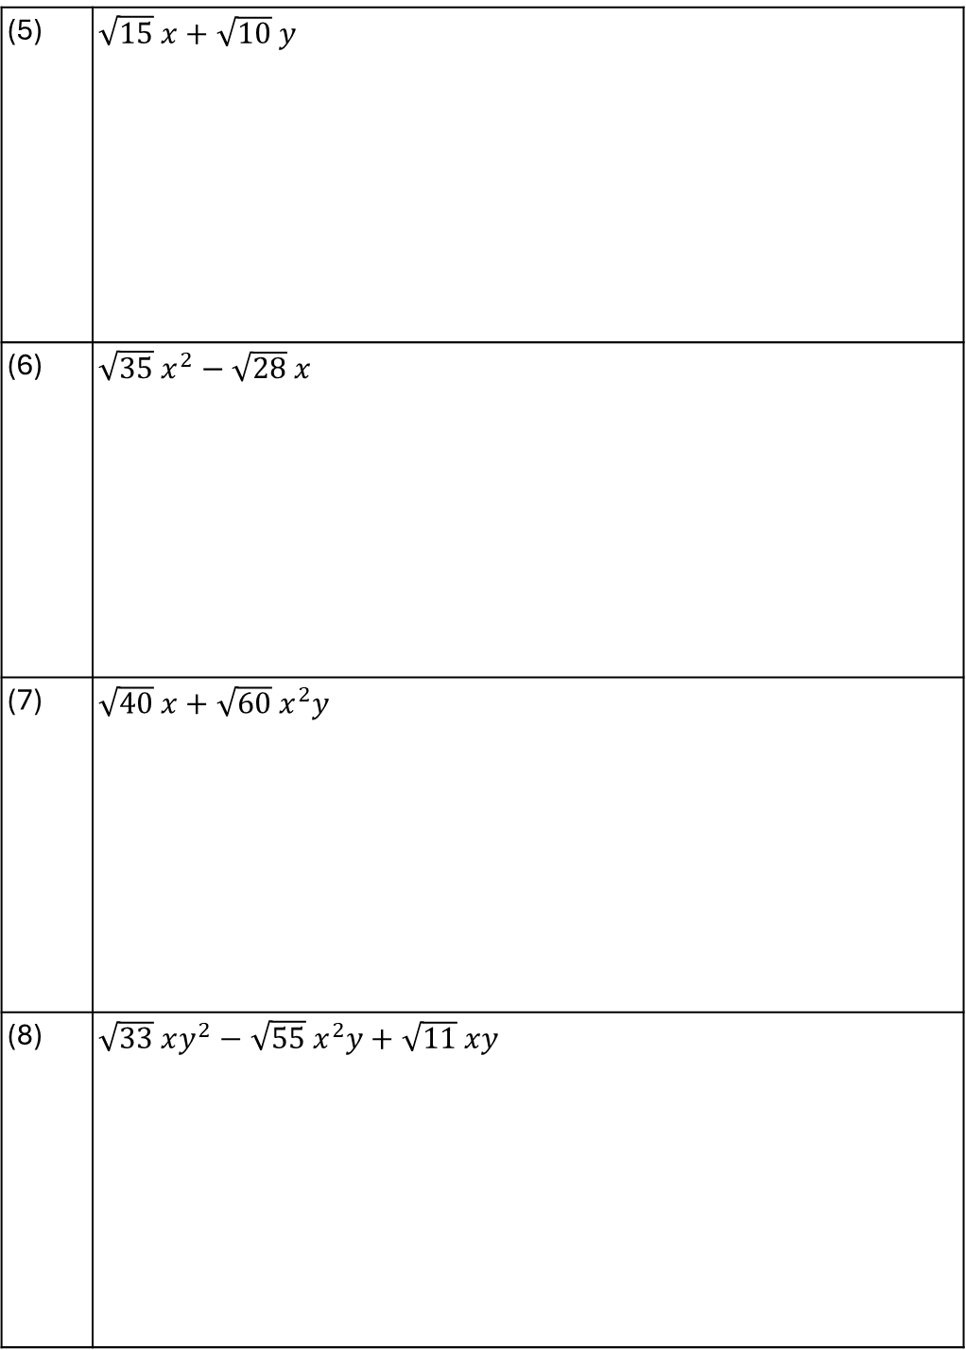
TASK
Fully factorise
(5) | $\sqrt{15} x+\sqrt{10} y$
(6) | $\sqrt{35} x^{2}−\sqrt{28} x$
(7) | $\sqrt{40} x+\sqrt{60} x^{2}y$
(8) | $\sqrt{33} xy^{2}−\sqrt{55} x^{2}y+\sqrt{11} xy$

Slide 3
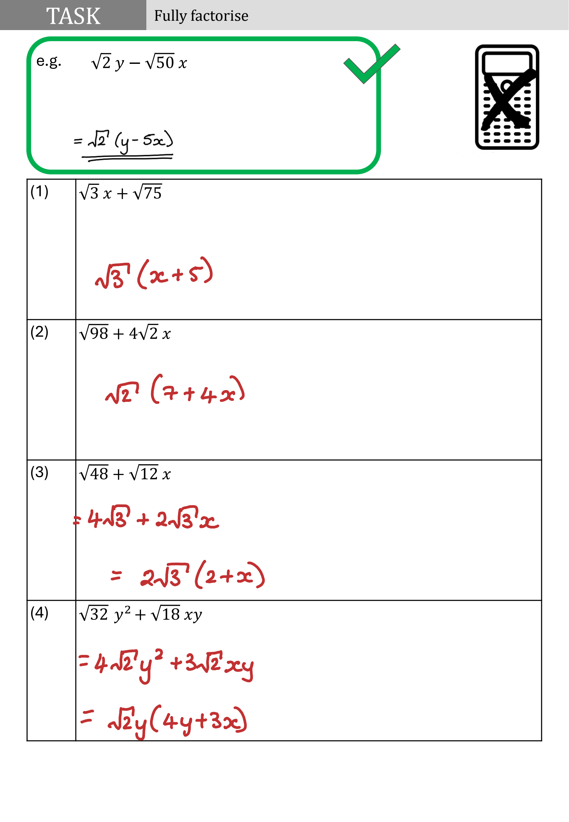

Slide 4
