Slide 1
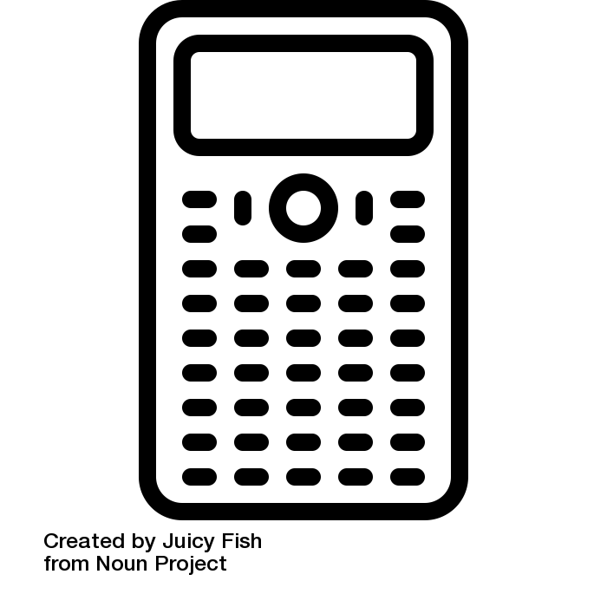

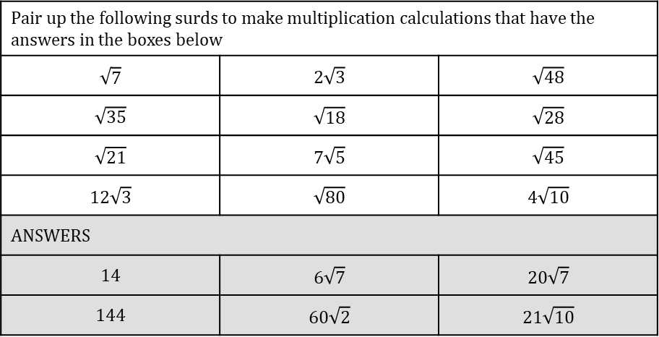
TASK
Multiplying surds
Pair up the following surds to make multiplication calculations that have the answers in the boxes below
$$\sqrt{7}$$ | $$2\sqrt{3}$$ | $$\sqrt{48}$$
$$\sqrt{35}$$ | $$\sqrt{18}$$ | $$\sqrt{28}$$
$$\sqrt{21}$$ | $$7\sqrt{5}$$ | $$\sqrt{45}$$
$$12\sqrt{3}$$ | $$\sqrt{80}$$ | $$4\sqrt{10}$$
ANSWERS
$$14$$ | $$6\sqrt{7}$$ | $$20\sqrt{7}$$
$$144$$ | $$60\sqrt{2}$$ | $$21\sqrt{10}$$

Slide 2
