Slide 1


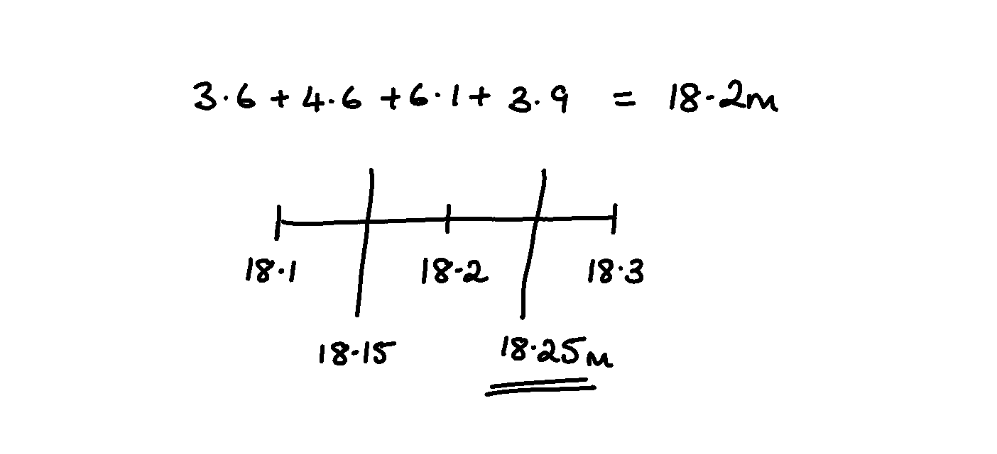
WORKED EXAMPLE
Bounds with calculations
Sharon has answered this question incorrectly |  |  | Study the solution carefully and answer these questions.
Here is a trapezium. All the lengths are measured to 1 decimal place. She calculated the greatest possible perimeter incorrectly. |  | (1) | Explain why Sharon’s answer is too small
 |  | (2) | Find the upper bound of all the lengths and hence the correct answer
 |  | (3) | How would you calculate the lower bound for the area?
4.6m
3.9m
3.6m
6.1m

Slide 2

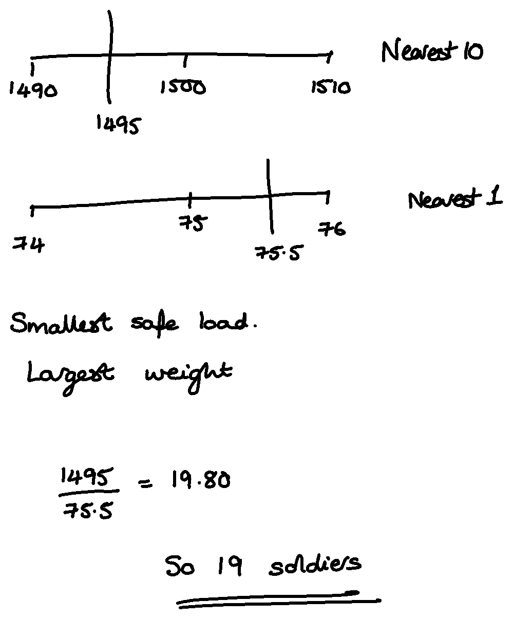
WORKED EXAMPLE
Greatest safely
Deniro has answered this question correctly |  |  | Study the solution carefully and answer these questions.
The maximum safe load of a bridge is 1500 kg to the nearest 10 kg. An average soldier is 75 kg to the nearest kilogram. Work out an estimate for the maximum number of soldiers that can safely cross the bridge at the same time. |  | (1) | Explain why you need the smallest safe load and the largest weight.
 |  | (2) | What if the question was: A lift can hold 2,700 kg to 2 significant figures. It is being used to lift people with an average weight of 80kg to the nearest 5kg. What is the maximum amount of people the lift could hold?

Slide 3

WORKED EXAMPLE
Reverse Percentages
Morgan has answered this question incorrectly |  |  | Study the solution carefully and answer these questions.
Prices are reduced by 10% in a sale. The sale price of a coat is £45. Find the original price of the coat. |  | (1) | Explain why increasing £45 by 10% is not the inverse of decreasing the original amount by 10%. (You may use numbers, calculations and/or words.)
 |  | (2) | Write a correct solution to the question. (Ensure you include sufficient working.)
 |  | (3) | How could Morgan have checked their answer to help them realise they had made a mistake.
 |  | (4) | Are there any keywords or other information in the question to help you identify how to approach this question?

Slide 4
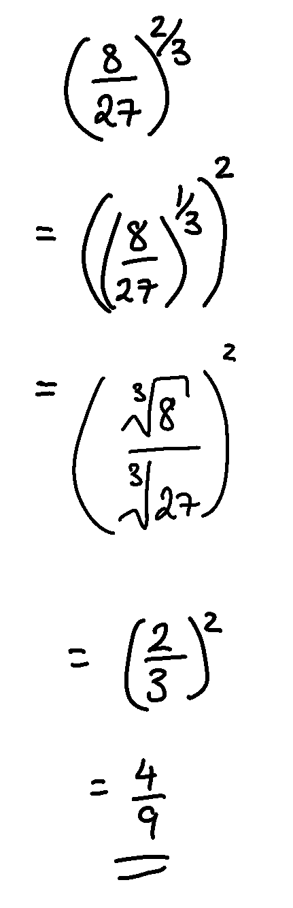
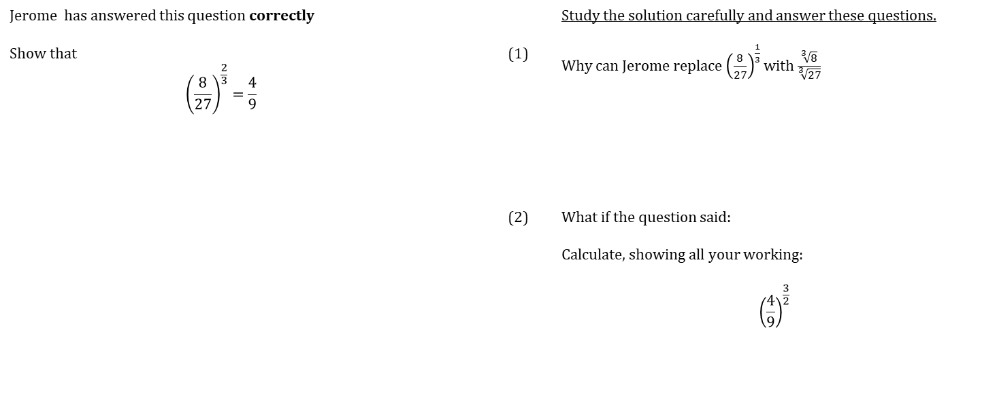
WORKED EXAMPLE
Fractional indices
Jerome has answered this question correctly |  |  | Study the solution carefully and answer these questions.
Show that $${\left(\frac{8}{27}\right)}^{\frac{2}{3}}=\frac{4}{9}$$ |  | (1) | Why can Jerome replace ${\left(\frac{8}{27}\right)}^{\frac{1}{3}}$ with $\frac{\sqrt[3]{8}}{\sqrt[3]{27}}$
 |  | (2) | What if the question said: Calculate, showing all your working: $${\left(\frac{4}{9}\right)}^{\frac{3}{2}}$$

Slide 5
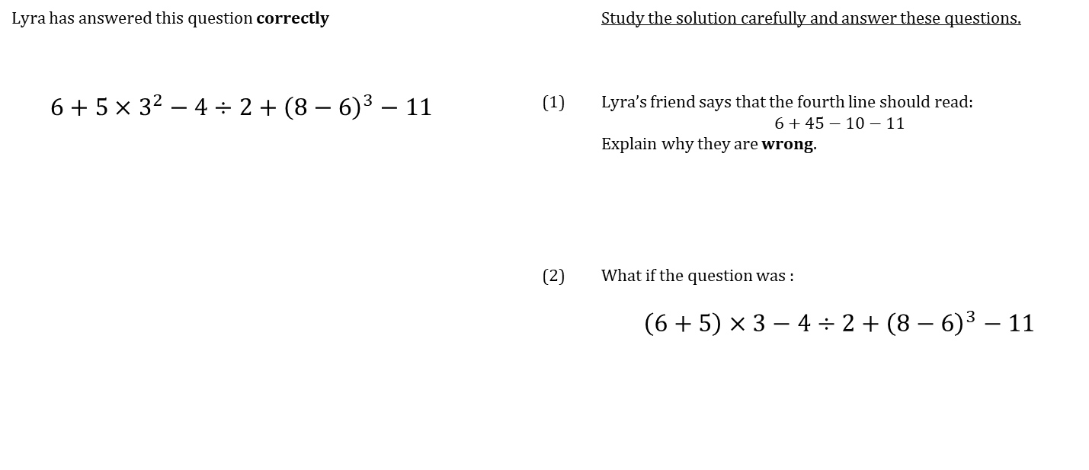
WORKED EXAMPLE
Order of Operations
Lyra has answered this question correctly |  |  | Study the solution carefully and answer these questions.
$$6+5×3^{2}−4÷2+{\left(8−6\right)}^{3}−11$$ |  | (1) | Lyra’s friend says that the fourth line should read: $$6+45−10−11$$ Explain why they are wrong.
 |  | (2) | What if the question was :
 |  |  | $$\left(6+5\right)×3−4÷2+{\left(8−6\right)}^{3}−11$$

Slide 6
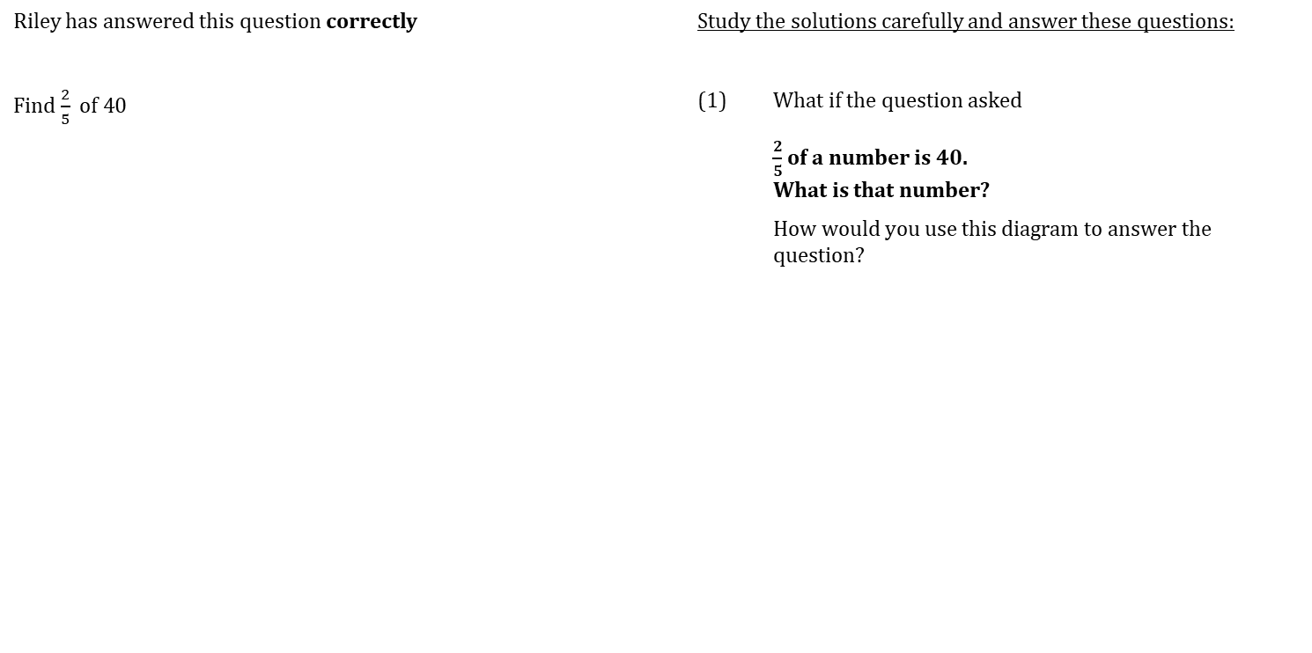
WORKED EXAMPLE
Fractions of an amount
Riley has answered this question correctly |  | Study the solutions carefully and answer these questions:
Find $\frac{2}{5} \text{of}\text{ 40}$ |  | (1) | What if the question asked
 |  |  | $\frac{2}{5}$ of a number is 40. What is that number?
 |  |  | How would you use this diagram to answer the question?
https://ag-web.completemaths.com/files/c3a4e1d2-0dad-4a62-8775-65cbe3b22b45

Slide 7
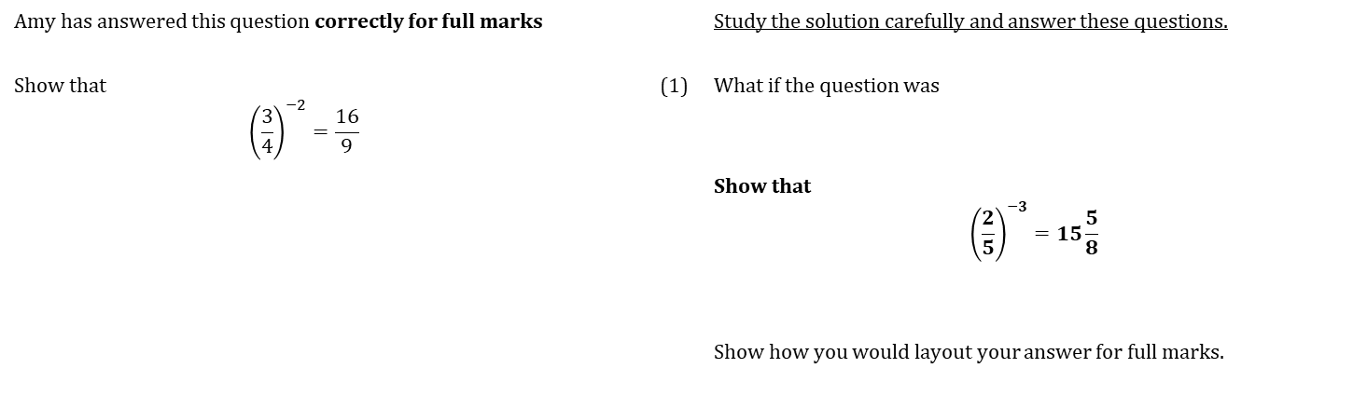
WORKED EXAMPLE
Negative powers
Amy has answered this question correctly for full marks |  |  | Study the solution carefully and answer these questions.
Show that $${\left(\frac{3}{4}\right)}^{−2}=\frac{16}{9}$$ |  | (1) | What if the question was
 |  |  | Show that $${\left(\frac{2}{5}\right)}^{−3}=15\frac{5}{8}$$
 |  |  | Show how you would layout your answer for full marks.

Slide 8
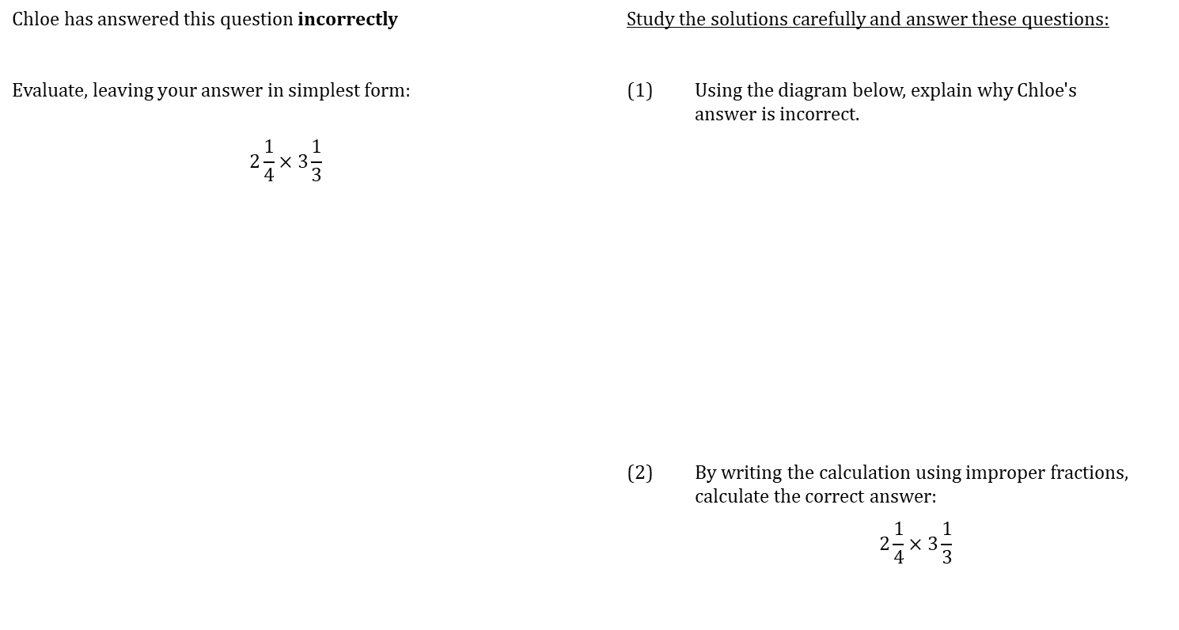
WORKED EXAMPLE
Dividing fractions
Chloe has answered this question incorrectly |  | Study the solutions carefully and answer these questions:
Evaluate, leaving your answer in simplest form: |  | (1) | Using the diagram below, explain why Chloe's answer is incorrect.
$$2\frac{1}{4}×3\frac{1}{3}$$
 |  | (2) | By writing the calculation using improper fractions, calculate the correct answer:
 |  |  | $$2\frac{1}{4}×3\frac{1}{3}$$
https://ag-web.completemaths.com/files/c3a4e1d2-0dad-4a62-8775-65cbe3b22b45

Slide 9
WORKED EXAMPLE
Percentage multipliers
Charlie has answered this question correctly |  |  | Study the solution carefully and answer these questions.
Increase £34 by 12% |  | (1) | Charlie could have answered this question by finding 12% and adding it to the £34. Showing all your working, demonstrate how this gives the same answer.
 |  | (2) | What calculation would you use to decrease £34 by 12%?
 |  | (3) | If £34 had been increased to £42.16. How could you find the percentage increase in a single calculation?

Slide 10
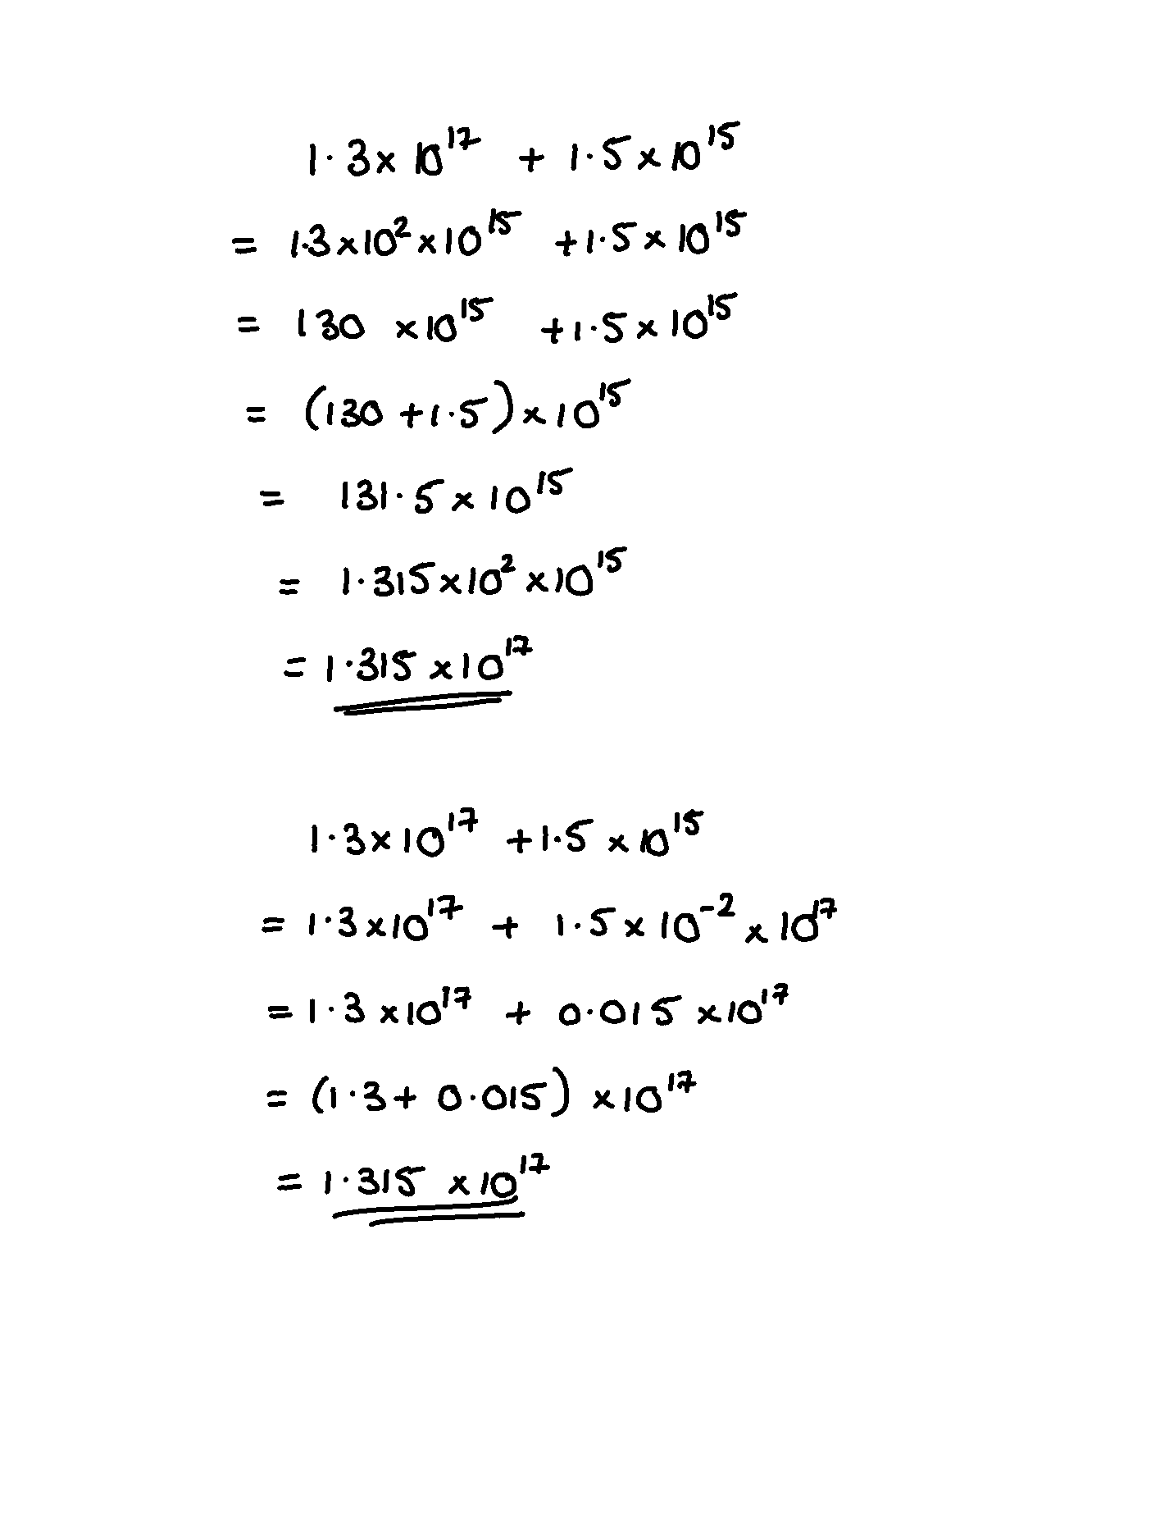
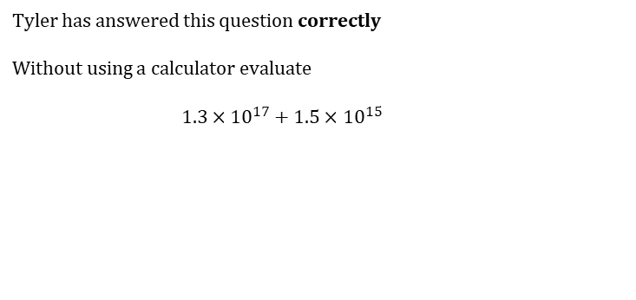
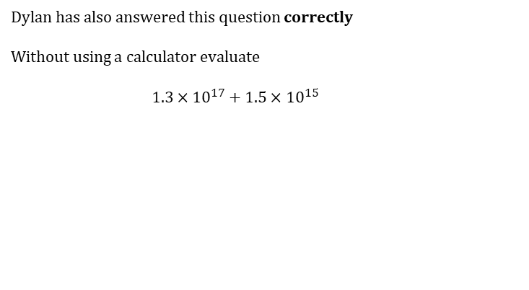
WORKED EXAMPLE
Addition in standard form page 1
Tyler has answered this question correctly
Without using a calculator evaluate $$1.3×{10}^{17}+1.5×{10}^{15}$$
Dylan has also answered this question correctly Without using a calculator evaluate $$1.3×{10}^{17}+1.5×{10}^{15}$$
 | Study the solutions carefully and answer these questions.
(1) | Tyler’s friend says that it is easier to write out both the numbers as ordinary numbers as a first step. Explain why this method could lead to errors.
(2) | Which method do you prefer?

Slide 11
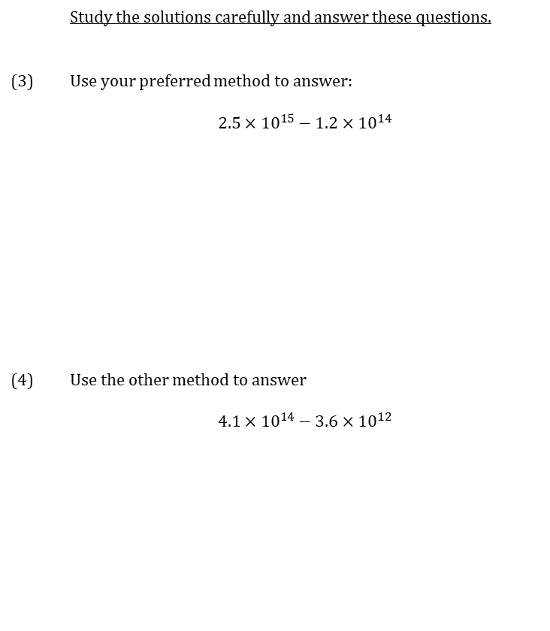
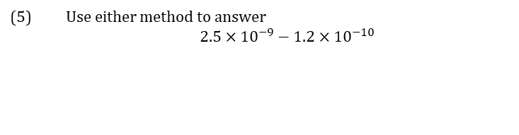
WORKED EXAMPLE
Addition in Standard Form page 2
 | Study the solutions carefully and answer these questions.
(3) | Use your preferred method to answer: $$2.5×{10}^{15}−1.2×{10}^{14}$$
(4) | Use the other method to answer $$4.1×{10}^{14}−3.6×{10}^{12}$$
(5) | Use either method to answer $$2.5×{10}^{−9}−1.2×{10}^{−10}$$

Slide 12
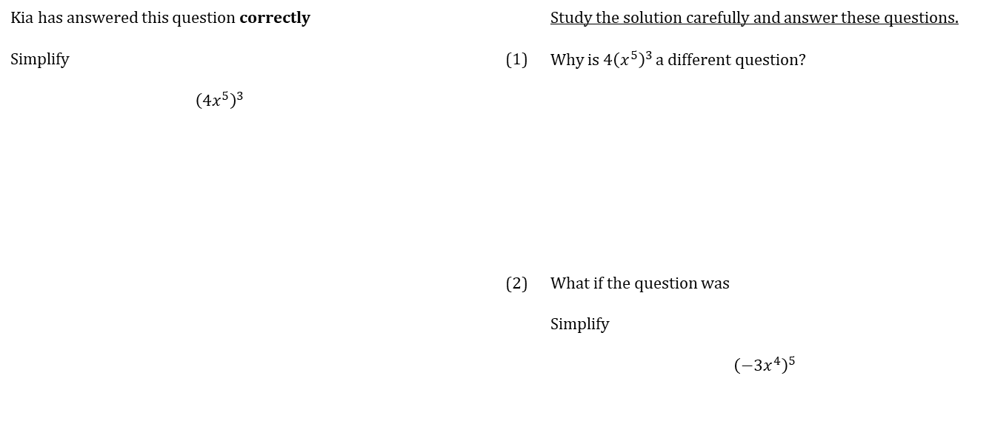
WORKED EXAMPLE
Powers of powers
Kia has answered this question correctly |  |  | Study the solution carefully and answer these questions.
Simplify $${\left(4x^{5}\right)}^{3}$$ |  | (1) | Why is $4{\left(x^{5}\right)}^{3}$ a different question?
 |  | (2) | What if the question was Simplify $${\left(−3x^{4}\right)}^{5}$$

Slide 13
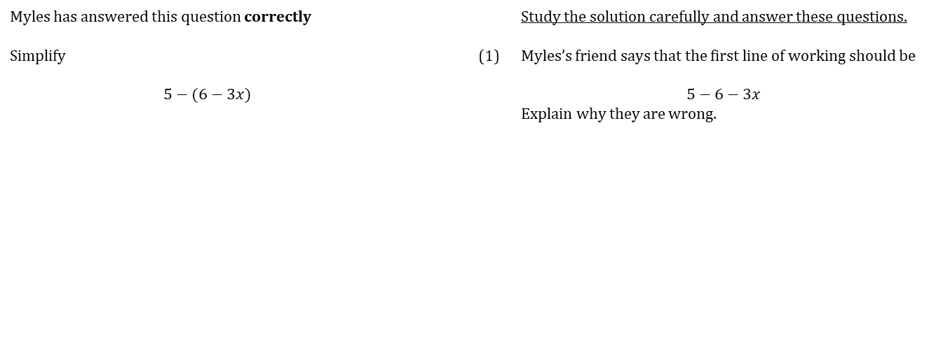
WORKED EXAMPLE
Expanding brackets
Myles has answered this question correctly |  |  | Study the solution carefully and answer these questions.
Simplify $$5−(6−3x)$$ |  | (1) | Myles’s friend says that the first line of working should be $$5−6−3x$$ Explain why they are wrong.

Slide 14
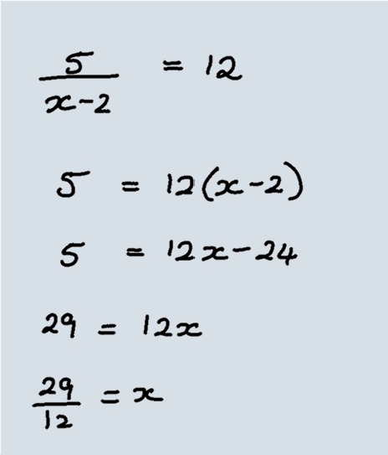
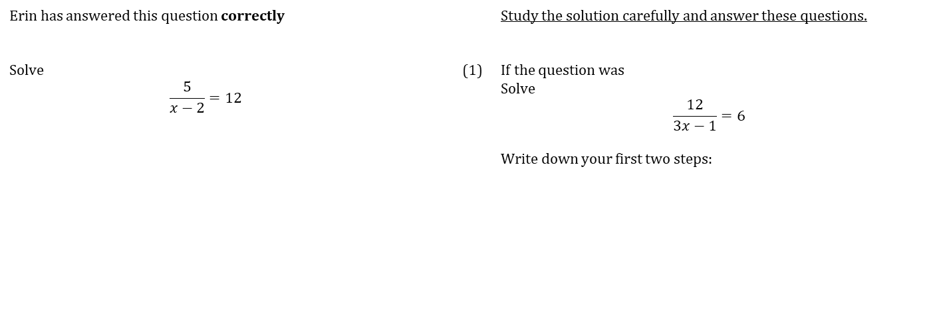
WORKED EXAMPLE
Fractional Equations
Erin has answered this question correctly |  |  | Study the solution carefully and answer these questions.
Solve $$\frac{5}{x−2}=12$$ |  | (1) | If the question was Solve $$\frac{12}{3x−1}=6$$ Write down your first two steps:

Slide 15
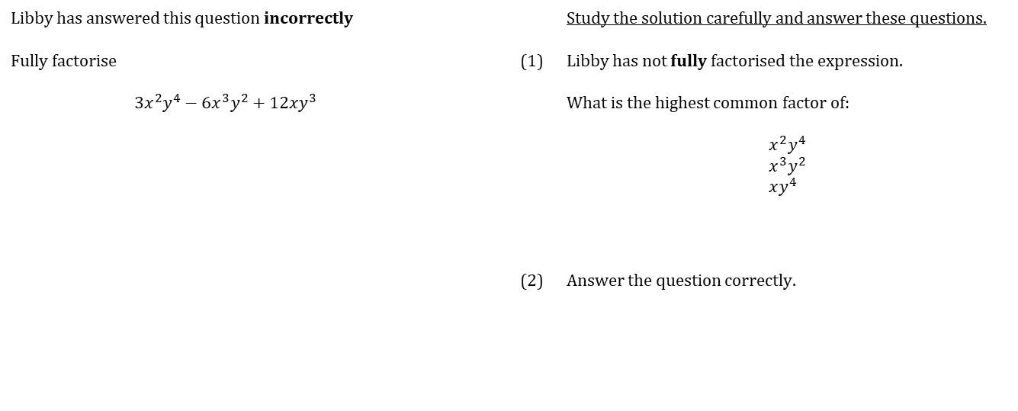
WORKED EXAMPLE
Fully factorising
Libby has answered this question incorrectly |  |  | Study the solution carefully and answer these questions.
Fully factorise $$3x^{2}y^{4}−6x^{3}y^{2}+12xy^{3}$$ |  | (1) | Libby has not fully factorised the expression. What is the highest common factor of: $$x^{2}y^{4} \\ x^{3}y^{2} \\ xy^{4}$$
 |  | (2) | Answer the question correctly.

Slide 16
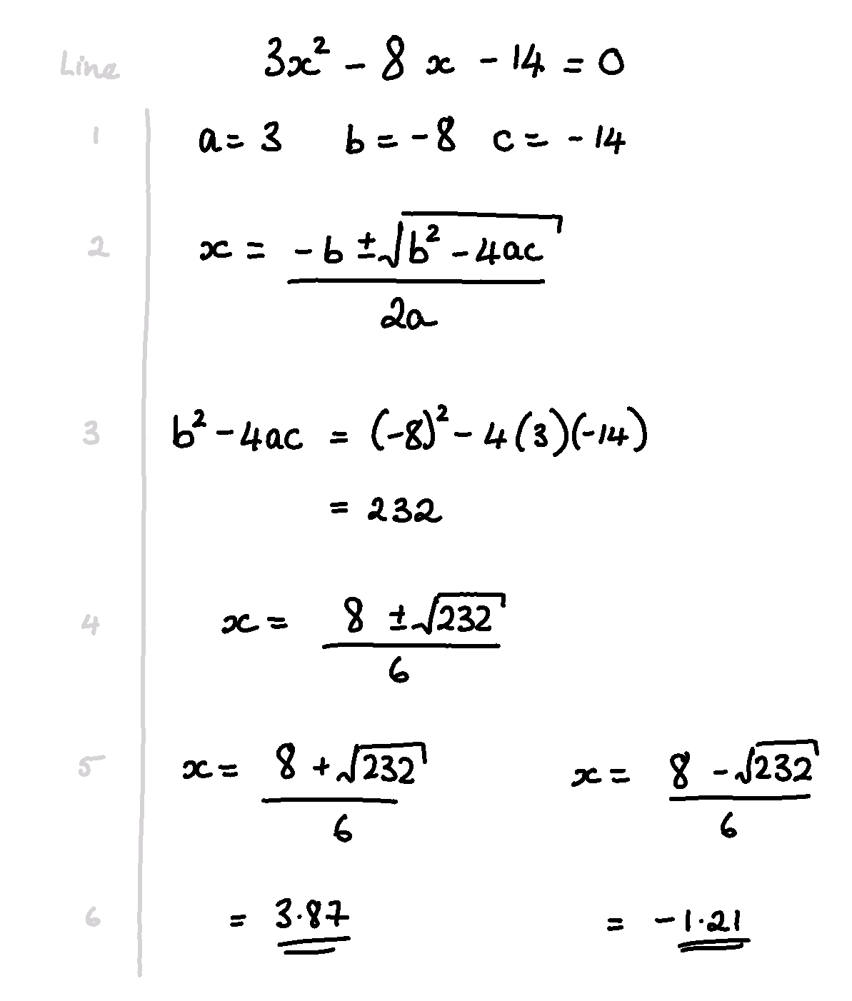
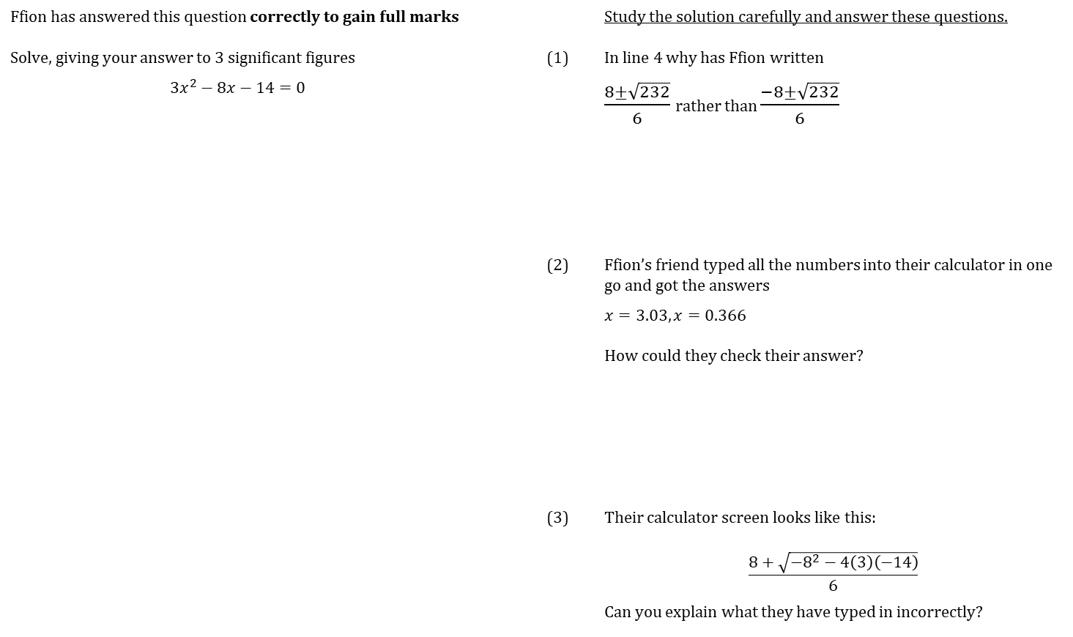
WORKED EXAMPLE
SOLVE USING QUADRATIC FORMULA
Ffion has answered this question correctly to gain full marks |  |  | Study the solution carefully and answer these questions.
Solve, giving your answer to 3 significant figures |  | (1) | In line 4 why has Ffion written
$$3x^{2}−8x−14=0$$ |  |  | $\frac{8±\sqrt{232}}{6}$ rather than $\frac{−8±\sqrt{232}}{6}$
 |  | (2) | Ffion’s friend typed all the numbers into their calculator in one go and got the answers
 |  |  | $x=3.03, x=0.366$
 |  |  | How could they check their answer?
 |  | (3) | Their calculator screen looks like this:
 |  |  | $$\frac{8+\sqrt{−8^{2}−4\left(3\right)\left(−14\right)}}{6}$$
 |  |  | Can you explain what they have typed in incorrectly?

Slide 17
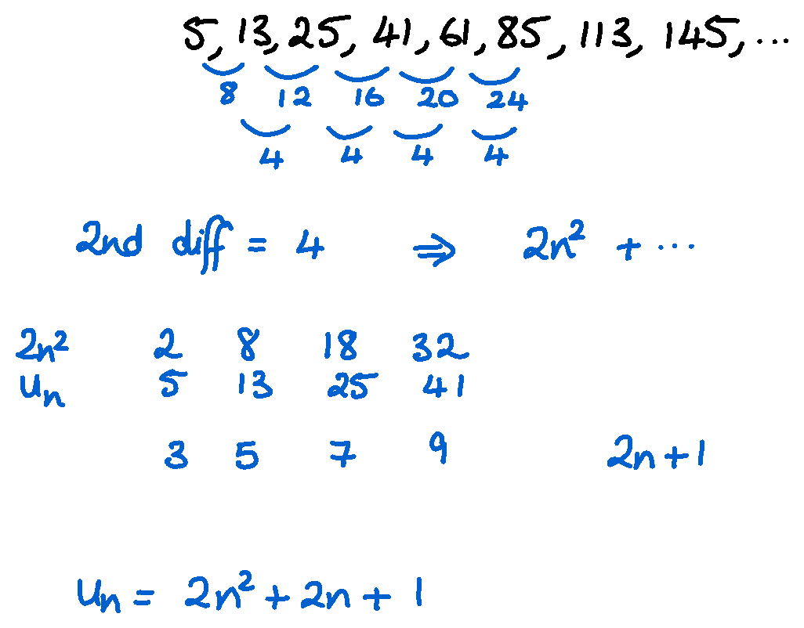
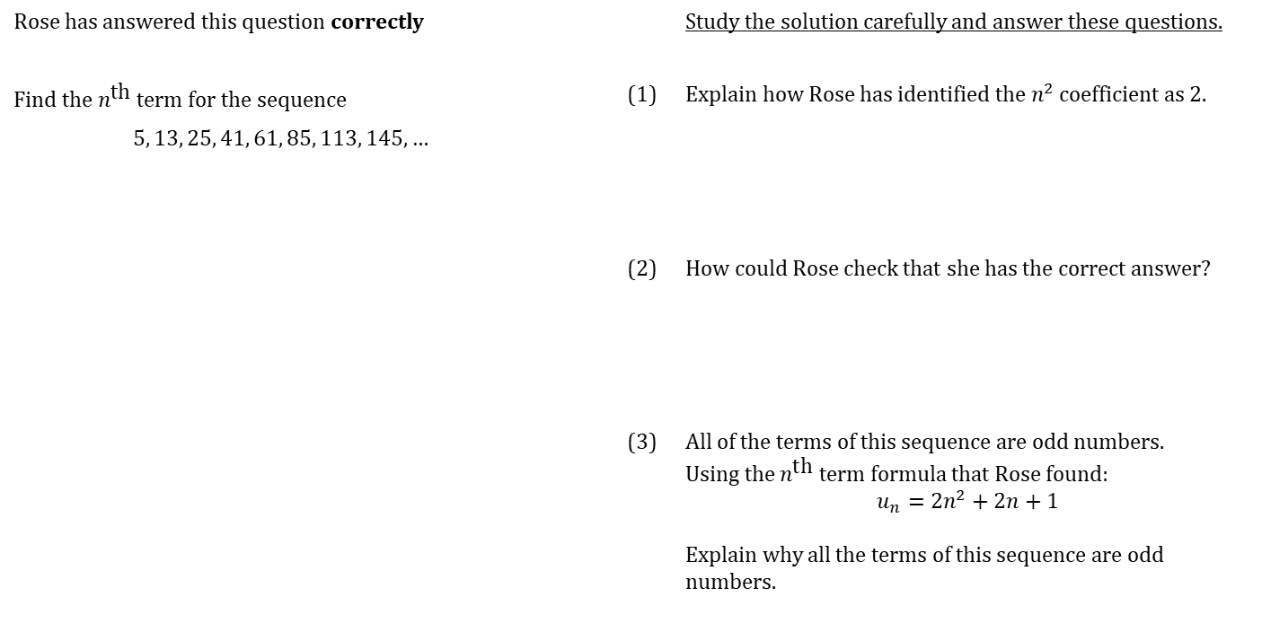
WORKED EXAMPLE
nth term of a quadratic sequence
Rose has answered this question correctly |  |  | Study the solution carefully and answer these questions.
Find the $n^{\text{th}}$ term for the sequence |  | (1) | Explain how Rose has identified the $n^{2}$ coefficient as 2.
$$5, 13, 25, 41, 61, 85, 113, 145,…$$
 |  | (2) | How could Rose check that she has the correct answer?
 |  | (3) | All of the terms of this sequence are odd numbers. Using the $n^{\text{th}}$ term formula that Rose found: $$u_{n}=2n^{2}+2n+1$$ Explain why all the terms of this sequence are odd numbers.

Slide 18
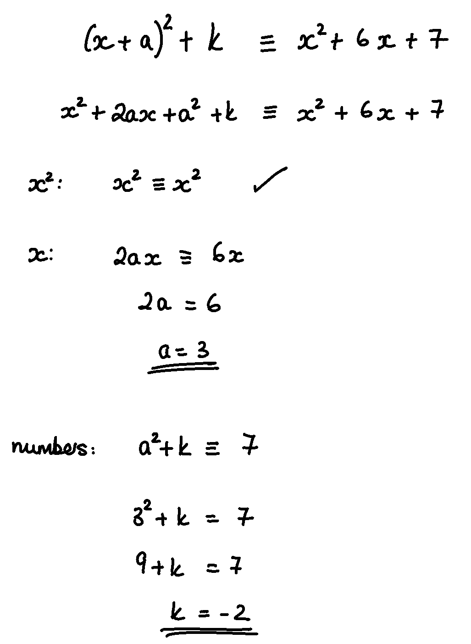
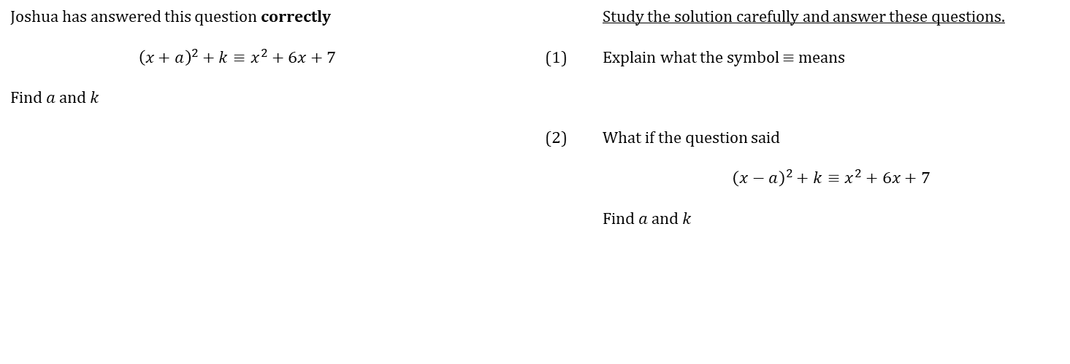
WORKED EXAMPLE
COMPARING COEFFICENTS
Joshua has answered this question correctly |  |  | Study the solution carefully and answer these questions.
$${\left(x+a\right)}^{2}+k≡x^{2}+6x+7$$ |  | (1) | Explain what the symbol $≡$ means
Find $a$ and $k$
 |  | (2) | What if the question said
 |  |  | $${\left(x−a\right)}^{2}+k≡x^{2}+6x+7$$
 |  |  | Find $a$ and $k$

Slide 19
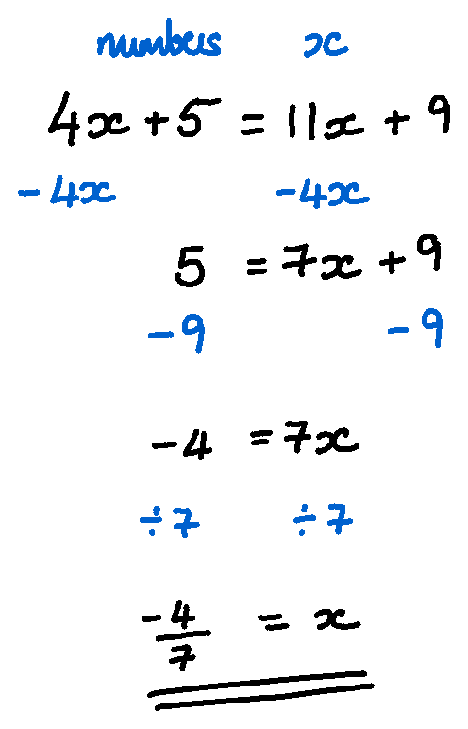
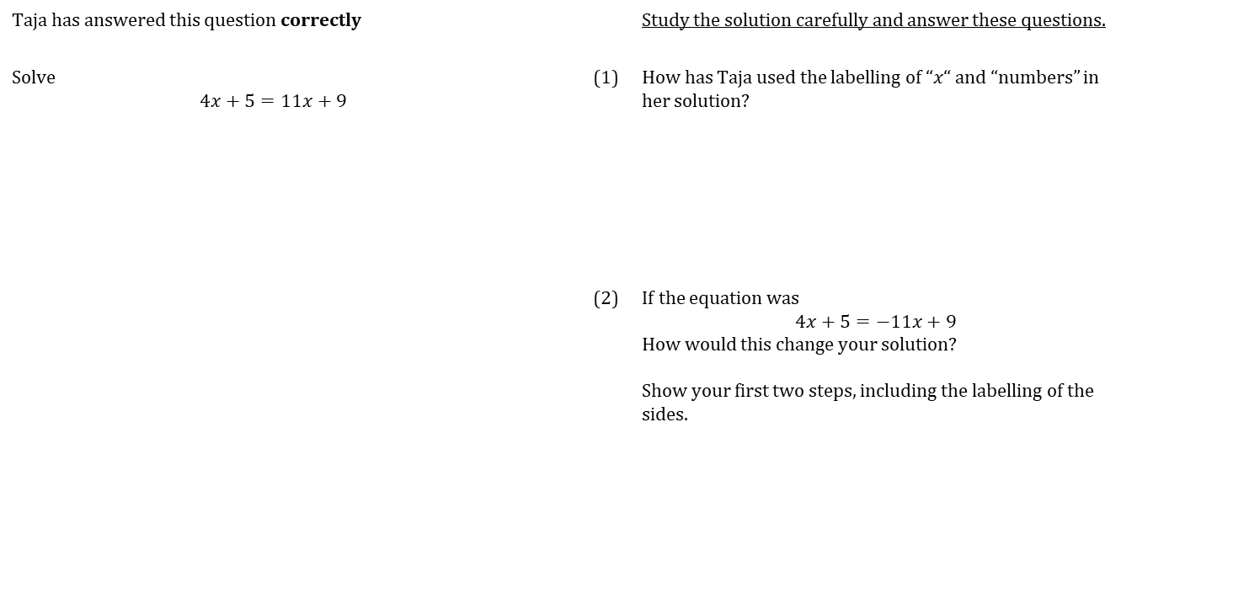
WORKED EXAMPLE
Solving equations – unknowns on both sides
Taja has answered this question correctly |  |  | Study the solution carefully and answer these questions.
Solve $$4x+5=11x+9$$ |  | (1) | How has Taja used the labelling of “$x“$ and “numbers” in her solution?
 |  | (2) | If the equation was $$4x+5=−11x+9$$ How would this change your solution? Show your first two steps, including the labelling of the sides.

Slide 20
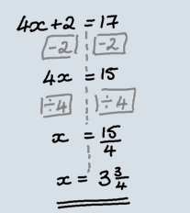
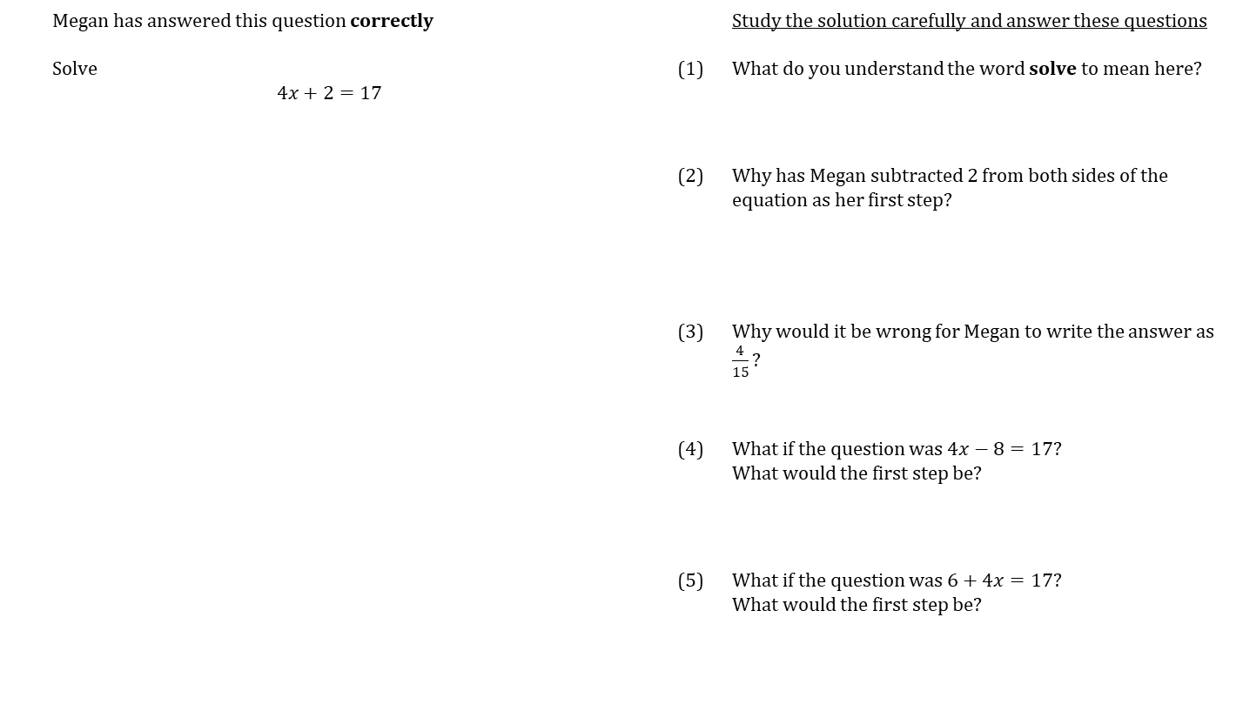
WORKED EXAMPLE
Solving equations
 | Megan has answered this question correctly |  |  | Study the solution carefully and answer these questions
 | Solve $$4x+2=17$$ |  | (1) | What do you understand the word solve to mean here?
 |  |  | (2) | Why has Megan subtracted 2 from both sides of the equation as her first step?
 |  |  | (3) | Why would it be wrong for Megan to write the answer as $\frac{4}{15}?$
 |  |  | (4) | What if the question was $4x−8=17?$ What would the first step be?
 |  |  | (5) | What if the question was $6+4x=17?$ What would the first step be?

Slide 21
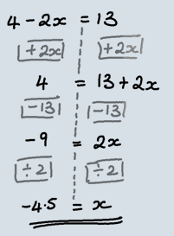
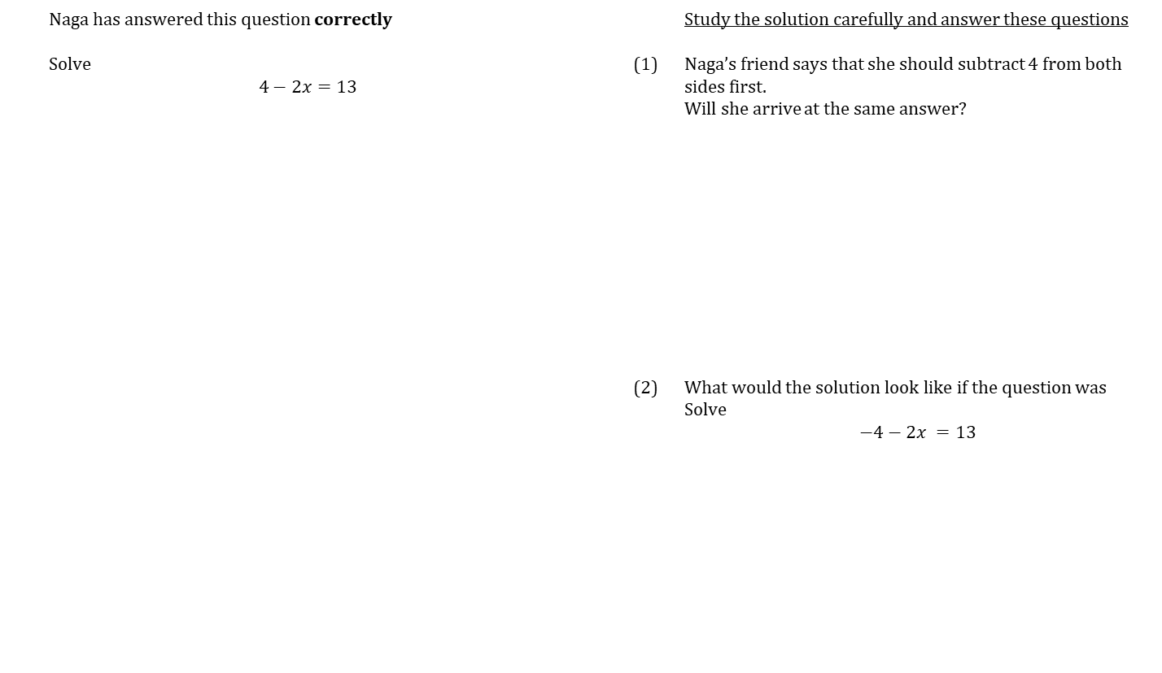
WORKED EXAMPLE
Solving equations – negative coefficients
 | Naga has answered this question correctly |  |  | Study the solution carefully and answer these questions
 | Solve $$4−2x=13$$ |  | (1) | Naga’s friend says that she should subtract 4 from both sides first. Will she arrive at the same answer?
 |  |  | (2) | What would the solution look like if the question was Solve $$−4−2x =13$$

Slide 22
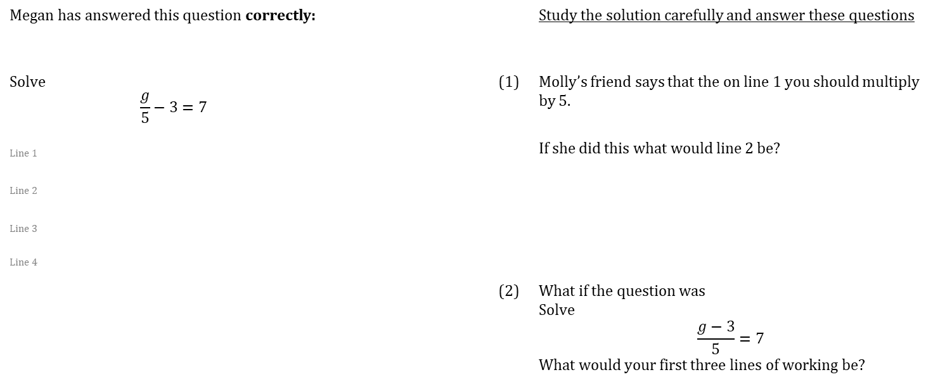
WORKED EXAMPLE
Solving equations – fractional equations
Megan has answered this question correctly: |  |  | Study the solution carefully and answer these questions
Solve $$\frac{g}{5}−3=7$$ |  | (1) | Molly’s friend says that the on line 1 you should multiply by 5.
Line 1 |  |  | If she did this what would line 2 be?
Line 2
Line 3
Line 4
 |  | (2) | What if the question was Solve $$\frac{g−3}{5}=7$$ What would your first three lines of working be?

Slide 23
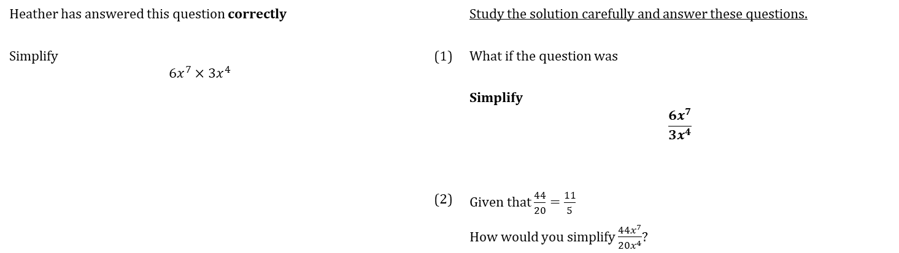
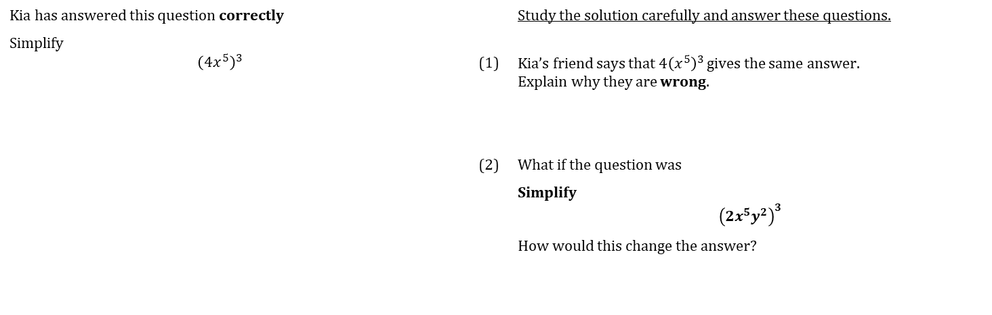
WORKED EXAMPLE
Rules of Indices
Heather has answered this question correctly |  |  | Study the solution carefully and answer these questions.
Simplify $$6x^{7}×3x^{4}$$ |  | (1) | What if the question was
 |  |  | Simplify $$\frac{6x^{7}}{3x^{4}}$$
 |  | (2) | Given that $\frac{44}{20}=\frac{11}{5}$
 |  |  | How would you simplify $\frac{44x^{7}}{20x^{4}}$?
Kia has answered this question correctly |  |  | Study the solution carefully and answer these questions.
Simplify $${\left(4x^{5}\right)}^{3}$$
 |  | (1) | Kia’s friend says that $4{\left(x^{5}\right)}^{3}$ gives the same answer. Explain why they are wrong.
 |  | (2) | What if the question was
 |  |  | Simplify $${\left(2x^{5}y^{2}\right)}^{3}$$
 |  |  | How would this change the answer?

Slide 24
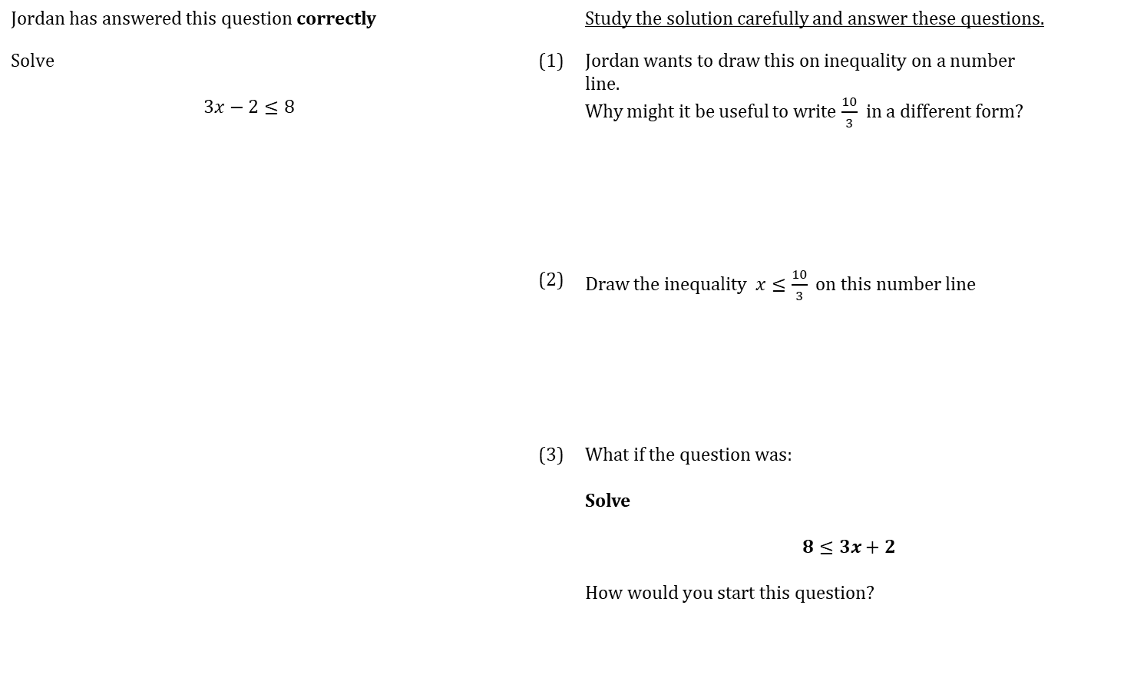
WORKED EXAMPLE
Solving inequalities
Jordan has answered this question correctly |  |  | Study the solution carefully and answer these questions.
Solve $$3x−2≤8$$ |  | (1) | Jordan wants to draw this on inequality on a number line. Why might it be useful to write $\frac{10}{3}$ in a different form?
 |  | (2) | Draw the inequality $x≤\frac{10}{3}$on this number line
 |  | (3) | What if the question was: Solve $$8≤3x+2$$ How would you start this question?
Notes:
After this - some mini whiteboard work – include opportunities to look at multiplying and dividing by negative numbers

Slide 25
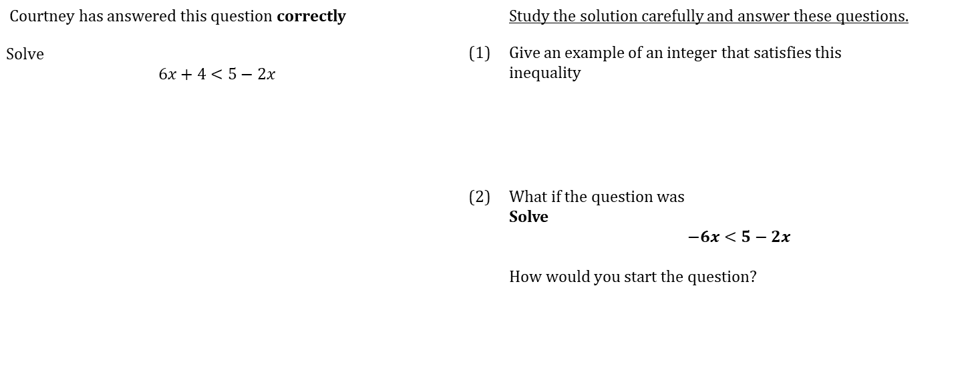
WORKED EXAMPLE
Solving inequalities – unknown both sides
Courtney has answered this question correctly |  |  | Study the solution carefully and answer these questions.
Solve $$6x+4<5−2x$$ |  | (1) | Give an example of an integer that satisfies this inequality
 |  | (2) | What if the question was Solve $$−6x<5−2x$$ How would you start the question?

Slide 26
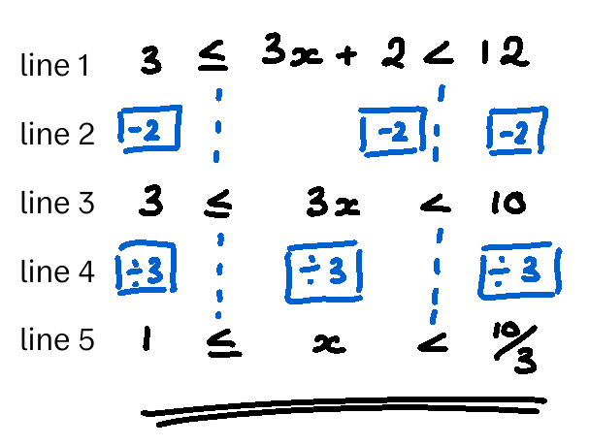
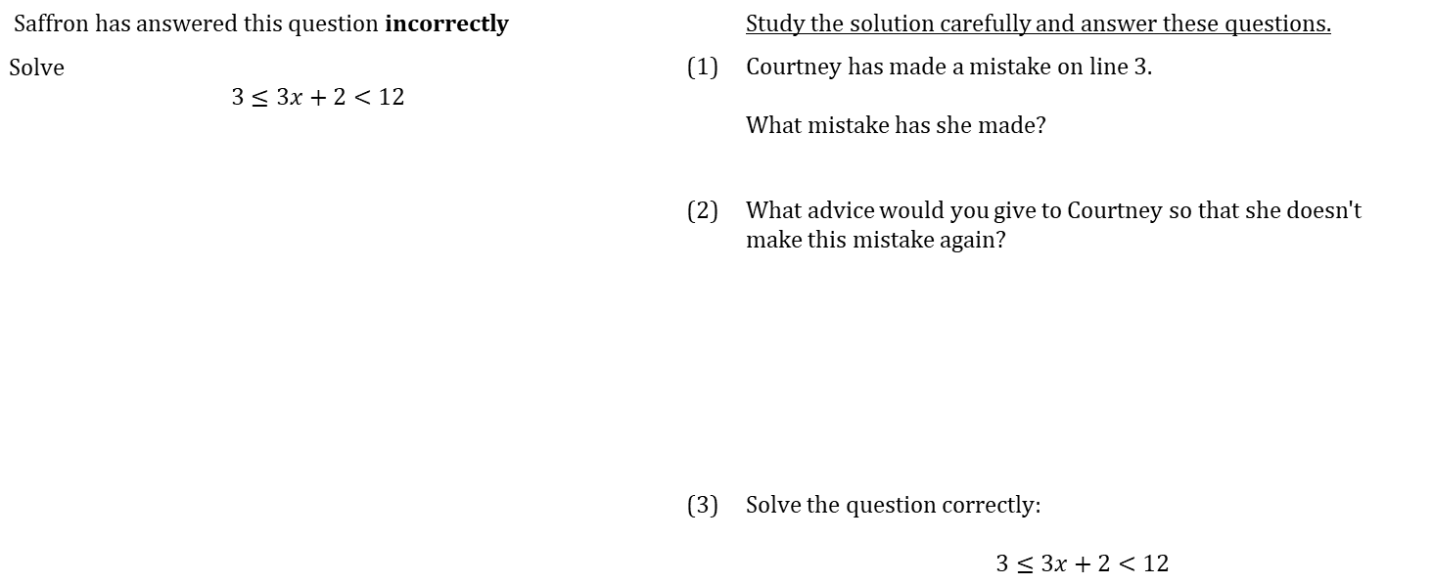
WORKED EXAMPLE
Solving inequalities – double inequality
Saffron has answered this question incorrectly |  |  | Study the solution carefully and answer these questions.
Solve $$3≤3x+2<12$$ |  | (1) | Courtney has made a mistake on line 3. What mistake has she made?
 |  | (2) | What advice would you give to Courtney so that she doesn't make this mistake again?
 |  | (3) | Solve the question correctly: $$3≤3x+2<12$$

Slide 27
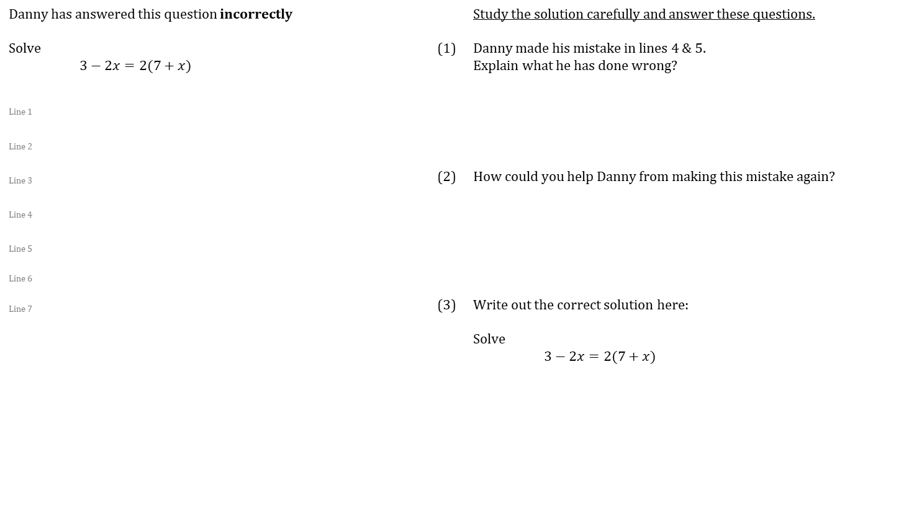
WORKED EXAMPLE
More complex equations
Danny has answered this question incorrectly |  |  | Study the solution carefully and answer these questions.
Solve $3−2x=2(7+x)$ |  | (1) | Danny made his mistake in lines 4 & 5. Explain what he has done wrong?
Line 1
Line 2
Line 3 |  | (2) | How could you help Danny from making this mistake again?
Line 4
Line 5
Line 6
Line 7 |  | (3) | Write out the correct solution here:
 |  |  | Solve $3−2x=2(7+x)$

Slide 28
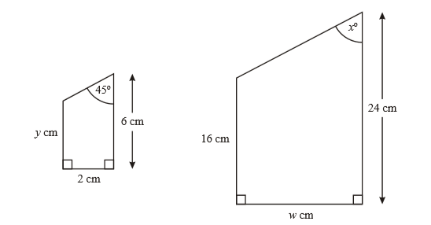
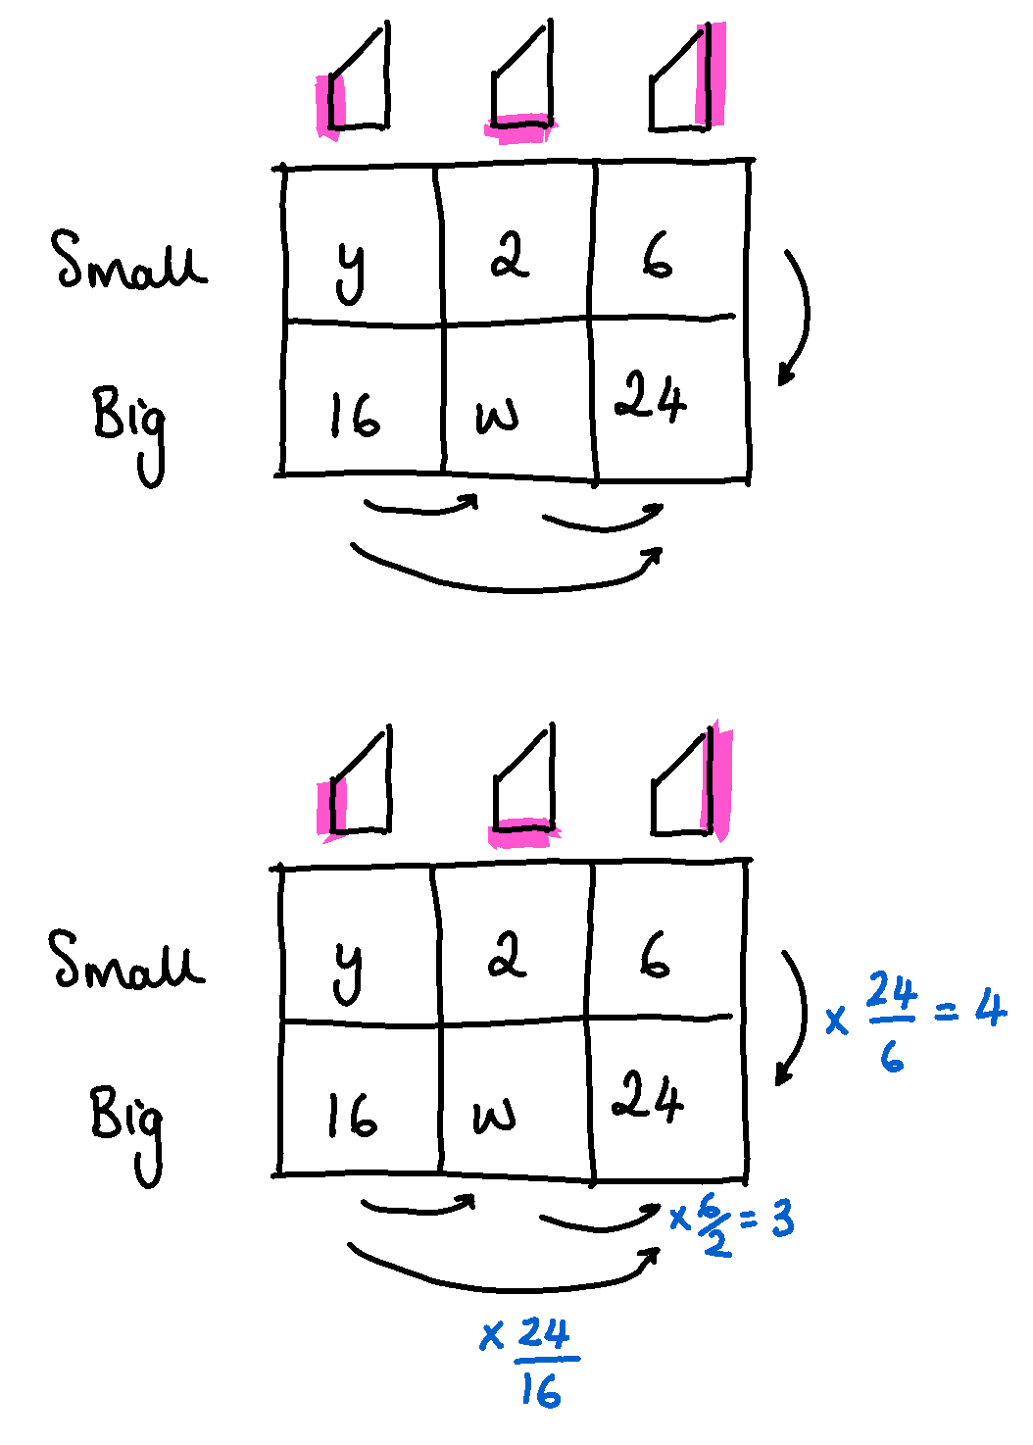
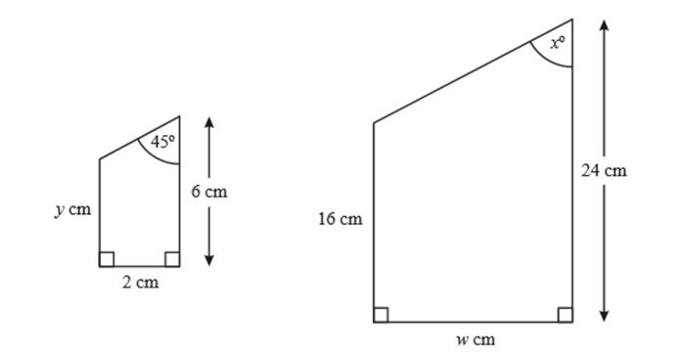
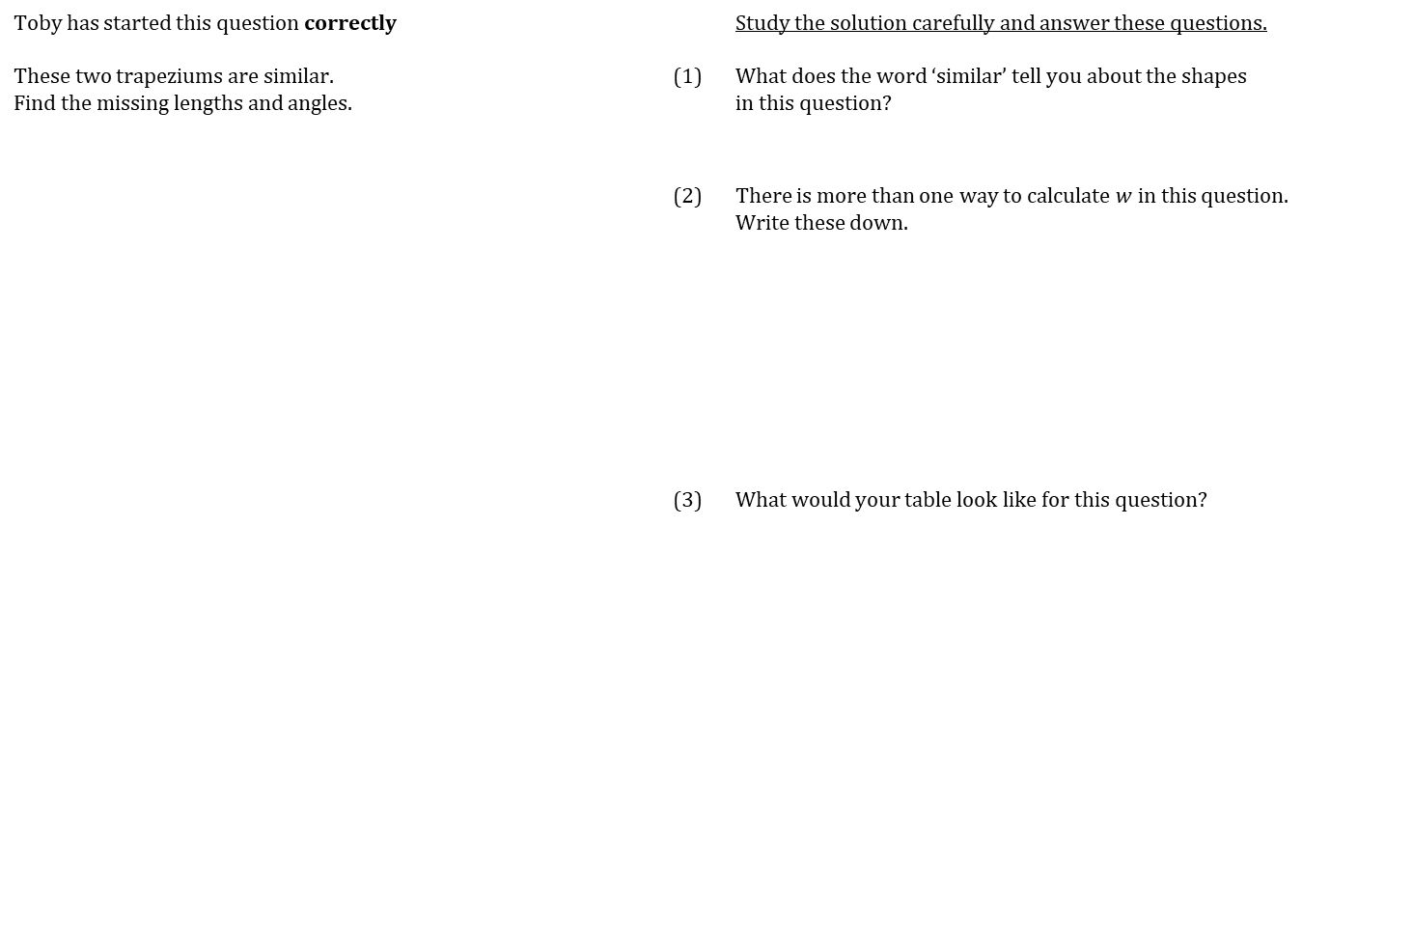

WORKED EXAMPLE
Similar shapes
Toby has started this question correctly |  |  | Study the solution carefully and answer these questions.
These two trapeziums are similar. Find the missing lengths and angles. |  | (1) | What does the word ‘similar’ tell you about the shapes in this question?
 |  | (2) | There is more than one way to calculate $w$ in this question. Write these down.
 |  | (3) | What would your table look like for this question?
$$y+6 \text{cm}$$

Slide 29
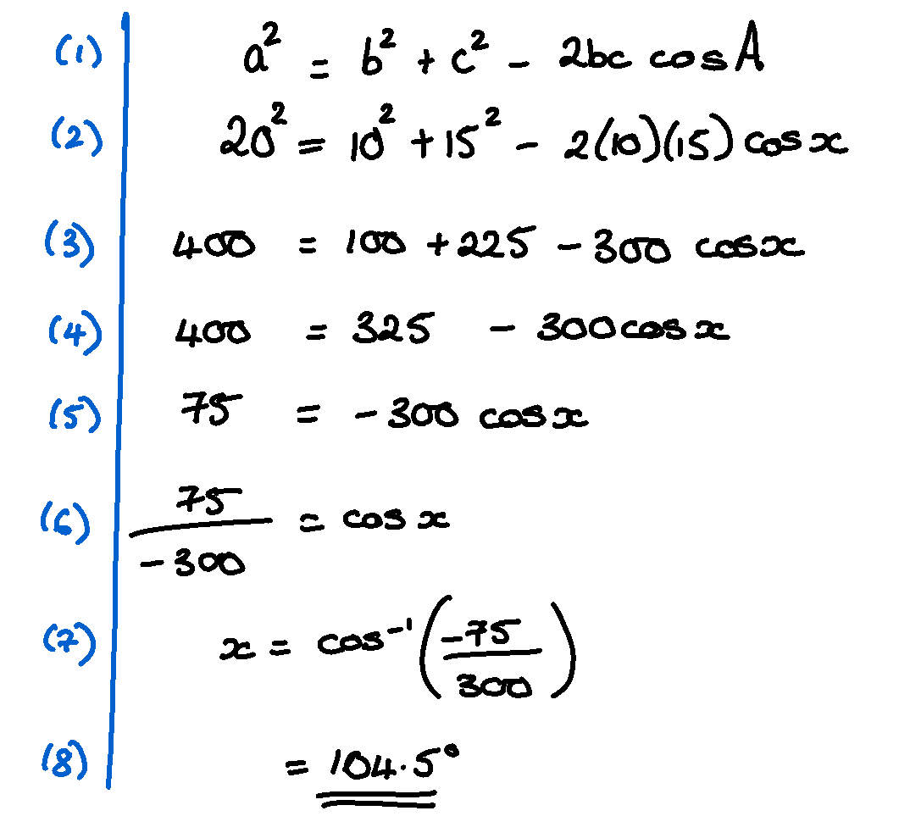

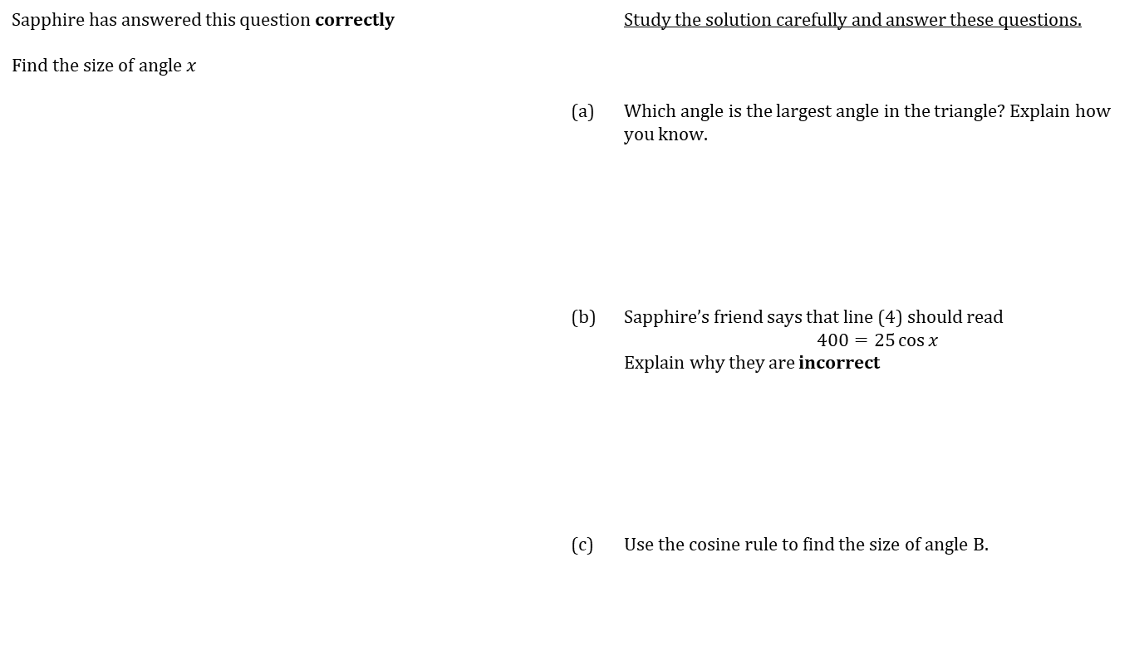
WORKED EXAMPLE
Cosine Rule - finding an angle
Sapphire has answered this question correctly |  |  | Study the solution carefully and answer these questions.
Find the size of angle $x$
 |  | (a) | Which angle is the largest angle in the triangle? Explain how you know.
 |  | (b) | Sapphire’s friend says that line (4) should read $$400=25\cos{x}$$ Explain why they are incorrect
 |  | (c) | Use the cosine rule to find the size of angle B.
$$x°$$
10 cm
15 cm
20 cm

Slide 30
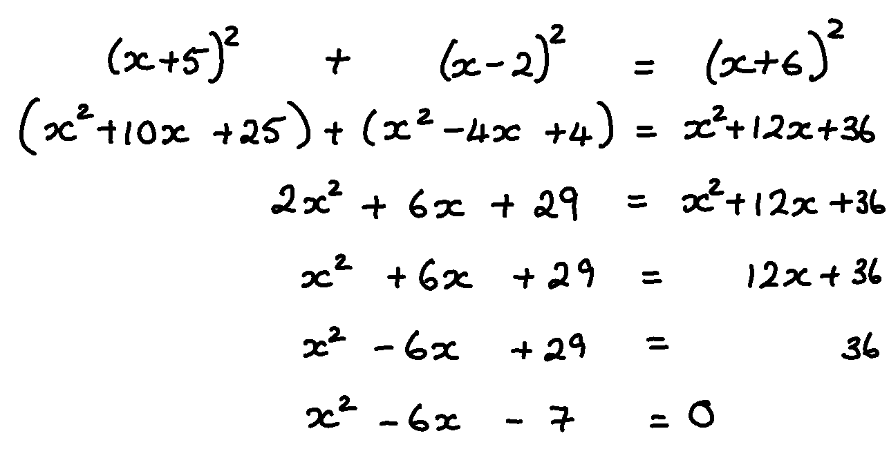

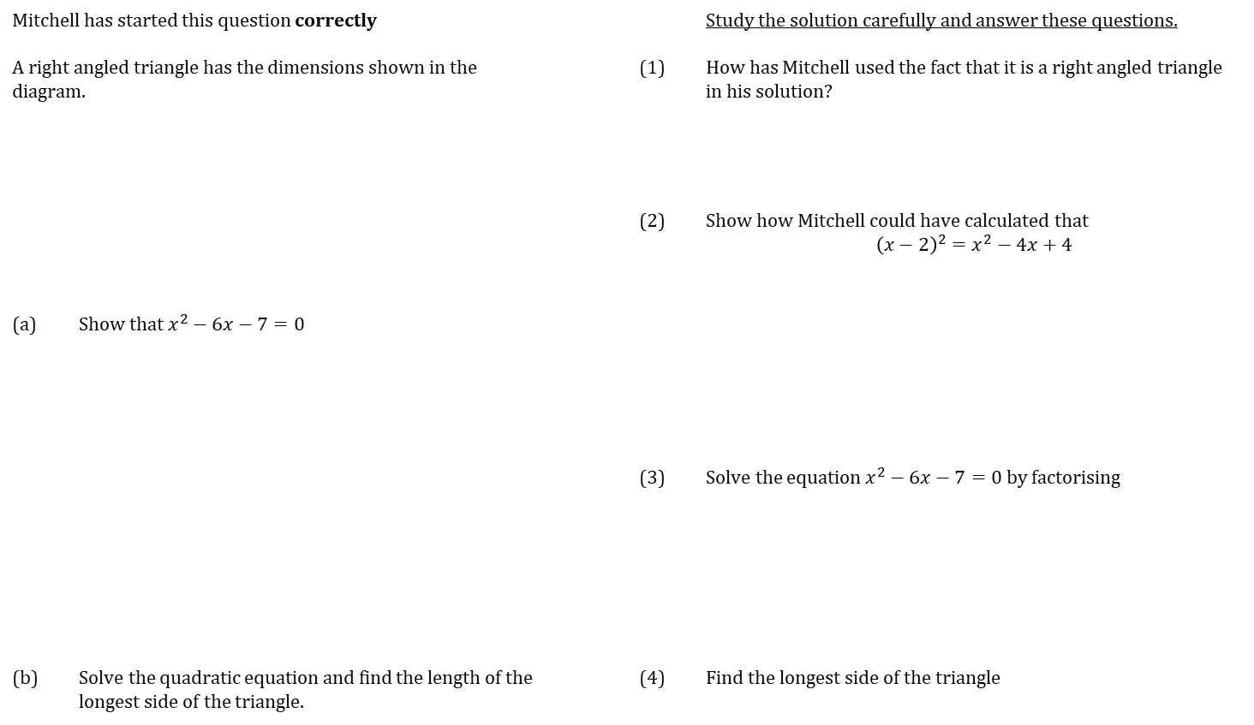


WORKED EXAMPLE
SET UP AND SOLVE QUADRATICS
Mitchell has started this question correctly |  |  |  | Study the solution carefully and answer these questions.
A right angled triangle has the dimensions shown in the diagram. | A right angled triangle has the dimensions shown in the diagram. |  | (1) | How has Mitchell used the fact that it is a right angled triangle in his solution?
 |  |  | (2) | Show how Mitchell could have calculated that $${\left(x−2\right)}^{2}=x^{2}−4x+4$$
(a) | Show that $x^{2}−6x−7=0$
 |  |  | (3) | Solve the equation $x^{2}−6x−7=0$ by factorising
(b) | Solve the quadratic equation and find the length of the longest side of the triangle. |  | (4) | Find the longest side of the triangle
$$\left(x+6\right)\text{cm}$$
$$\left(x−2\right)\text{cm}$$
$$\left(x+5\right)\text{cm}$$

Slide 31
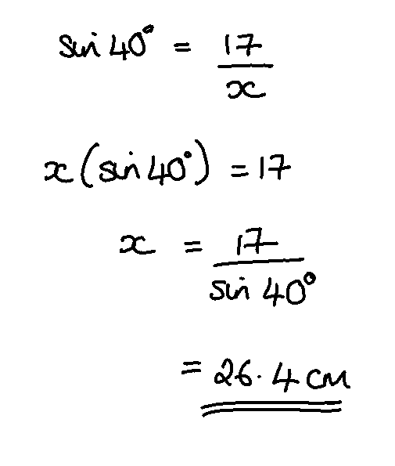




WORKED EXAMPLE
Trigonometry Finding Lengths
Veronica has answered this question correctly |  |  | Study the solution carefully and answer these questions.
Find the length of $x$ |  | (1) | How does Veronica know to use the sine ratio?
 |  | (2) | Veronica’s friend types $17\left(\sin{40°}\right)$ into their calculator and gets the answer: $$10.9 \text{cm}$$ Explain how they can tell they have made a mistake.
 |  | (3) | What if the question was:
 |  | (a) | Which trigonometric ratio would you use?
 |  | (b) | What would your working look like?
$x$ cm
17 cm
$$40°$$
10 cm
$$40°$$
$x$ cm

Slide 32
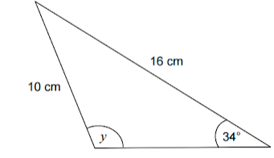
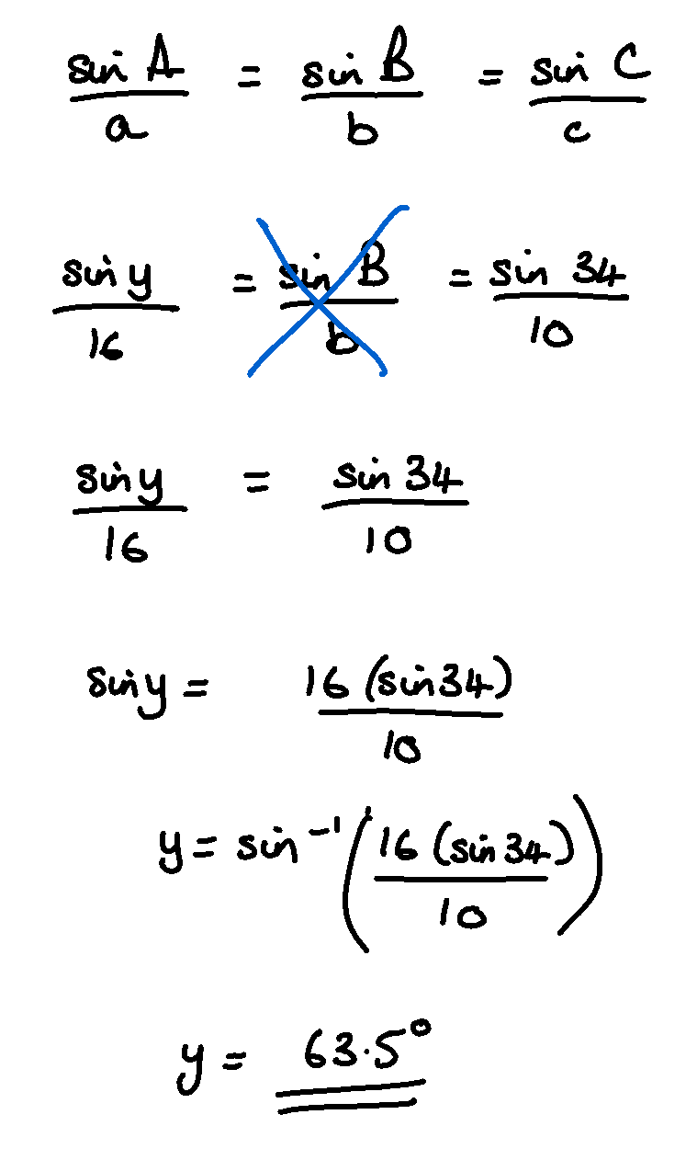

WORKED EXAMPLE
Sine Rule – obtuse angles
Jack has answered this question incorrectly |  |  | Study the solution carefully and answer these questions.
In the triangle, angle $y$ is obtuse.
Work out the size of angle $y$ |  | (1) | Explain how Jack can work out that his angle is incorrect.
 |  | (2) | Sketch the curve $y=\sin{x}$
 |  | (3) | Add an additional line to the end of Jack’s answer to make it correct

Slide 33


WORKED EXAMPLE
Combining inequalities
Veronica has answered this question correctly |  |  | Study the solution carefully and answer these questions.
Find the set of values for which both these inequalities are true $$3x+2>7 \text{and} x^{2}−3x−4≤0$$ |  | (1) | Explain why the solution set is the intersection of the valid range for two inequalities
 |  | (2) | If the question was Find the set of values for which both these inequalities are true $$3x+2<7 \text{and} x^{2}−3x−4≥0$$
 |  | (a) | Draw a number line showing the solutions sets for both inequalities separately.
 |  | (b) | Write down the single solution set that is valid for both inequalities.

Slide 34




WORKED EXAMPLE
Trigonometry Finding Angles
Jordan has answered this question correctly |  |  | Study the solution carefully and answer these questions.
Find the length of $x$ |  | (1) | How does Jordan know to use the tangent ratio?
 |  | (2) | Jordan’s friend has their calculator in the wrong mode. They get an answer of 0.359. Explain how they can tell they have a wrong answer.
 |  | (3) (a) | What mode should their calculator be in?
 |  | (b) | How can they check this?
 |  | (c) | What keys should they press to put it in the correct mode?
 |  | (4) | What if the question was
 |  |  | What would your first line of working look like?
3 cm
$$θ$$
8 cm
10 cm
$$θ$$
7 cm

Slide 35



WORKED EXAMPLE
Area of a circle
Matias has answered this question correctly |  |  | Study the solution carefully and answer these questions.
Calculate the area of the following circle |  | (1) | Matias’s friend typed the following in his calculator. $$π×2.5=$$ $${\text{ANS}}^{2}=$$
 |  |  | How would you explain to them that $π{\left(2.5\right)}^{2}$ is not the same as their calculation?
 |  | (2) | What if the question asked you to find the area of this shape?
 |  |  | How would you split this shape up? What calculations would you need to do?
5 cm

Slide 36


WORKED EXAMPLE
Circumference of a circle
Leo has answered this question correctly |  |  | Study the solution carefully and answer these questions.
Calculate the circumference of a circle with diameter 12 cm |  | (1) | Why might is be useful to leave your answer as $12π$ cm?
 |  | (2) | What if the question had said: Calculate the circumference of a circle is radius 8 cm. What would your first line of working be?

Slide 37



WORKED EXAMPLE
Angles in Polygons - with algebra
Declan has answered this question correctly |  | Study the solution carefully and answer these questions
The interior angle of a regular polygon is 11 times the size of the exterior angle. How many sides does it have? |  | (1) | What fact does Declan use when he writes down $12e=180$?
 |  | (2) | What if the question was
 |  |  | The interior angle of a regular polygon is $100°$ more than the exterior angle.
 |  |  | Complete the diagram and then answer the question.
https://ag-web.completemaths.com/files/c3a4e1d2-0dad-4a62-8775-65cbe3b22b45

Slide 38


WORKED EXAMPLE
Angles in Polygons
Zahra has answered this question correctly |  | Study the solution carefully and answer these questions
The interior angle sum of a polygon is 4140°, how many sides does this polygon have? |  | (1) | Zahra’s friend did the same question and got an answer of $n=25.5$. How do they know immediately that they have made a mistake?
 |  | (2) | What if the question was
 |  |  | The interior angle sum of a polygon is 3240°, how many sides does this polygon have?
 |  |  | What would your working look like?
https://ag-web.completemaths.com/files/c3a4e1d2-0dad-4a62-8775-65cbe3b22b45

Slide 39



WORKED EXAMPLE
Back Bearings
Emma has answered this question incorrectly |  |  | Study the solution carefully and answer these questions.
Find the bearing of A from B |  | (1) | What key point about bearings has Emma forgotten?
 |  | (2) | Write a correct solution to the question.
 |  | (3) | What if the question said: Find the bearing from B to A?

Slide 40


WORKED EXAMPLE
Unknown intersection
This question has been answered correctly |  |  | Study the solution carefully and answer these questions.
In a class of 30 pupils, 20 like football, 12 like rugby and 4 like neither. Suppose $n$ pupils like both football and rugby. (a) Write down an expression for the number of pupils who like football but not rugby. (b) Draw a Venn diagram using expressions where necessary. (c) Find $n$ |  | (1) | Use a similar method to answer this question. 40 teenagers have all seen Harry Potter and the Deathly Hallows 22 have seen it on DVD 23 have streamed it 17 saw it at the cinema 12 have seen it on DVD and streamed it 6 have streamed it and seen it at the cinema 7 have seen it on DVD and at the cinema How many have seen it in all three formats?

Slide 41


WORKED EXAMPLE
Probability trees without replacement
Jordan has answered this question correctly |  |  | Study the solution carefully and answer these questions.
In a sock drawer there are 11 black socks and 8 navy blue socks. What is the probability that, if I select two socks in the dark, both my socks are the same colour? |  | (1) | Explain how Jordan worked out the probability of $\frac{10}{18}$ on the second set of branches
 |  | (2) | What is the probability that the second sock is black?
 |  | (3) | Draw the tree diagram if there were 5 black socks and 1 navy sock

