Slide 1


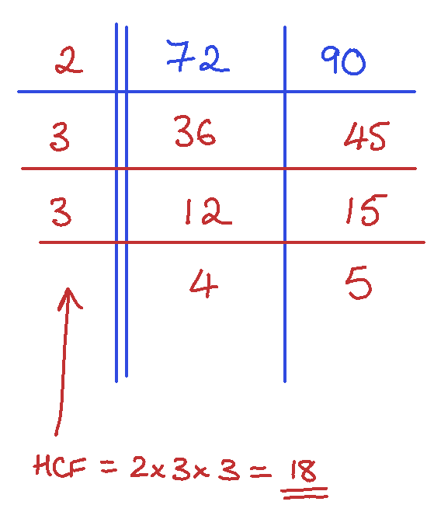
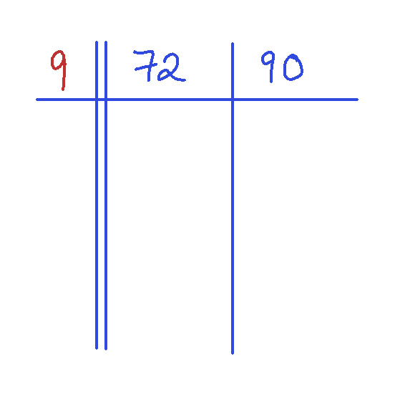
WORKED EXAMPLE
HCF by division
Gautam has used division to correctly answer this question. | Study the solution carefully and answer these questions
Find the HCF of 72 and 90 | (1) | Gautam’s friend say you don’t have to use prime factors for the dividing Complete this grid to show they are correct.
 | (2) | Use this method to find the HCF of 200 and 96

Slide 2
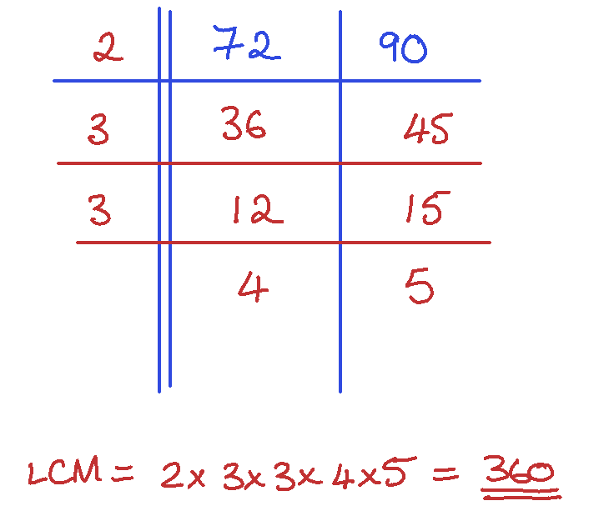
WORKED EXAMPLE
LCM by division
Gautam has used division to correctly answer this question. | Study the solution carefully and answer these questions
Find the LCM of 72 and 90 | (1) | Gautam’s friend say you don’t have to use prime factors for the dividing Complete this grid to show they are correct.
 | (2) | Use this method to find the LCM of 200 and 96

Slide 3
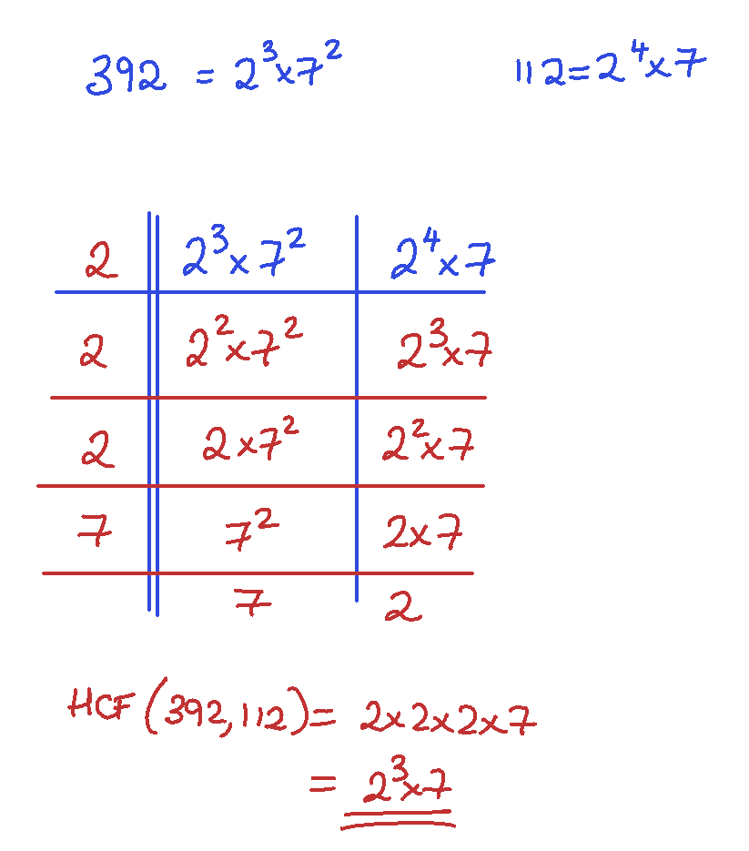

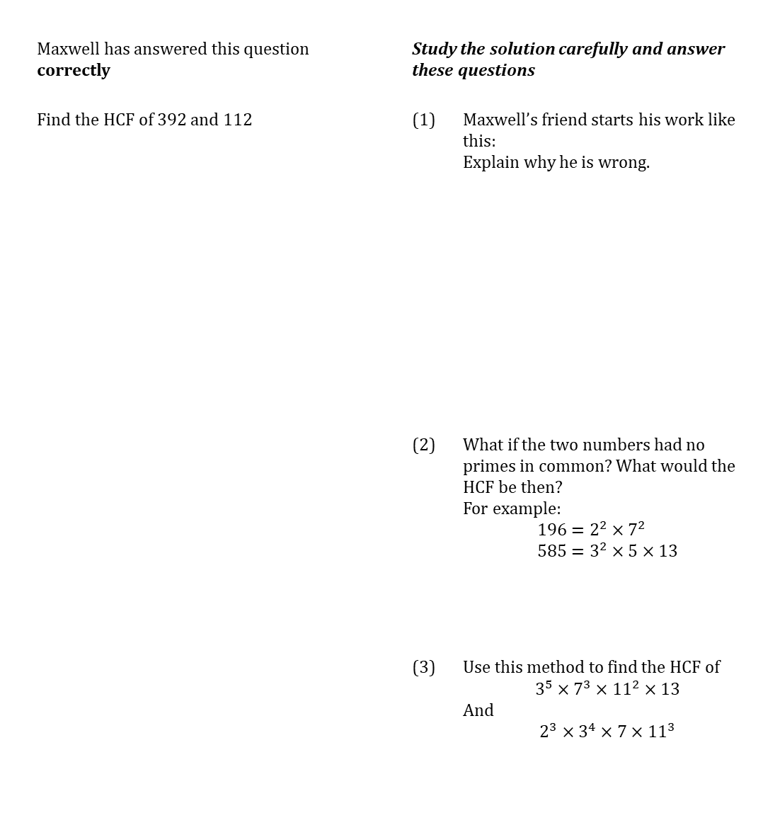
WORKED EXAMPLE
HCF for larger numbers
 | Maxwell has answered this question correctly |  | Study the solution carefully and answer these questions
 | Find the HCF of 392 and 112 |  | (1) | Maxwell’s friend starts his work like this: Explain why he is wrong.
 |  |  | (2) | What if the two numbers had no primes in common? What would the HCF be then? For example: $$196=2^{2}×7^{2} \\ 585=3^{2}×5×13$$
 |  |  | (3) | Use this method to find the HCF of $$3^{5}×7^{3}×{11}^{2}×13$$ And $$2^{3}×3^{4}×7×{11}^{3}$$

Slide 4
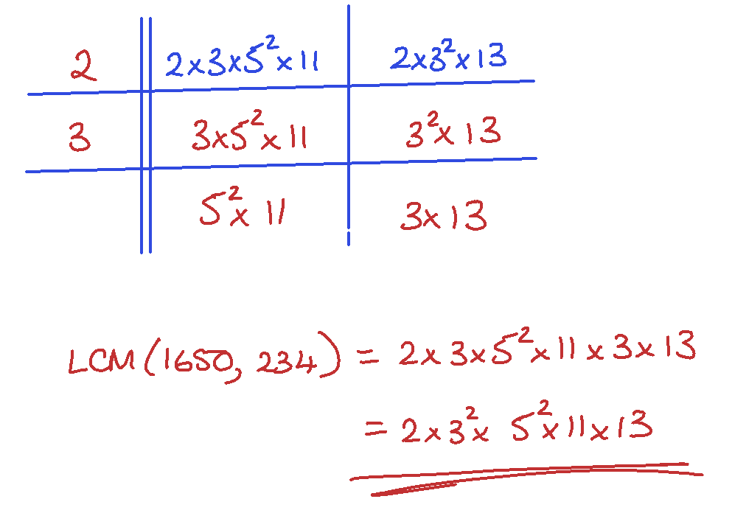
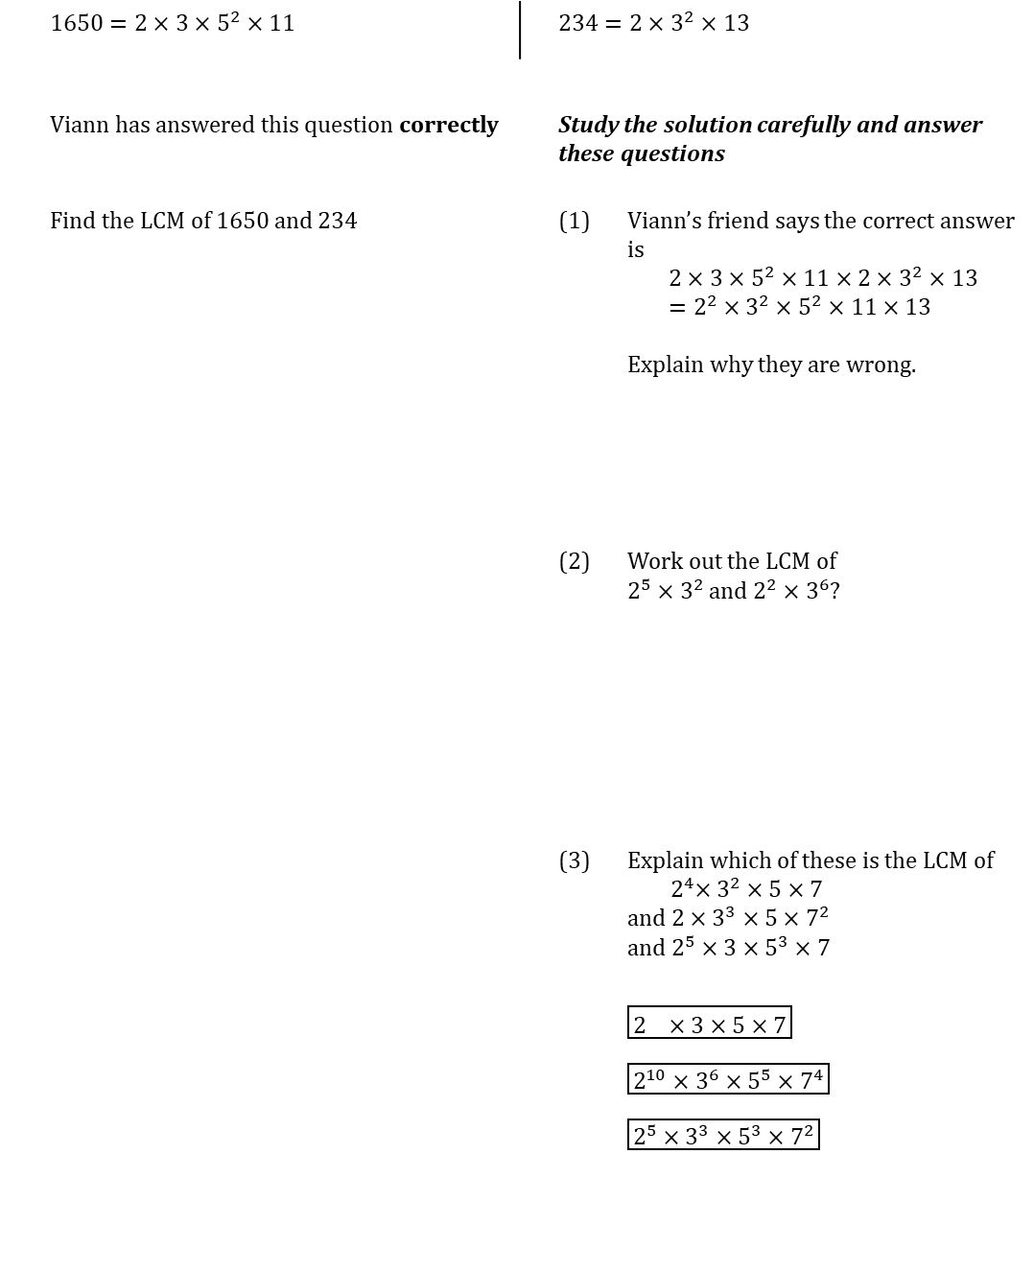
WORKED EXAMPLE
LCM for larger numbers
 | $1650=2×3×5^{2}×11$ |  | $234=2×3^{2}×13$
 | Viann has answered this question correctly |  | Study the solution carefully and answer these questions
 | Find the LCM of 1650 and 234 |  | (1) | Viann’s friend says the correct answer is $$2×3×5^{2}×11×2×3^{2}×13 \\ =2^{2}×3^{2}×5^{2}×11×13$$ Explain why they are wrong.
 |  |  | (2) | Work out the LCM of $2^{5}×3^{2}$ and $2^{2}×3^{6}$?
 |  |  | (3) | Explain which of these is the LCM of ${ 2}^{4}×3^{2}×5×7$ and $2×3^{3}×5×7^{2}$ and $2^{5}×3×5^{3}×7$ $\boxed{2^{}×3×5×7}$ $\boxed{2^{10}×3^{6}×5^{5}×7^{4}}$ $\boxed{2^{5}×3^{3}×5^{3}×7^{2}}$

Slide 5
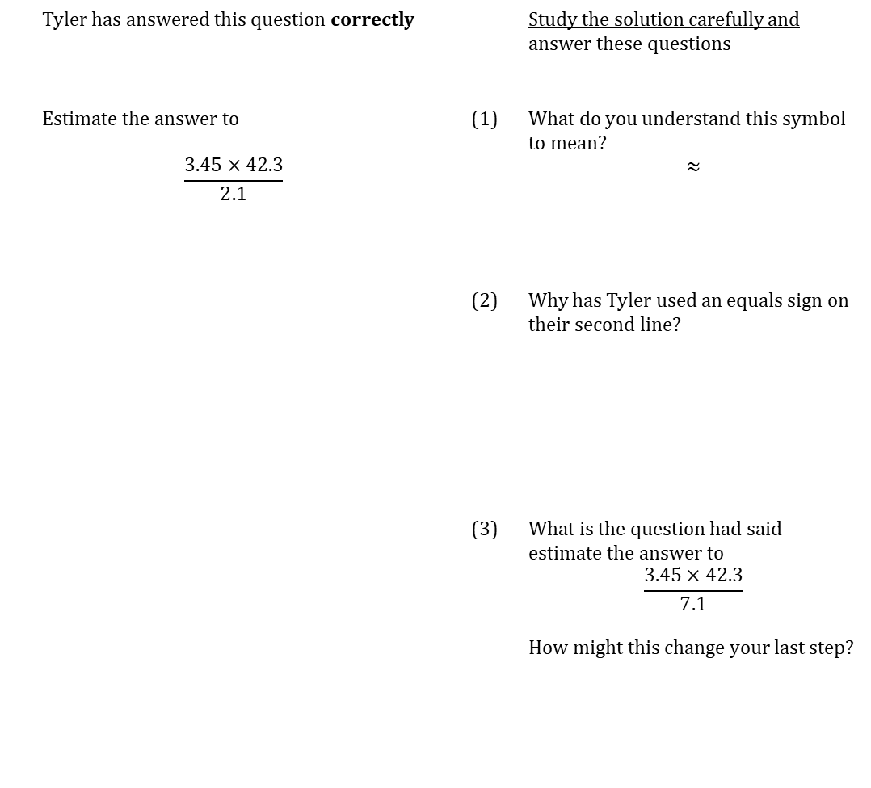
WORKED EXAMPLE
Estimating
 | Tyler has answered this question correctly |  |  | Study the solution carefully and answer these questions
 | Estimate the answer to $$\frac{3.45×42.3}{2.1}$$ |  | (1) | What do you understand this symbol to mean? $$≈$$
 |  |  | (2) | Why has Tyler used an equals sign on their second line?
 |  |  | (3) | What is the question had said estimate the answer to $$\frac{3.45×42.3}{7.1}$$ How might this change your last step?

Slide 6
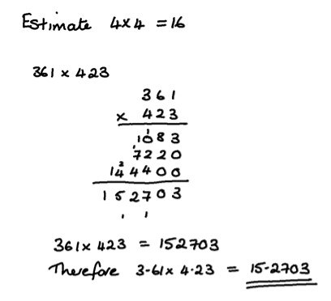
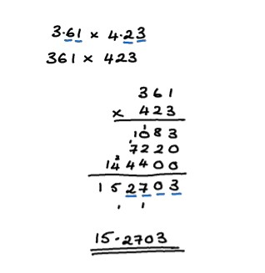
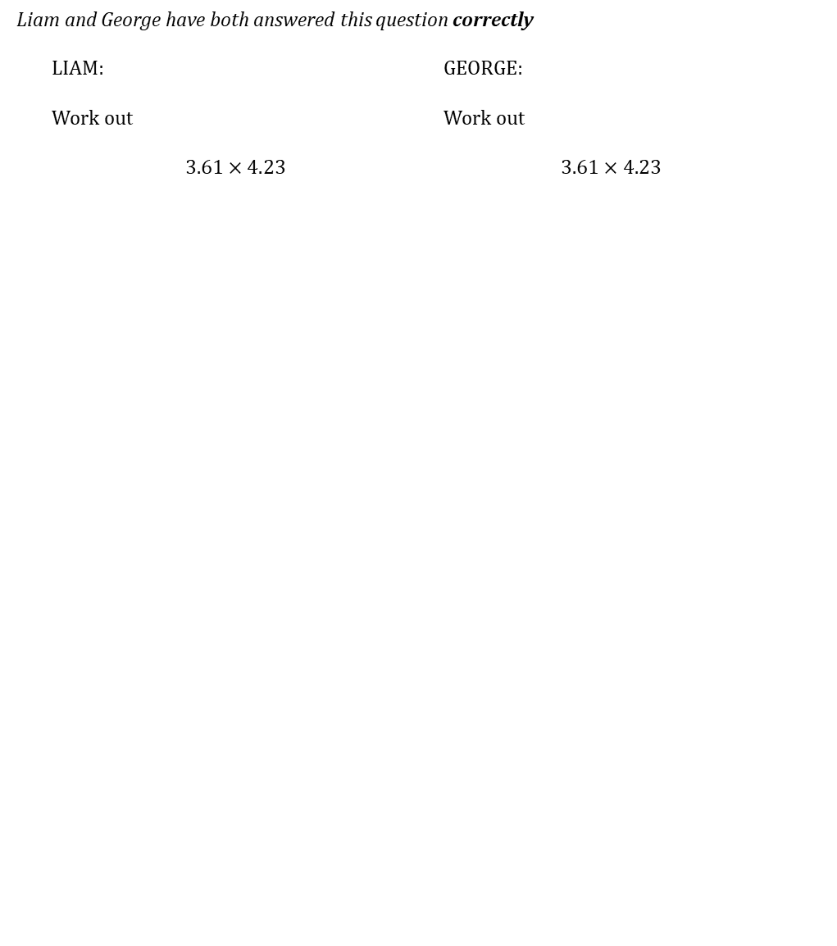
WORKED EXAMPLE
Decimal Multiplication page 1
Liam and George have both answered this question correctly
 | LIAM: | LIAM: | GEORGE:
 | Work out $$3.61×4.23$$ | Work out $$3.61×4.23$$ | Work out $$3.61×4.23$$

Slide 7
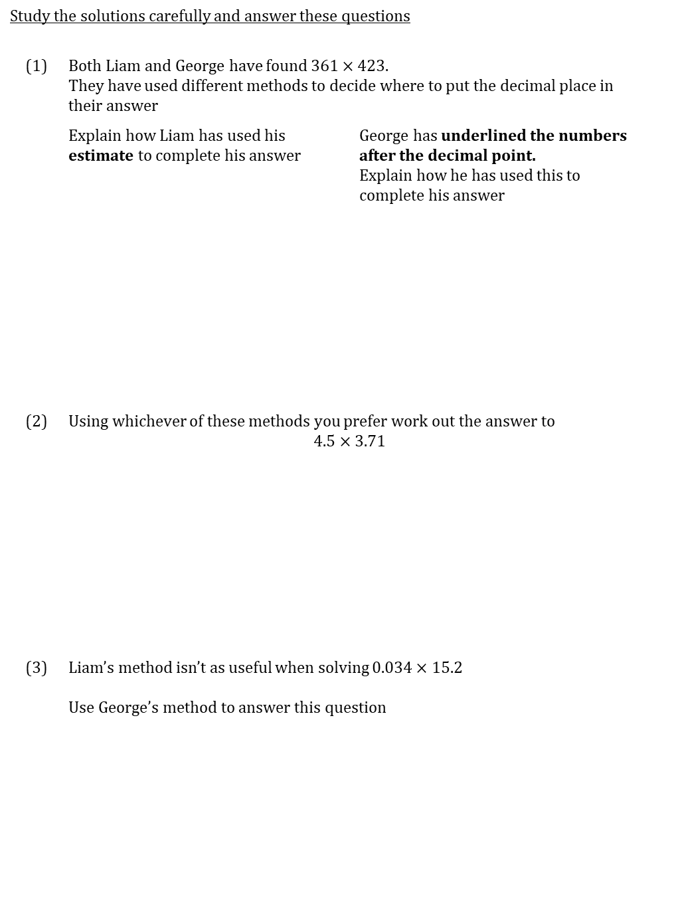
WORKED EXAMPLE
Decimal Multiplication page 2
Study the solutions carefully and answer these questions
(1) | Both Liam and George have found $361×423$. They have used different methods to decide where to put the decimal place in their answer
 | Explain how Liam has used his estimate to complete his answer | George has underlined the numbers after the decimal point. Explain how he has used this to complete his answer
(2) | Using whichever of these methods you prefer work out the answer to $$4.5×3.71$$
(3) | Liam’s method isn’t as useful when solving $0.034×15.2$ Use George’s method to answer this question

Slide 8
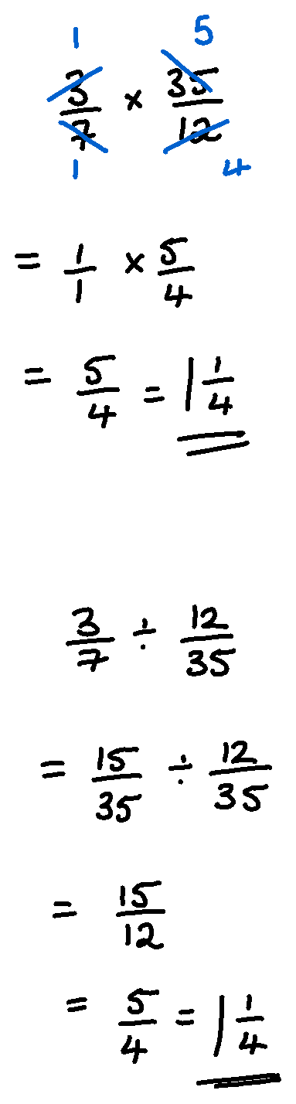
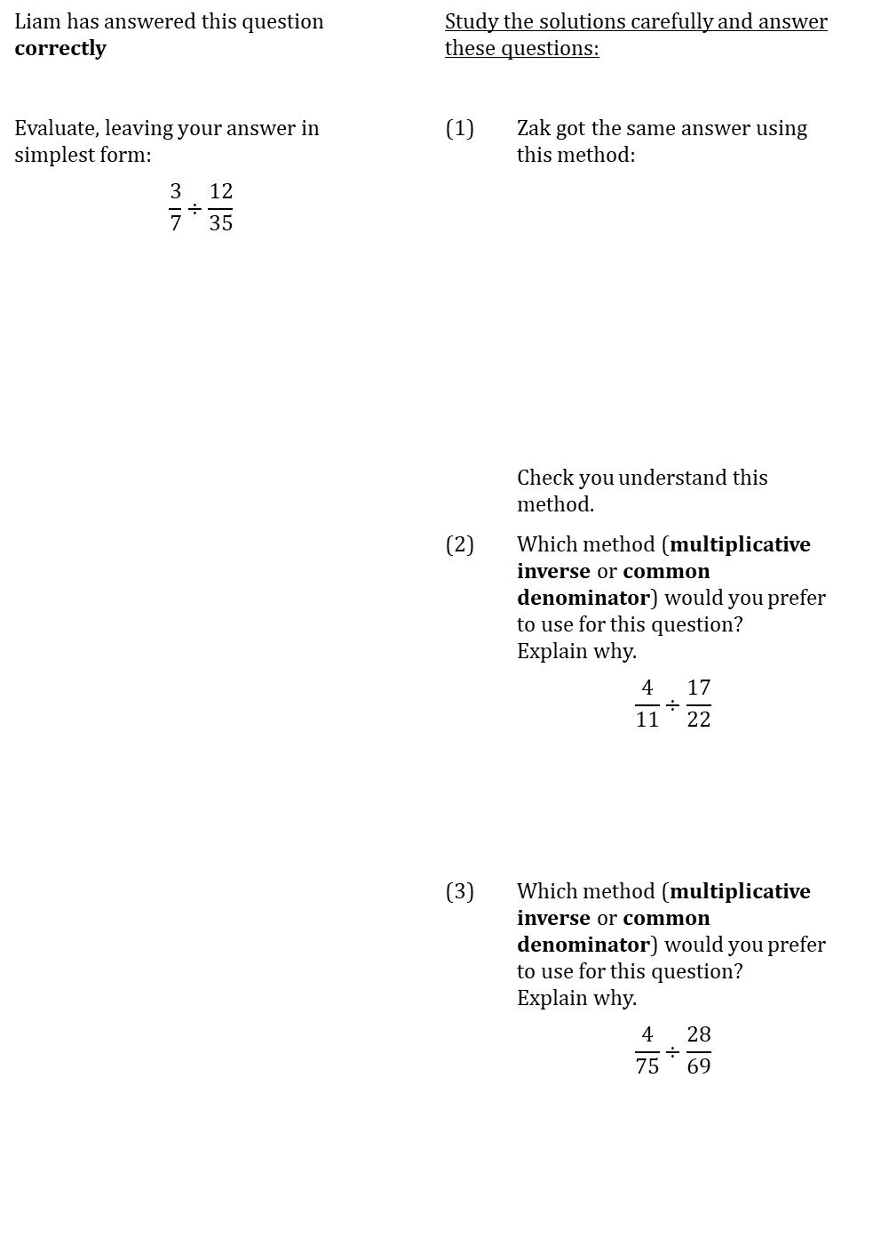
WORKED EXAMPLE
Dividing fractions
Liam has answered this question correctly |  | Study the solutions carefully and answer these questions:
Evaluate, leaving your answer in simplest form: |  | (1) | Zak got the same answer using this method:
$$\frac{3}{7}÷\frac{12}{35}$$
 |  |  | Check you understand this method.
 |  | (2) | Which method (multiplicative inverse or common denominator) would you prefer to use for this question? Explain why.
 |  |  | $$\frac{4}{11}÷\frac{17}{22}$$
 |  | (3) | Which method (multiplicative inverse or common denominator) would you prefer to use for this question? Explain why.
 |  |  | $$\frac{4}{75}÷\frac{28}{69}$$

Slide 9
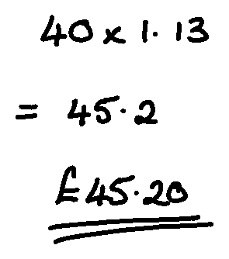
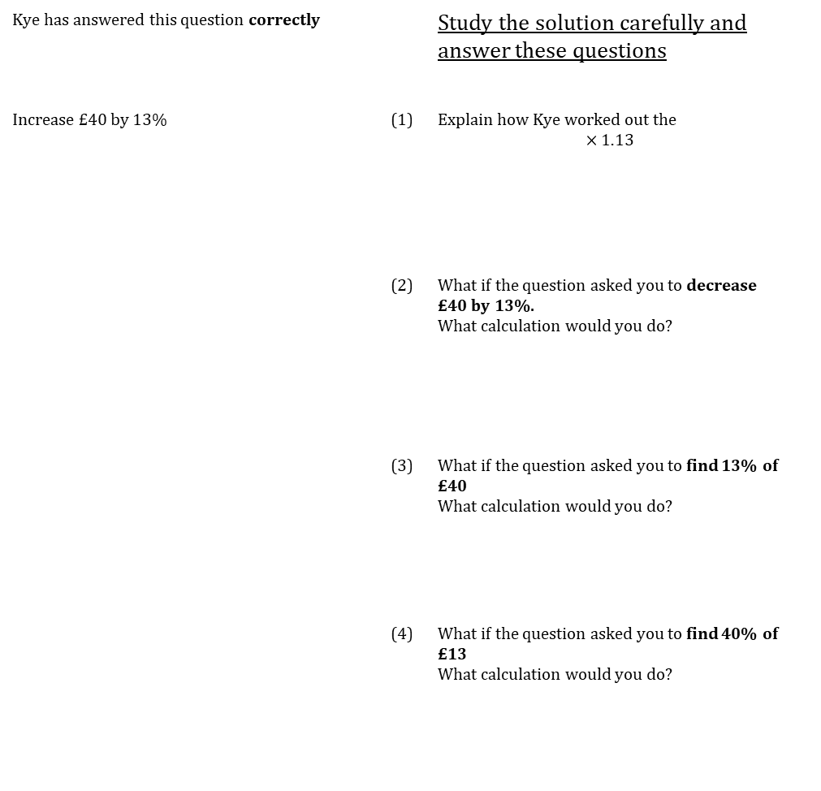
WORKED EXAMPLE
Percentage increase with multiplier
Kye has answered this question correctly |  |  | Study the solution carefully and answer these questions
Increase £40 by 13% |  | (1) | Explain how Kye worked out the $$×1.13$$
 |  | (2) | What if the question asked you to decrease £40 by 13%. What calculation would you do?
 |  | (3) | What if the question asked you to find 13% of £40 What calculation would you do?
 |  | (4) | What if the question asked you to find 40% of £13 What calculation would you do?

Slide 10
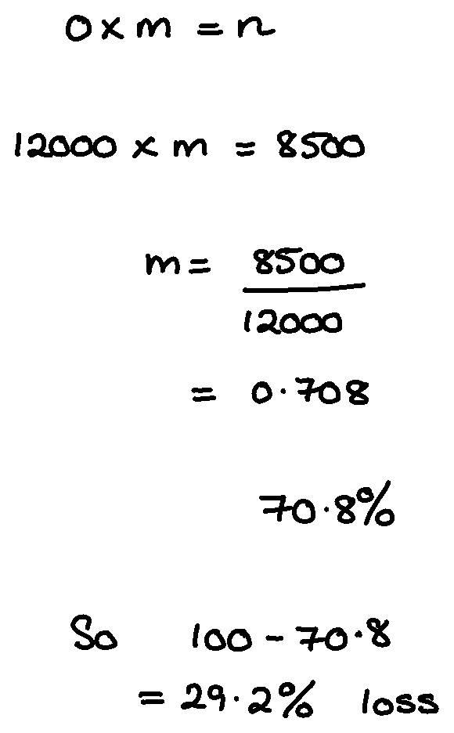
WORKED EXAMPLE
Percentage Change with multiplier
Carys has answered this question correctly |  |  | Study the solution carefully and answer these questions
I buy a car for £12000. I sell the car one year later for £8500. What percentage loss do I make? |  | (1) | Explain how a multiplier of 0.708 means the percentage loss is 29.2%
 |  | (2) | What if the question asked The population of a town rises from 3600 to 4000. What percentage increase is this? What would your solution look like?

Slide 11
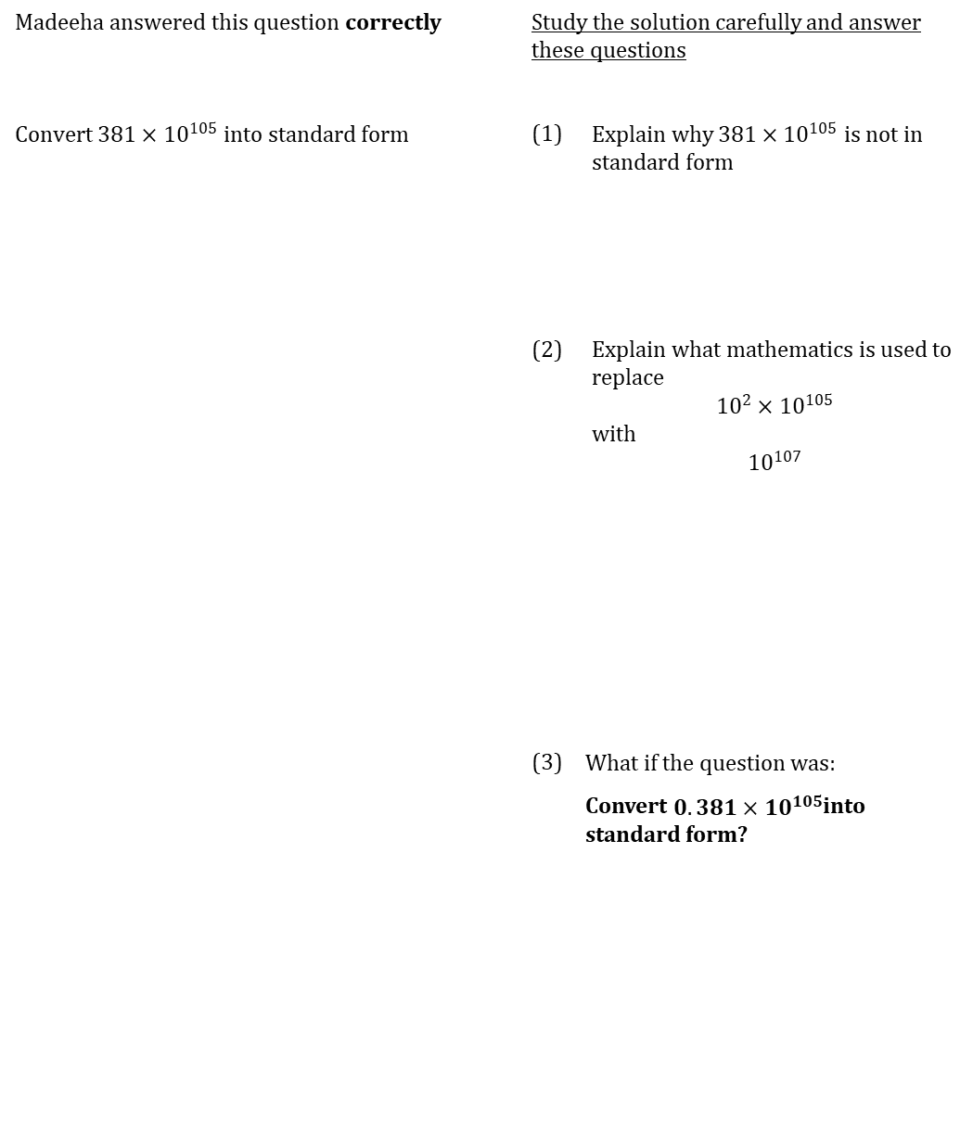
WORKED EXAMPLE
Standard Form
Madeeha answered this question correctly |  | Study the solution carefully and answer these questions | Study the solution carefully and answer these questions
Convert $381×{10}^{105}$ into standard form |  | (1) | Explain why $381×{10}^{105}$ is not in standard form
 |  | (2) | Explain what mathematics is used to replace $${10}^{2}×{10}^{105}$$ with $${10}^{107}$$
 |  | (3) | What if the question was:
 |  |  | Convert $0.381×{10}^{105}$into standard form?

Slide 12
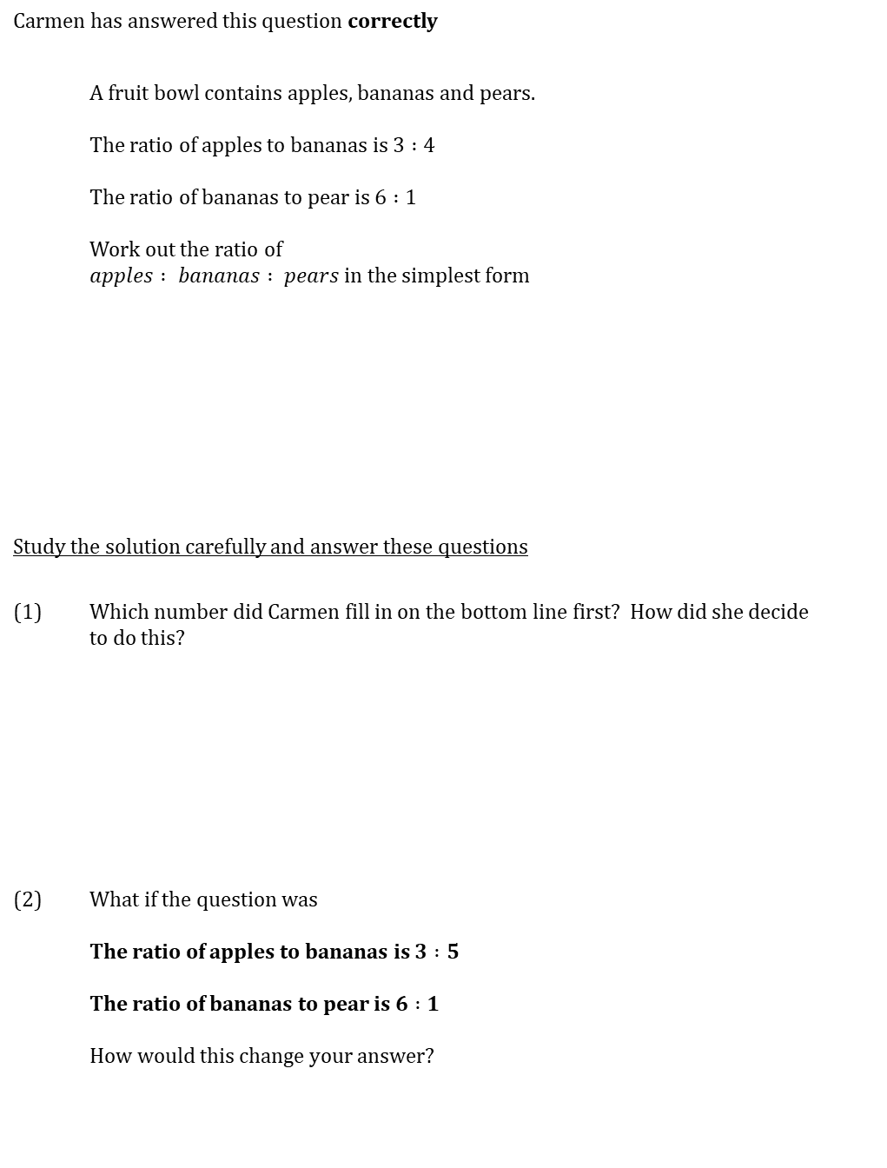
WORKED EXAMPLE
Combining Ratios
Carmen has answered this question correctly
 | A fruit bowl contains apples, bananas and pears. The ratio of apples to bananas is $3 :4$ The ratio of bananas to pear is $6 :1$ Work out the ratio of $apples : bananas : pears$in the simplest form
Study the solution carefully and answer these questions
(1) | Which number did Carmen fill in on the bottom line first? How did she decide to do this?
(2) | What if the question was The ratio of apples to bananas is $3 :5$ The ratio of bananas to pear is $6 :1$ How would this change your answer?

Slide 13
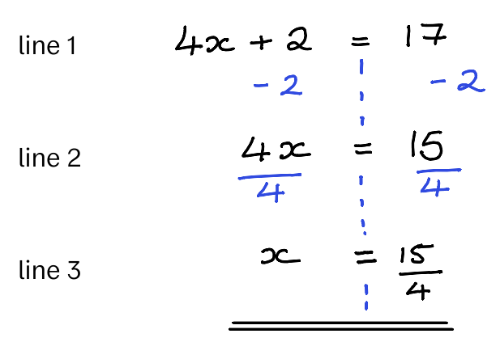
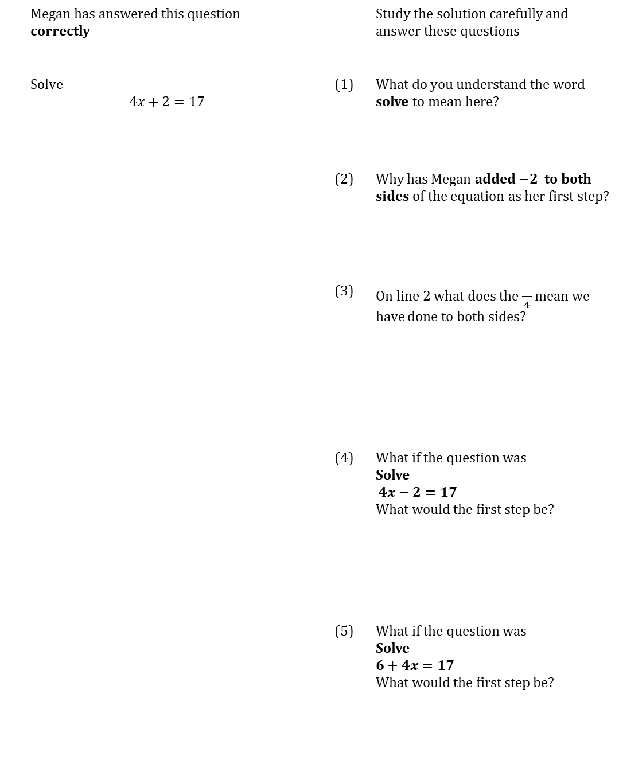
WORKED EXAMPLE
Two step equations
 | Megan has answered this question correctly |  |  | Study the solution carefully and answer these questions
 | Solve $$4x+2=17$$ |  | (1) | What do you understand the word solve to mean here?
 |  |  | (2) | Why has Megan added $−2$ to both sides of the equation as her first step?
 |  |  | (3) | On line 2 what does the $\frac{}{4}$ mean we have done to both sides?
 |  |  | (4) | What if the question was Solve $4x−2=17$ What would the first step be?
 |  |  | (5) | What if the question was Solve $6+4x=17$ What would the first step be?

Slide 14
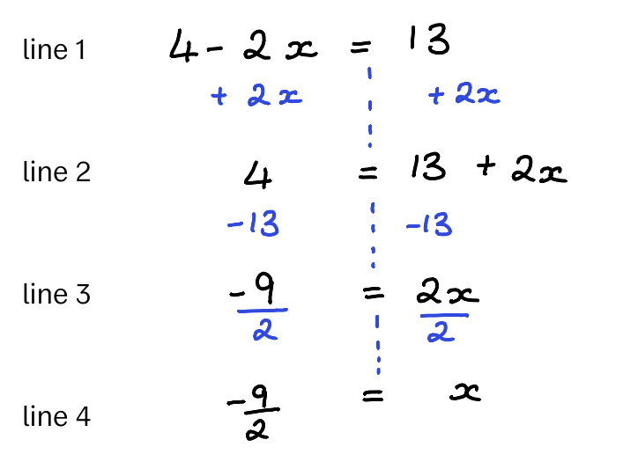
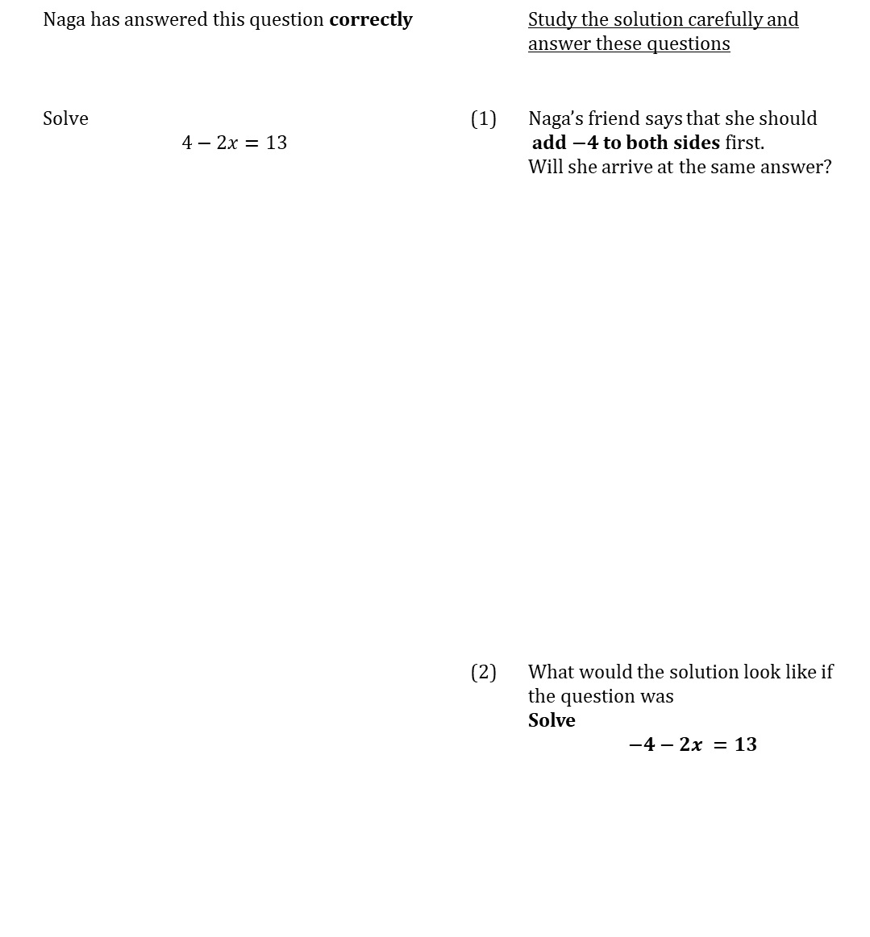
WORKED EXAMPLE
Two step equations negative coefficient
 | Naga has answered this question correctly |  |  | Study the solution carefully and answer these questions
 | Solve $$4−2x=13$$ |  | (1) | Naga’s friend says that she should add $−4$to both sides first. Will she arrive at the same answer?
 |  |  | (2) | What would the solution look like if the question was Solve $$−4−2x =13$$

Slide 15
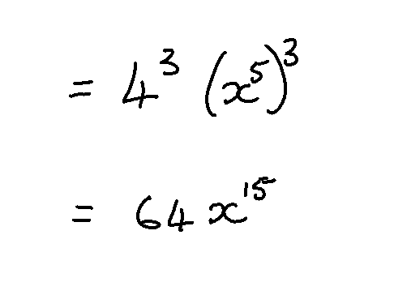

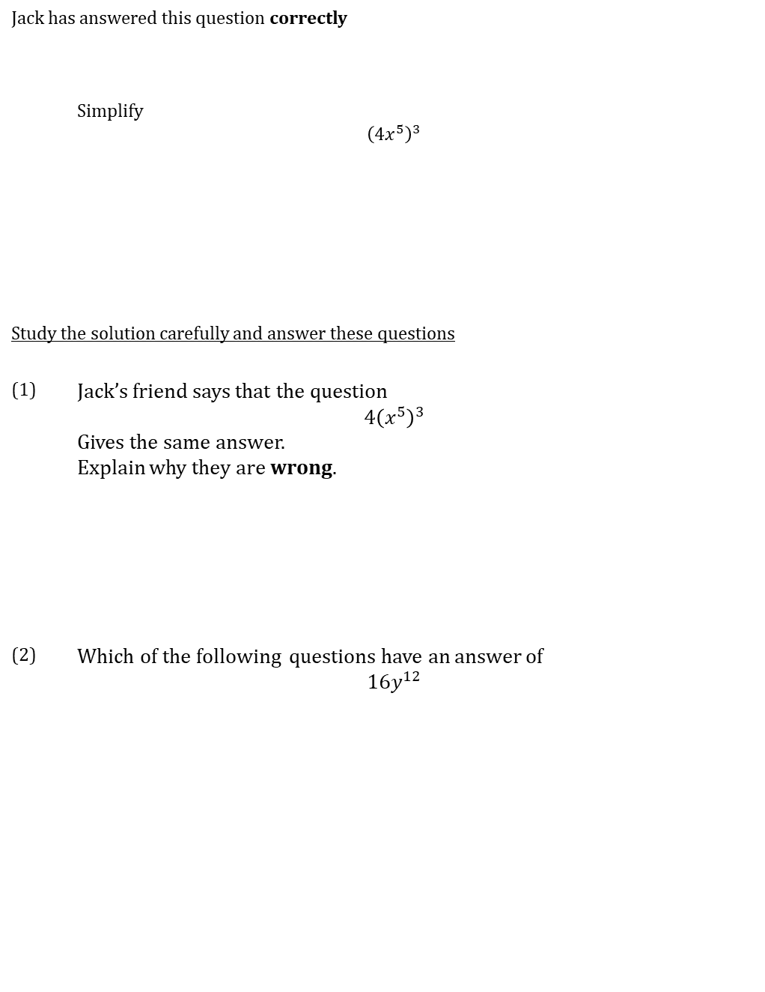
WORKED EXAMPLE
Power of a power
Jack has answered this question correctly
 | Simplify $${\left(4x^{5}\right)}^{3}$$
Study the solution carefully and answer these questions
(1) | Jack’s friend says that the question $$4{\left(x^{5}\right)}^{3}$$ Gives the same answer. Explain why they are wrong.
(2) | Which of the following questions have an answer of $$16y^{12}$$
$${\left(4x^{6}\right)}^{2}$$ | $${\left(16x^{4}\right)}^{3}$$ | $${\left(2x^{3}\right)}^{4}$$ | $${\left(4x^{10}\right)}^{2}$$

Slide 16
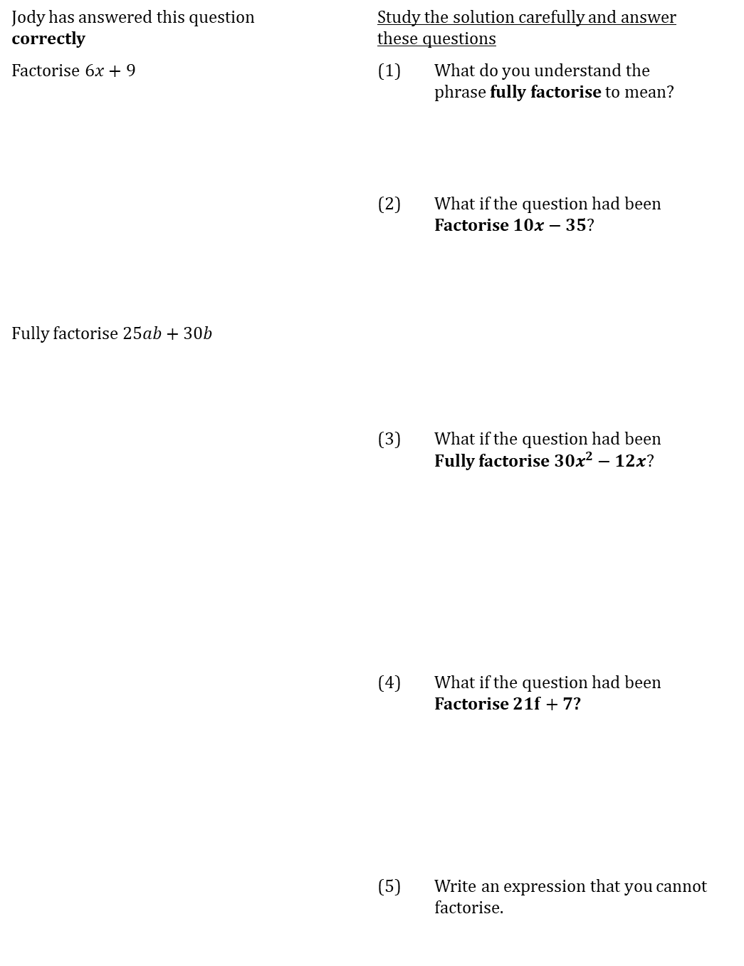
WORKED EXAMPLE
Factorising
Jody has answered this question correctly |  | Study the solution carefully and answer these questions
Factorise $6x+9$ |  | (1) | What do you understand the phrase fully factorise to mean?
 |  | (2) | What if the question had been Factorise $10x−35$?
Fully factorise $25ab+30b$
 |  | (3) | What if the question had been Fully factorise $30x^{2}−12x$?
 |  | (4) | What if the question had been Factorise $21f+7$?
 |  | (5) | Write an expression that you cannot factorise.

Slide 17
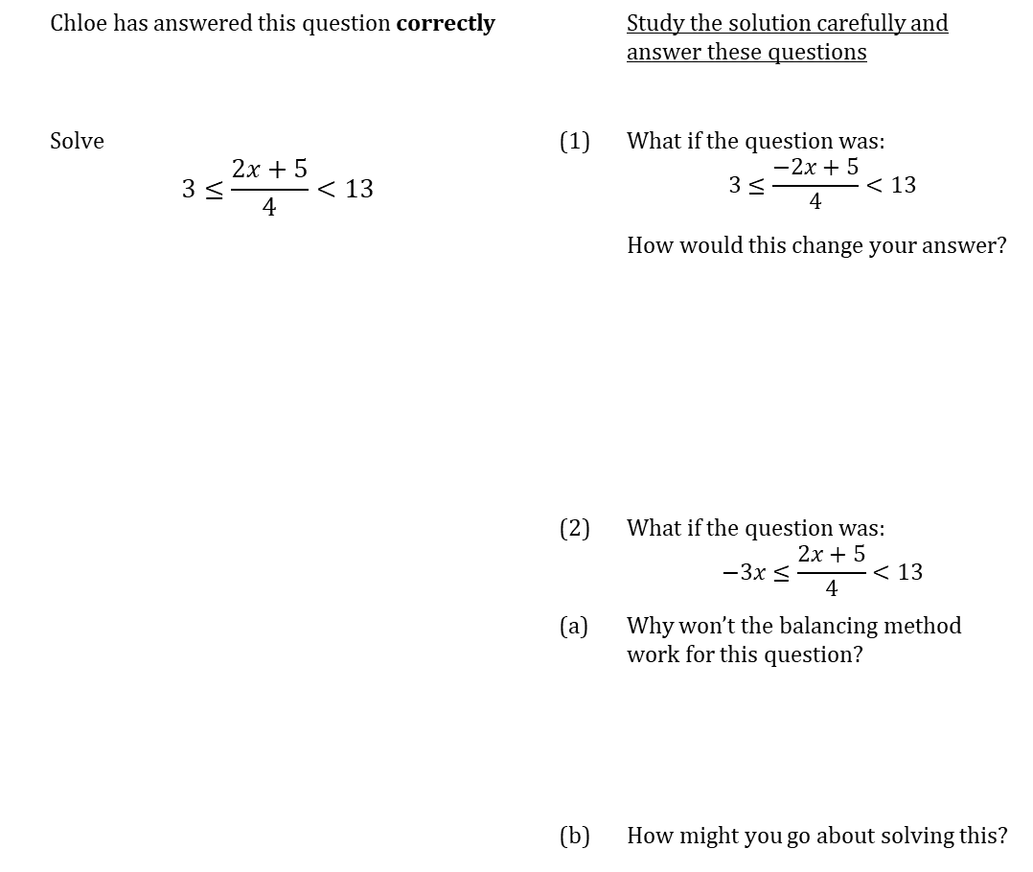
WORKED EXAMPLE
Double inequalities
 | Chloe has answered this question correctly |  |  | Study the solution carefully and answer these questions
 | Solve $$3≤\frac{2x+5}{4}<13$$ |  | (1) | What if the question was: $$3≤\frac{−2x+5}{4}<13$$
 |  |  |  | How would this change your answer?
 |  |  | (2) | What if the question was: $$−3x≤\frac{2x+5}{4}<13$$
 |  |  | (a) | Why won’t the balancing method work for this question?
 |  |  | (b) | How might you go about solving this?

Slide 18
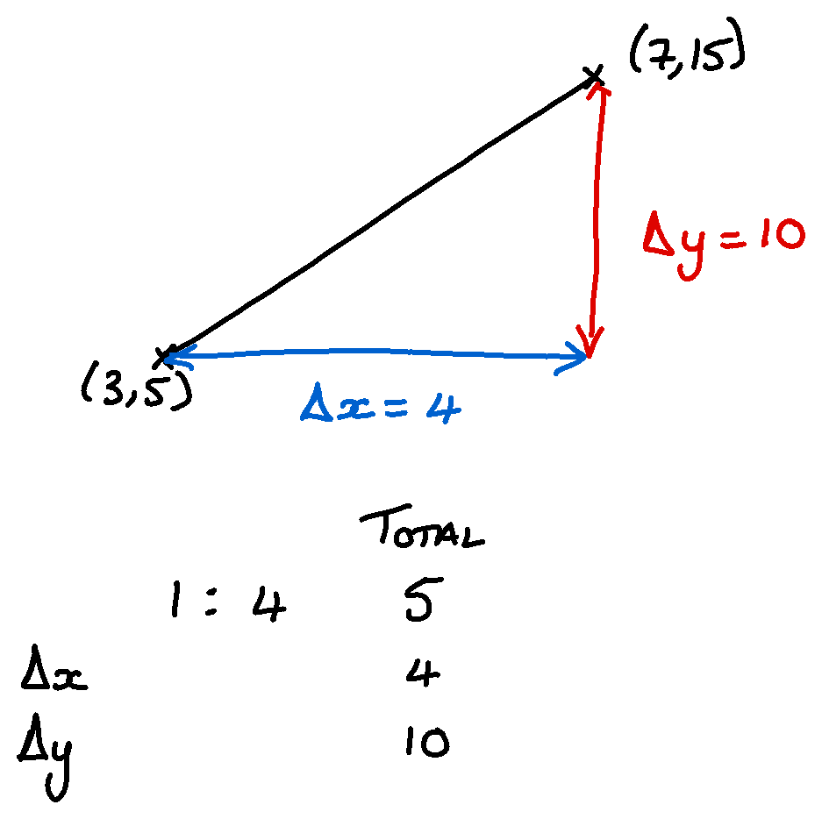
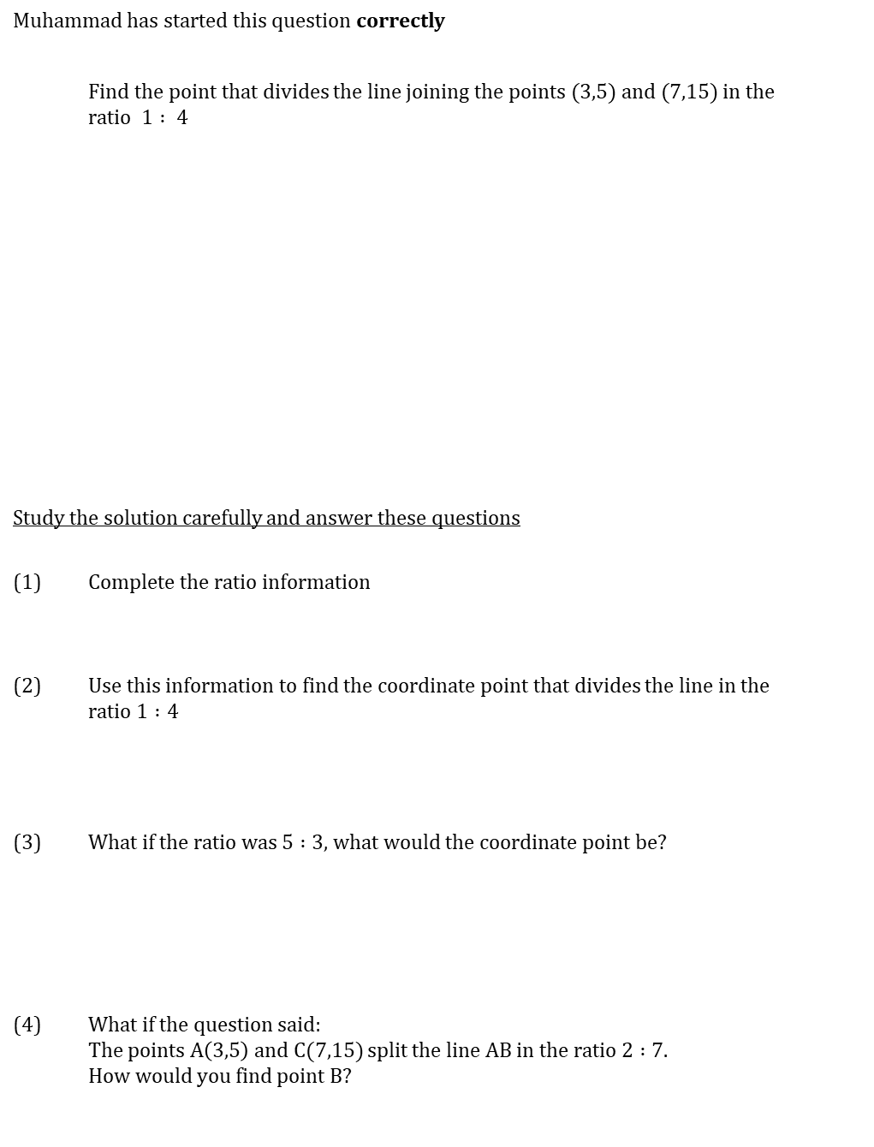
WORKED EXAMPLE
Ratio with Coordinates (FM)
Muhammad has started this question correctly
 | Find the point that divides the line joining the points $(3,5)$ and $(7,15)$ in the ratio $1 : 4$
Study the solution carefully and answer these questions
(1) | Complete the ratio information
(2) | Use this information to find the coordinate point that divides the line in the ratio $1 :4$
(3) | What if the ratio was $5 :3$, what would the coordinate point be?
(4) | What if the question said: The points A$\left(3,5\right)$ and C$(7,15)$ split the line AB in the ratio $2 :7.$ How would you find point B?

Slide 19
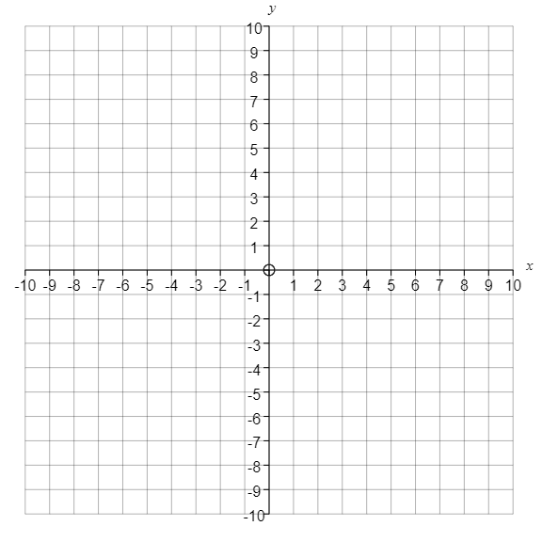
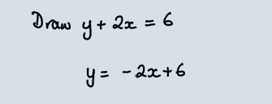
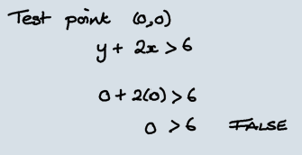




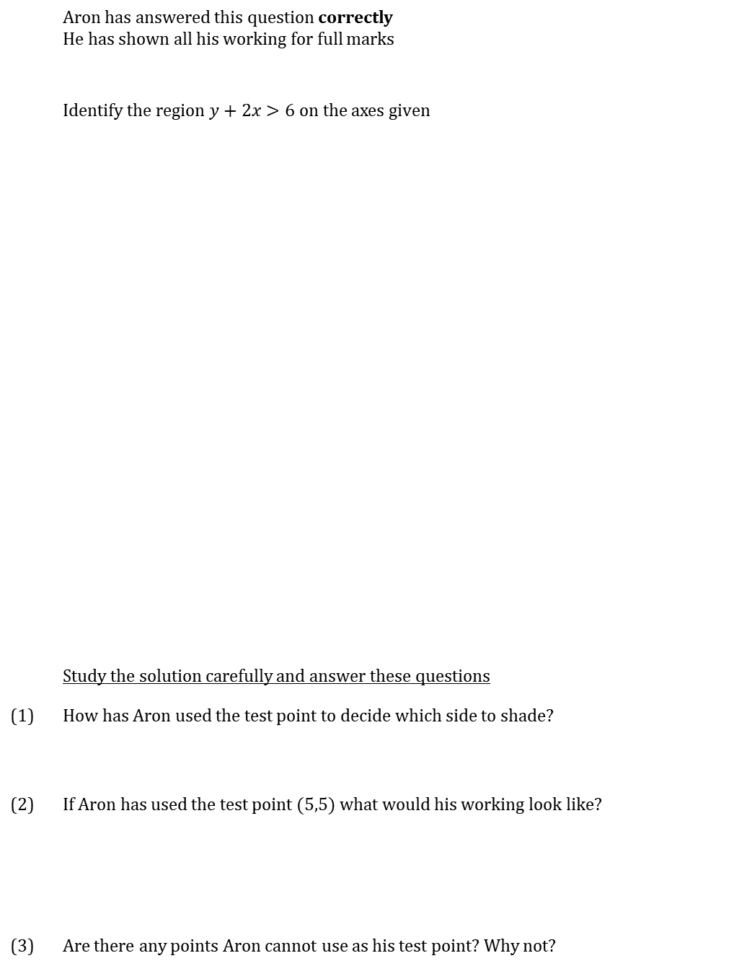














WORKED EXAMPLE
Shading inequalities
 | Aron has answered this question correctly He has shown all his working for full marks
 | Identify the region $y+2x>6$ on the axes given
 | Study the solution carefully and answer these questions
(1) | How has Aron used the test point to decide which side to shade?
(2) | If Aron has used the test point $(5,5)$ what would his working look like?
(3) | Are there any points Aron cannot use as his test point? Why not?

Slide 20
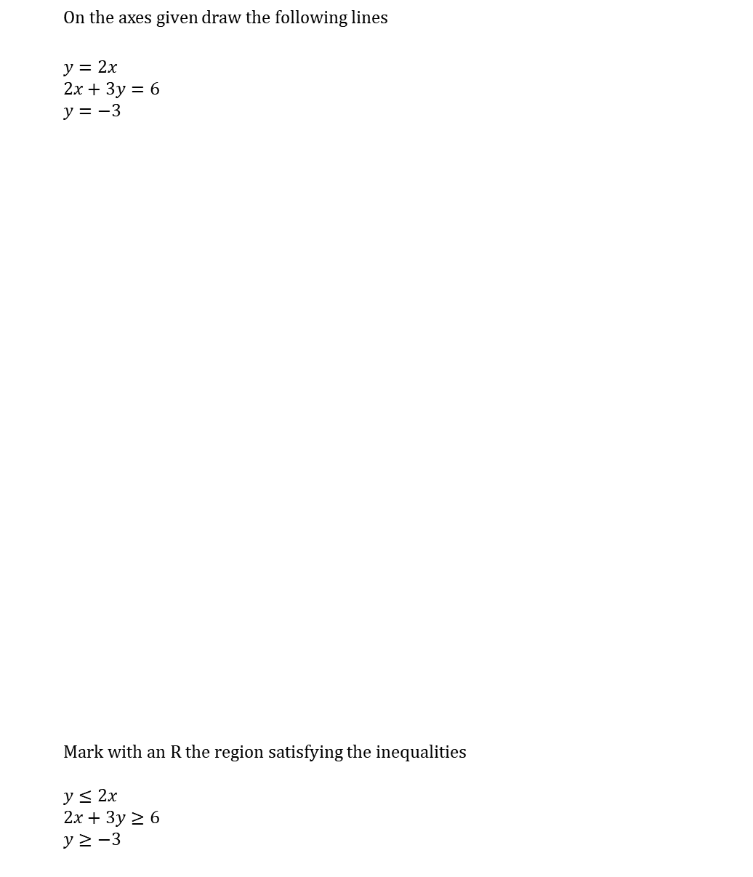
WORKED EXAMPLE
Regions
Remember you can choose to shade the true or false side.
With multiple inequalities, it’s often easier to shade the false side so you end up with a white space
 | On the axes given draw the following lines
 | $y=2x$ $2x+3y=6$ $y=−3$
 | Mark with an R the region satisfying the inequalities $y≤2x$ $2x+3y≥6$ $y≥−3$

Slide 21
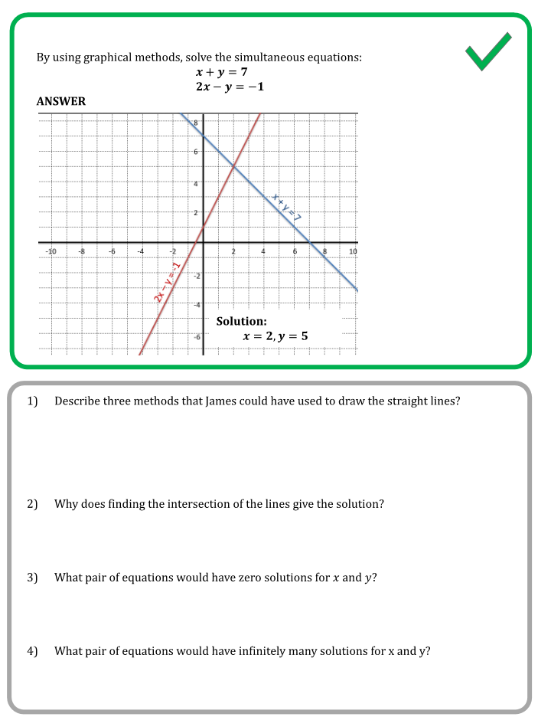
WORKED EXAMPLE
Simultaneous Equations graphical

Slide 22
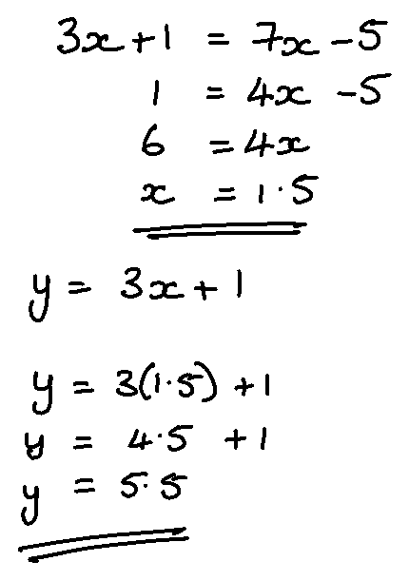
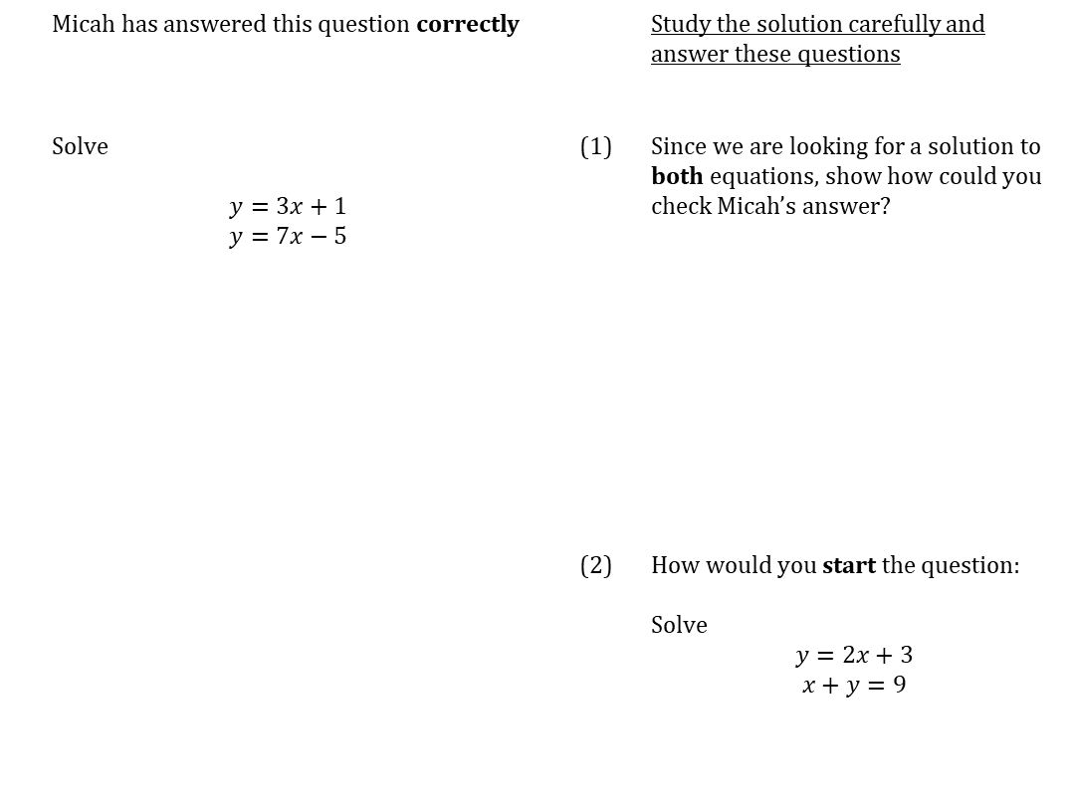
WORKED EXAMPLE
Substitution
 | Micah has answered this question correctly |  |  | Study the solution carefully and answer these questions
 | Solve $$y=3x+1$$ $$y=7x−5$$ |  | (1) | Since we are looking for a solution to both equations, show how could you check Micah’s answer?
 |  |  | (2) | How would you start the question: Solve $$y=2x+3$$ $$x+y=9$$

Slide 23
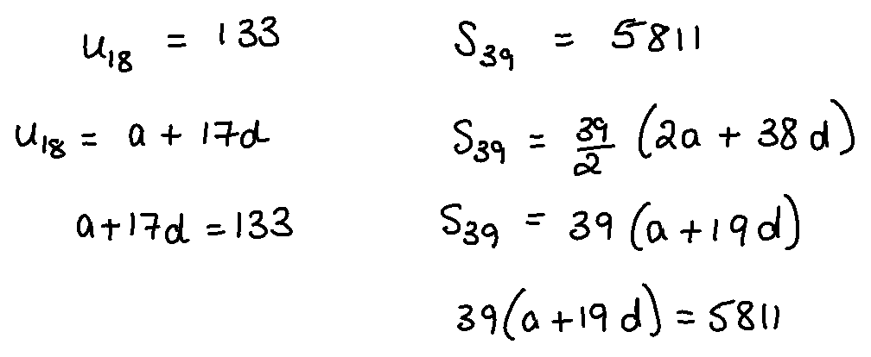


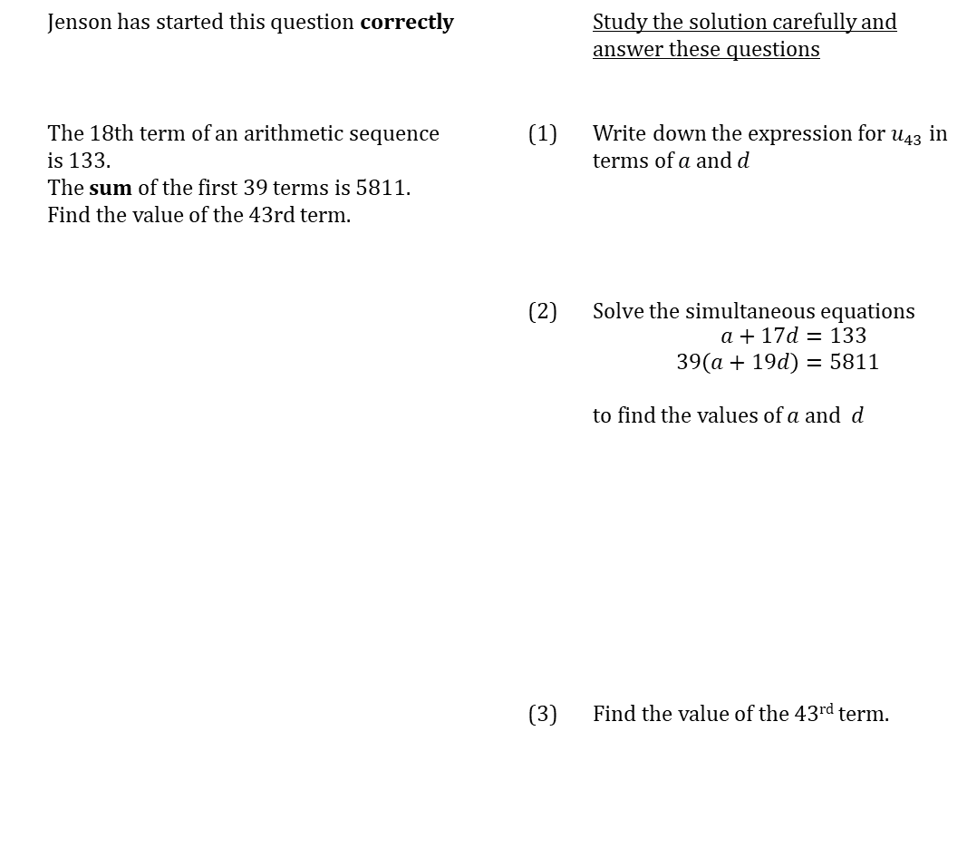
NOTES
Arithmetic Sequences19
$$u_{n}=a+\left(n−1\right)d$$
$$S_{n}=\frac{n}{2}\left[2a+\left(n−1\right)d\right]$$
WORKED EXAMPLE
Arithmetic Sequences
 | Jenson has started this question correctly |  |  | Study the solution carefully and answer these questions
 | The 18th term of an arithmetic sequence is 133. The sum of the first 39 terms is 5811. Find the value of the 43rd term. |  | (1) | Write down the expression for $u_{43}$ in terms of $a$ and $d$
 |  |  | (2) | Solve the simultaneous equations $$\begin{aligned}a+17d&=133 \\ 39\left(a+19d\right)&=5811\end{aligned}$$ to find the values of $a$ and $d$
 |  |  | (3) | Find the value of the 43rd term.

Slide 24
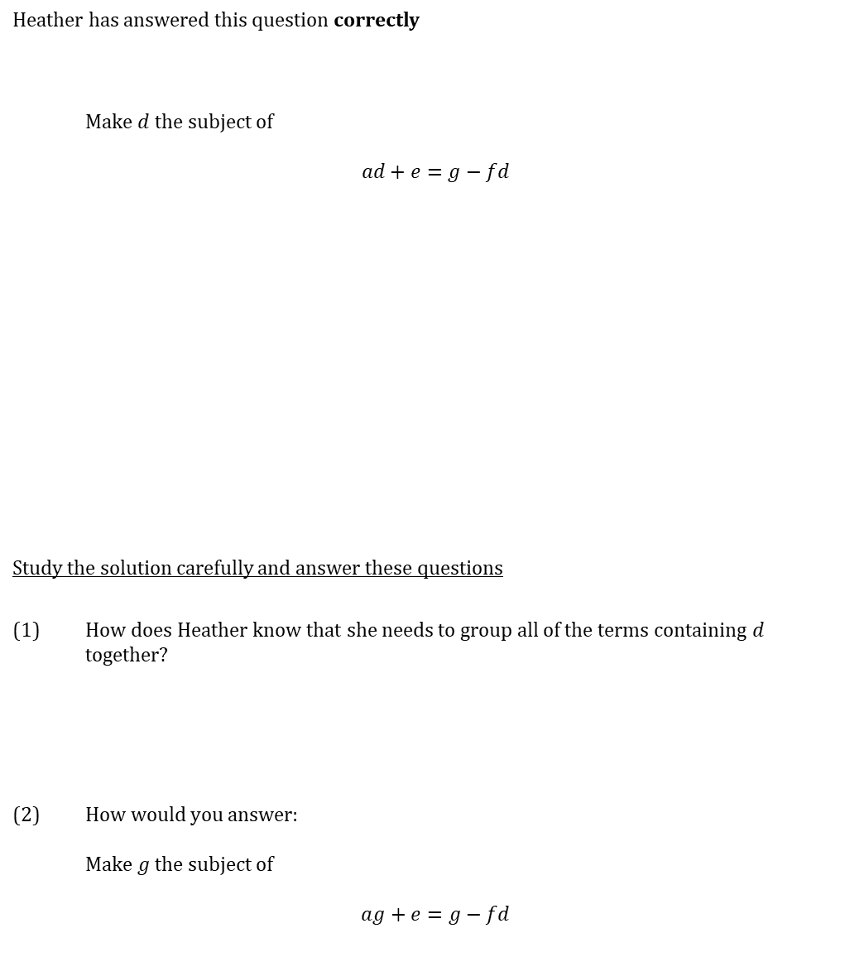
WORKED EXAMPLE
Rearranging Formula
Heather has answered this question correctly
 | Make $d$the subject of $$ad+e=g−fd$$
Study the solution carefully and answer these questions
(1) | How does Heather know that she needs to group all of the terms containing $d$ together?
(2) | How would you answer: Make $g$the subject of $$ag+e=g−fd$$

Slide 25
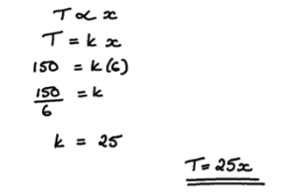
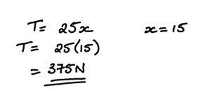
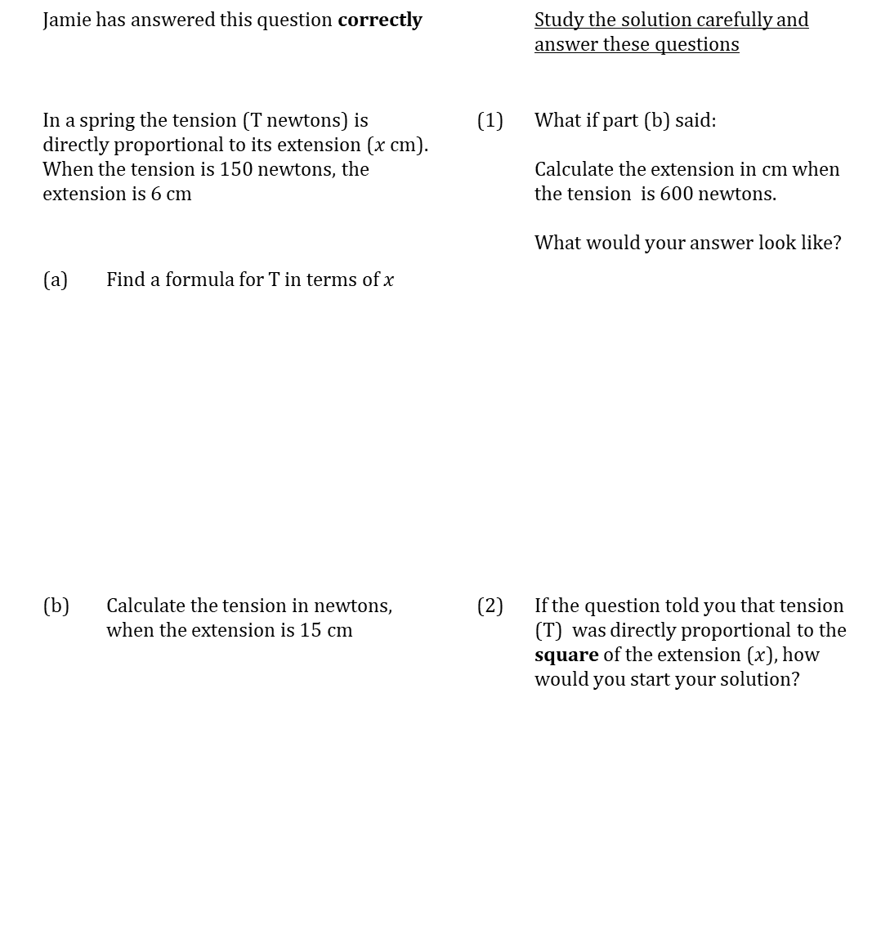
WORKED EXAMPLE
Direct Proportion 1
 | Jamie has answered this question correctly |  |  |  | Study the solution carefully and answer these questions
 | In a spring the tension (T newtons) is directly proportional to its extension ($x$ cm). When the tension is 150 newtons, the extension is 6 cm |  |  | (1) | What if part (b) said: Calculate the extension in cm when the tension is 600 newtons. What would your answer look like?
 | (a) | Find a formula for T in terms of $x$
 | (b) | Calculate the tension in newtons, when the extension is 15 cm |  | (2) | If the question told you that tension (T) was directly proportional to the square of the extension ($x$), how would you start your solution?

Slide 26
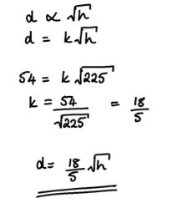
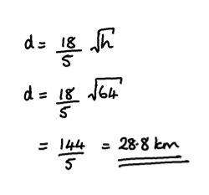
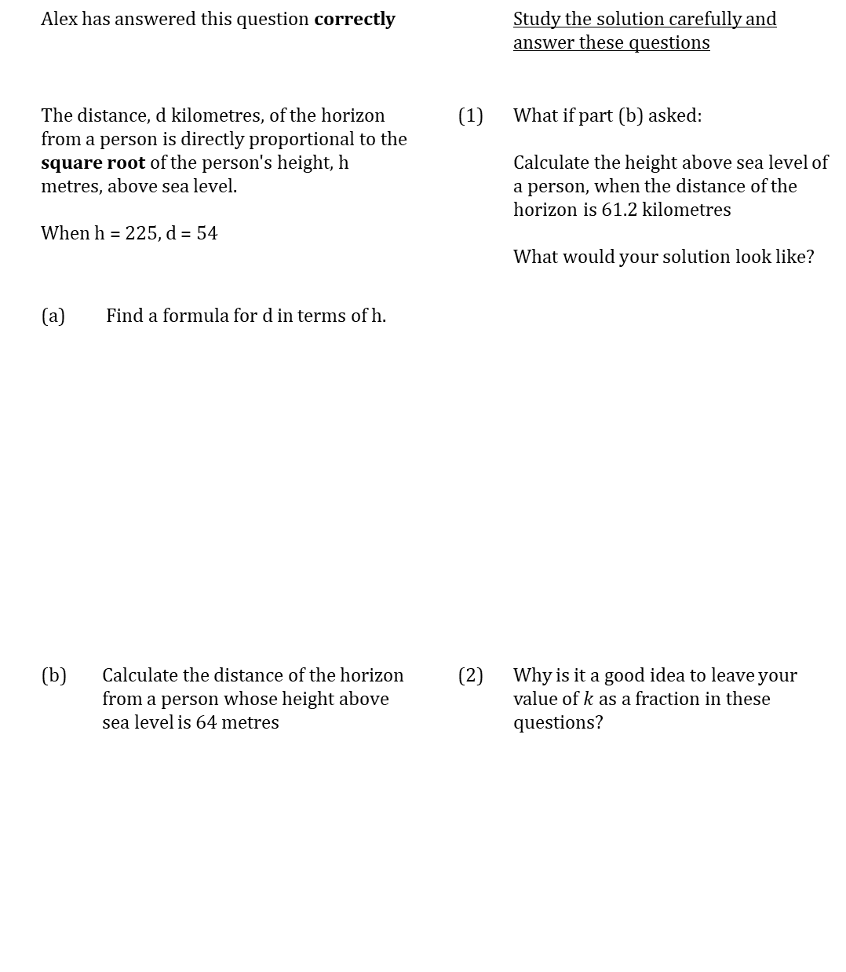
WORKED EXAMPLE
Direct Proportion 2
 | Alex has answered this question correctly |  |  |  | Study the solution carefully and answer these questions
 | The distance, d kilometres, of the horizon from a person is directly proportional to the square root of the person's height, h metres, above sea level. When h = 225, d = 54 |  |  | (1) | What if part (b) asked: Calculate the height above sea level of a person, when the distance of the horizon is 61.2 kilometres What would your solution look like?
 | (a) | Find a formula for d in terms of h.
 | (b) | Calculate the distance of the horizon from a person whose height above sea level is 64 metres |  | (2) | Why is it a good idea to leave your value of $k$ as a fraction in these questions?

Slide 27
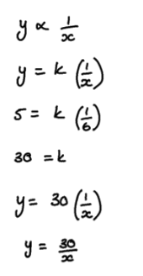
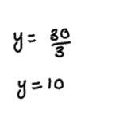
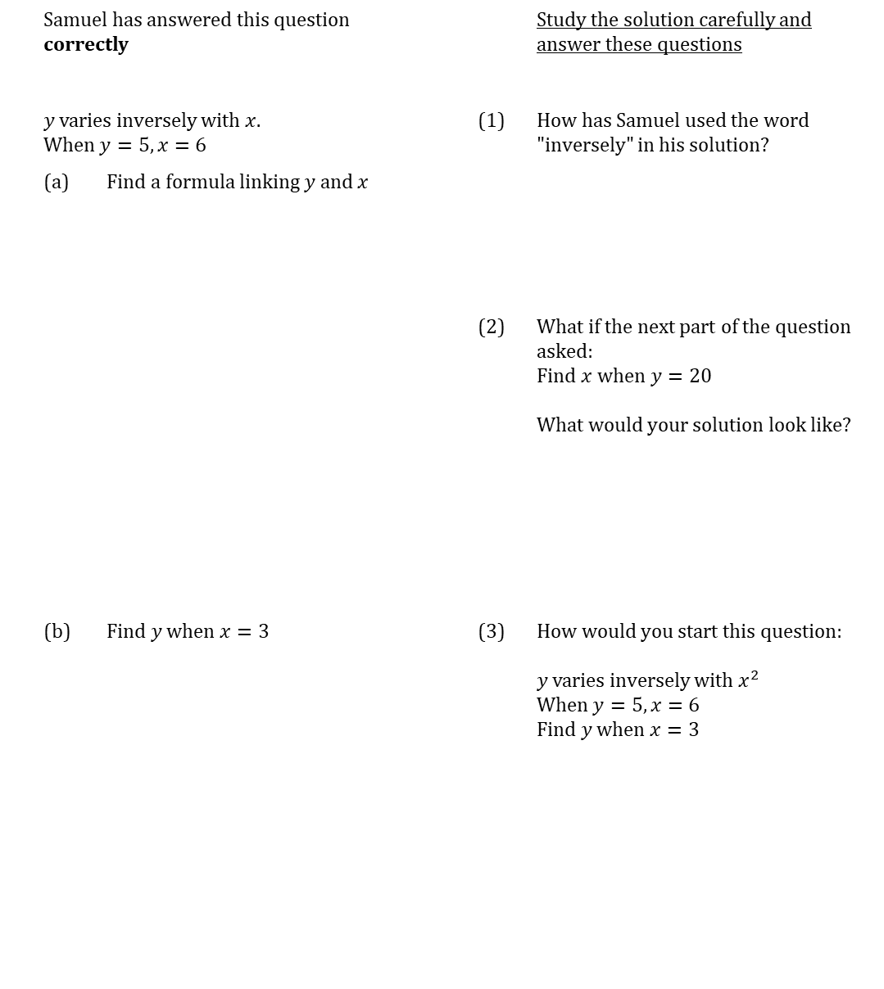
WORKED EXAMPLE
Inverse Proportion
 | Samuel has answered this question correctly |  |  |  | Study the solution carefully and answer these questions
 | $y$ varies inversely with $x$. When $y=5, x=6$ |  |  | (1) | How has Samuel used the word "inversely" in his solution?
 | (a) | Find a formula linking $y$ and $x$
 |  |  |  | (2) | What if the next part of the question asked: Find $x$when $y=20$ What would your solution look like?
 | (b) | Find $y$ when $x=3$ |  | (3) | How would you start this question: $y$ varies inversely with $x^{2}$ When $y=5, x=6$ Find $y$ when $x=3$

Slide 28
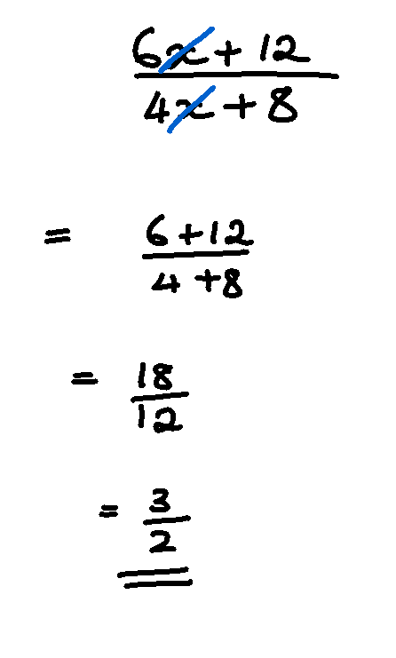


WORKED EXAMPLE
Algebraic Fractions
 | Shauna has answered this question correctly |  |  | Study the solution carefully and answer these questions
 | Simplify $$\frac{6x+12}{4x+8}$$ |  | (1) | Shauna’s friend says that you can reach the correct answer using this method.
 |  |  | (2) | Show that Shauna’s method does not work for the following question:
 |  |  |  | Simplify $$\frac{6x+8}{4x+10}$$

Slide 29


WORKED EXAMPLE
Expanding triple brackets
Logan has answered this question correctly (but has not shown all his working)
 | Expand and simplify $$\left(3x+1\right)\left(x+4\right)\left(x−4\right)$$
Study the solution carefully and answer these questions
(1) | Show how Logan could have worked out $3x^{2}+13x+4$ in line 1
(2) | Show all the working for how you would expand line 1 to give all the terms in line 2.

Slide 30


WORKED EXAMPLE
Adding algebraic fractions 1
 | Megan has answered this question correctly |  |  | Study the solution carefully and answer these questions
 | Simplify $$\frac{3}{x+2}+\frac{4}{x+5}$$ |  | (1) | If the question was $$\frac{3}{x+2}−\frac{4}{x+5}$$ show that the answer is $$\frac{7−x}{\left(x+2\right)\left(x+5\right)}$$
 |  |  | (2) | If the question was $$\frac{3}{x+4}+\frac{4}{\left(x+4\right)\left(x+3\right)}$$ What would the common denominator be?

Slide 31


WORKED EXAMPLE
Adding algebraic fractions 2
 | Megan has answered this question correctly |  |  | Study the solution carefully and answer these questions
 | Solve $$\frac{x+1}{x+2}+\frac{x+3}{x−2}$$ |  | (1) | If the question said $$\frac{x+1}{x+2}−\frac{x+3}{x−2}$$ Show that the answer is $$−\frac{2\left(3x+4\right)}{\left(x+2\right)\left(x−2\right)}$$

Slide 32


WORKED EXAMPLE
Quadratic simultaneous
Ceira has answered started this question correctly
 | Solve these equations simultaneously $$y=x^{2}+2x+10 \\ y=−3x+4$$
Study the solution carefully and answer these questions
(1) | Ceira plans to solve the equation by factorising or using the quadratic formula, explain why she cannot stop at line 3.
(2) | If the question was: Solve these equations simultaneously $$\begin{aligned}y&=x^{2}+2x+10 \\ y+3x&=4\end{aligned}$$ What would your first line of working be?

Slide 33


WORKED EXAMPLE
Comparing Coefficients Surds
 | Megan has answered this question correctly |  |  | Study the solution carefully and answer these questions
 | Find $a$ and $b$ given that $$\left(3+a\sqrt{2}\right)\left(4+\sqrt{2}\right)≡b+7\sqrt{2}$$ $a$ and $b$ are rational numbers |  | (1) | $e$ is a positive integer, such that $${\left(6+\sqrt{e}\right)}^{2}=43+12\sqrt{e}$$ Find $e$

Slide 34


WORKED EXAMPLE
Rationalising Denominators
 | Megan has answered this question correctly |  |  | Study the solution carefully and answer these questions
 | Rationalise the denominator on: (a) $\frac{4}{\sqrt{3}}$ |  | (1) | Show that multiplying $\left(a+\sqrt{b}\right)$ by $\left(a−\sqrt{b}\right)$ gives a rational number
 | (b) $\frac{2}{7\sqrt{5}}$
 |  |  | (2) | What would you multiply $\left(3+4\sqrt{5}\right)$ by to get a rational number? Show that your answer is correct.
 | (c) $\frac{6}{3+\sqrt{2}}$
 |  |  | (3) | Rationalise the denominator on $$\frac{3+\sqrt{7} }{2\sqrt{7}−5}$$
 | (d) $\frac{7}{5−\sqrt{3}}$
 | (d) $\frac{7}{5−\sqrt{3}}$
 | (e) $\frac{8+\sqrt{5}}{6−\sqrt{5}}$
 | (e) $\frac{8+\sqrt{5}}{6−\sqrt{5}}$

Slide 35

WORKED EXAMPLE
Back bearings
 | Emma has answered this question incorrectly |  |  | Study the solution carefully and answer these questions
 | Find the bearing of A from B |  | (1) | What key point about bearings has Emma forgotten?
 |  |  | (2) | Write a correct solution to the question:
 |  |  | (3) | What if the question said: Find the bearing from B to A?

Slide 36



WORKED EXAMPLE
Vector Geometry
Study the solution carefully and answer these questions
(1) | Another way to express $\overset{⃑}{MP}$ is $$\overset{⃑}{MP}=\overset{⃑}{MD}+ \overset{⃑}{DO}+\overset{⃑}{NP}$$ Show that this results in the same vector in terms of $a$ and $d$
(2) | An alternative way of saying $MP$ and $PQ$ are parallel in line 2 is to say that $$\overset{⃑}{MP}=k\overset{⃑}{PQ}$$ Explain why this means that $MPQ$ is a straight line

Slide 37
WORKED EXAMPLE
Sample Spaces
Lily has started this question correctly – complete her working
 | 1,1,2,2,3,6 1, 2, 2, 4, 5, 6
 | The two dice shown are rolled and the total of their rolls is worked out. Use a sample space to find the probability that the total of the two dices is 5.
Study the solution carefully and answer these questions
(1) | Lily’s friend says that the sample space should look like this. Explain why she is wrong
2
3
2
6.
1
5

Slide 38

WORKED EXAMPLE
Venn diagrams
 | Molly has answered this question correctly |  |  |  | Study the solution carefully and answer these questions
 | 40 people are surveyed about the sports they play and the results are shown in the Venn diagram |  |  | (1) | $P\left(F\right)=\frac{11}{40}$ and $P\left(T\right)=\frac{15}{40}$
 |  |  |  |  | Explain why
 |  |  |  |  | $$P\left(F∪T\right)≠P\left(F\right)+P(T)$$
 | One of these people is chosen at random. |  |  | (2) | What is the answer to:
 | (a) | Find the probability that they play football and tennis |  |  | One of these people is chosen at random.
 |  |  |  |  | Given that they play football, find the probability that they play tennis.
 | (b) | Find the probability that they play football or tennis.
 | (c) | Given that they play tennis, find the probability that they play football.

Slide 39
WORKED EXAMPLE
Relative Frequency
Maryam has answered this question correctly
 | An experiment is carried out with a piece of buttered toast. It is dropped 50 times and it lands butter side down 35 times. What is the relative frequency of toast landing butter side down?
Study the solution carefully and answer these questions
(1) | Why is relative frequency also known as an estimate of probability?
(2) | How could we get a better estimate of the probability of buttered toast landing butter side down?
(3) | Give some examples of events where you have to calculate relative frequency rather than theoretical probability

Slide 40




WORKED EXAMPLE
Venn Diagrams basic
Huda has answered this question incorrectly
$ξ=\text{\{}\text{positive} \text{integers} \text{less} \text{than}\text{ 15\}}$ $\text{A}=\text{\{}\text{even} \text{numbers}\text{\}}$ $\text{B}=\text{\{}\text{prime} \text{numbers}\text{\}}$
Show this on a Venn diagram
 | Study the solution carefully and answer these questions.
(1) | Explain why Huda’s solution is incomplete
(2) | How could Huda check her answer?
(3) | If the question said:
 | $ξ=\text{(}\text{positive} \text{integers} \text{less} \text{than}\text{ 15\}}$ $\text{A}=\text{\{}\text{even} \text{numbers}\text{\}}$ $\text{B}=\{odd \text{numbers}\text{\}}$ Show this on a Venn diagram
(a) | How would you draw the Venn diagram?
(b) | What is the relationship between A and B? Write this symbolically.
(4) | If the question said:
 | $ξ=\text{\{}\text{positive} \text{integers} \text{less} \text{than}\text{ 15\}}$ $\text{A}=\text{\{}\text{even} \text{numbers}\text{\}}$ $\text{B}=\text{\{}\text{multiples} \text{of}\text{ 4\}}$ Show this on a Venn diagram
(a) | How would you draw the Venn diagram?
(b) | What is the relationship between A and B? Write this symbolically.

